Slide 1
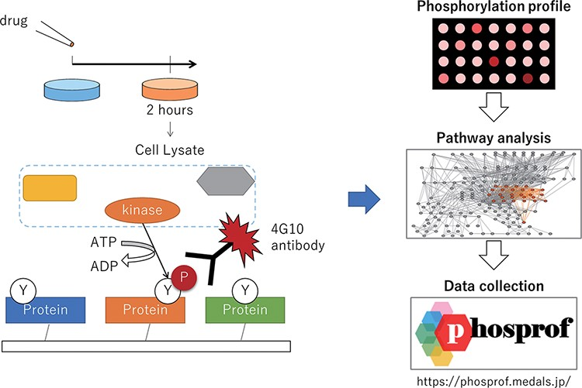
Figure 1. Scheme of the data collection and analysis for Phosprof. (Left) A drug from the Selleck L2400 Library was ...
Notes:
Figure 1. Scheme of the data collection and analysis for Phosprof. (Left) A drug from the Selleck L2400 Library was added to the cell culture media 2 h prior to the harvest of the cell lysate, which was then applied to a protein array with ATP. The tyrosine residues of the proteins on the array are phosphorylated by the cell lysate and detected using 4G10 antibody. (Right) The resultant ‘phosphorylation profiles’ were then analyzed to identify the significant pathways. The collected data can be browsed using various pathway analysis tools.
Unless provided in the caption above, the following copyright applies to the content of this slide: © The Author(s) 2022. Published by Oxford University Press.This is an Open Access article distributed under the terms of the Creative Commons Attribution-NonCommercial License (https://creativecommons.org/licenses/by-nc/4.0/), which permits non-commercial re-use, distribution, and reproduction in any medium, provided the original work is properly cited. For commercial re-use, please contact journals.permissions@oup.com

