Slide 1
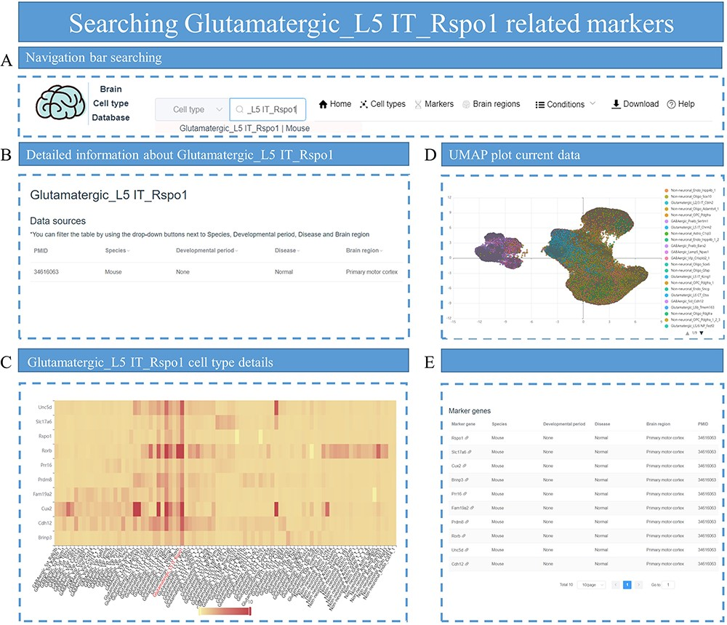
Figure 7. The process of searching for markers related to Glutamatergic_L5 IT_Rspo1. (A) Enter ‘Glutamatergic_L5 ...
Notes:
Figure 7. The process of searching for markers related to Glutamatergic_L5 IT_Rspo1. (A) Enter ‘Glutamatergic_L5 IT_Rspo1’ in the search box on the homepage. (B) The data related to Glutamatergic_L5 IT_Rspo1 are displayed, including parameters such as PMID, species and other conditions. (C) A heatmap displays the distribution of marker genes for Glutamatergic_L5 IT_Rspo1 among different cell types in the specific dataset. (D) The UMAP plot shows all cells in the dataset and provides annotation information on cell types. (E) All marker genes for the Glutamatergic_L5 IT_Rspo1 cell type are listed.
Unless provided in the caption above, the following copyright applies to the content of this slide: © The Author(s) 2023. Published by Oxford University Press.This is an Open Access article distributed under the terms of the Creative Commons Attribution License (https://creativecommons.org/licenses/by/4.0/), which permits unrestricted reuse, distribution, and reproduction in any medium, provided the original work is properly cited.

