Slide 1
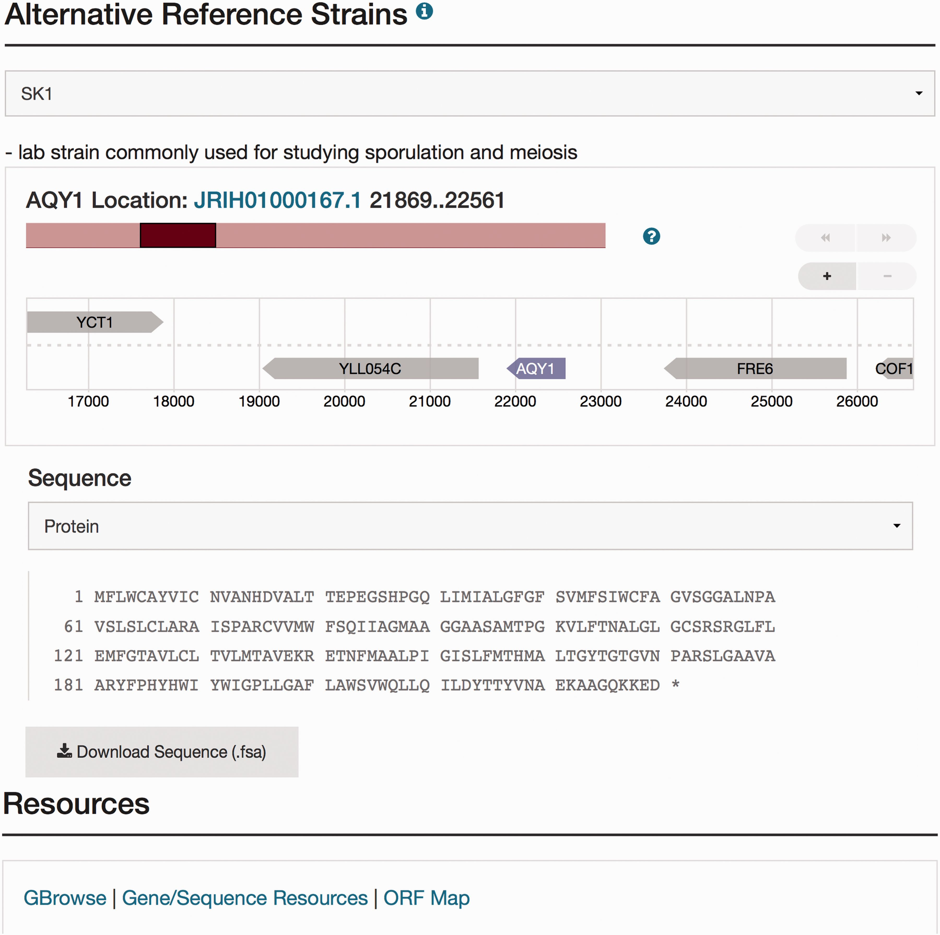
Figure 1. Visualization of the new sequence data for AQY1 in the database. The Sequence page can be accessed by ...
Notes:
Figure 1. Visualization of the new sequence data for AQY1 in the database. The Sequence page can be accessed by selecting the tab at the top of the AQY1 LSP, labeled ‘Sequence.’ There are six sections within the Sequence page including the ‘Sequence Overview’ for descriptive information, ‘Alternative Reference Strains’ for viewing the DNA or protein sequence in a selected alternative reference strain, and ‘Resources’ for access to processed results using sequence analysis tools (e.g. a new tool called SGD Variant Viewer ( 28 ), updated BLAST search, and ClustalW multiple sequence alignments). Selection of SK1 as an alternative strain is illustrated in this figure. Neighbor genes of AQY1 in SK1 are also shown in the visualization. When the user clicks a sequence analysis tool (URL in blue) in the resources tab, they will view the gene-specific results using that tool.
Unless provided in the caption above, the following copyright applies to the content of this slide: © The Author(s) 2016. Published by Oxford University Press. This is an Open Access article distributed under the terms of the Creative Commons Attribution License ( http://creativecommons.org/licenses/by/4.0/ ), which permits unrestricted reuse, distribution, and reproduction in any medium, provided the original work is properly cited.

Slide 2
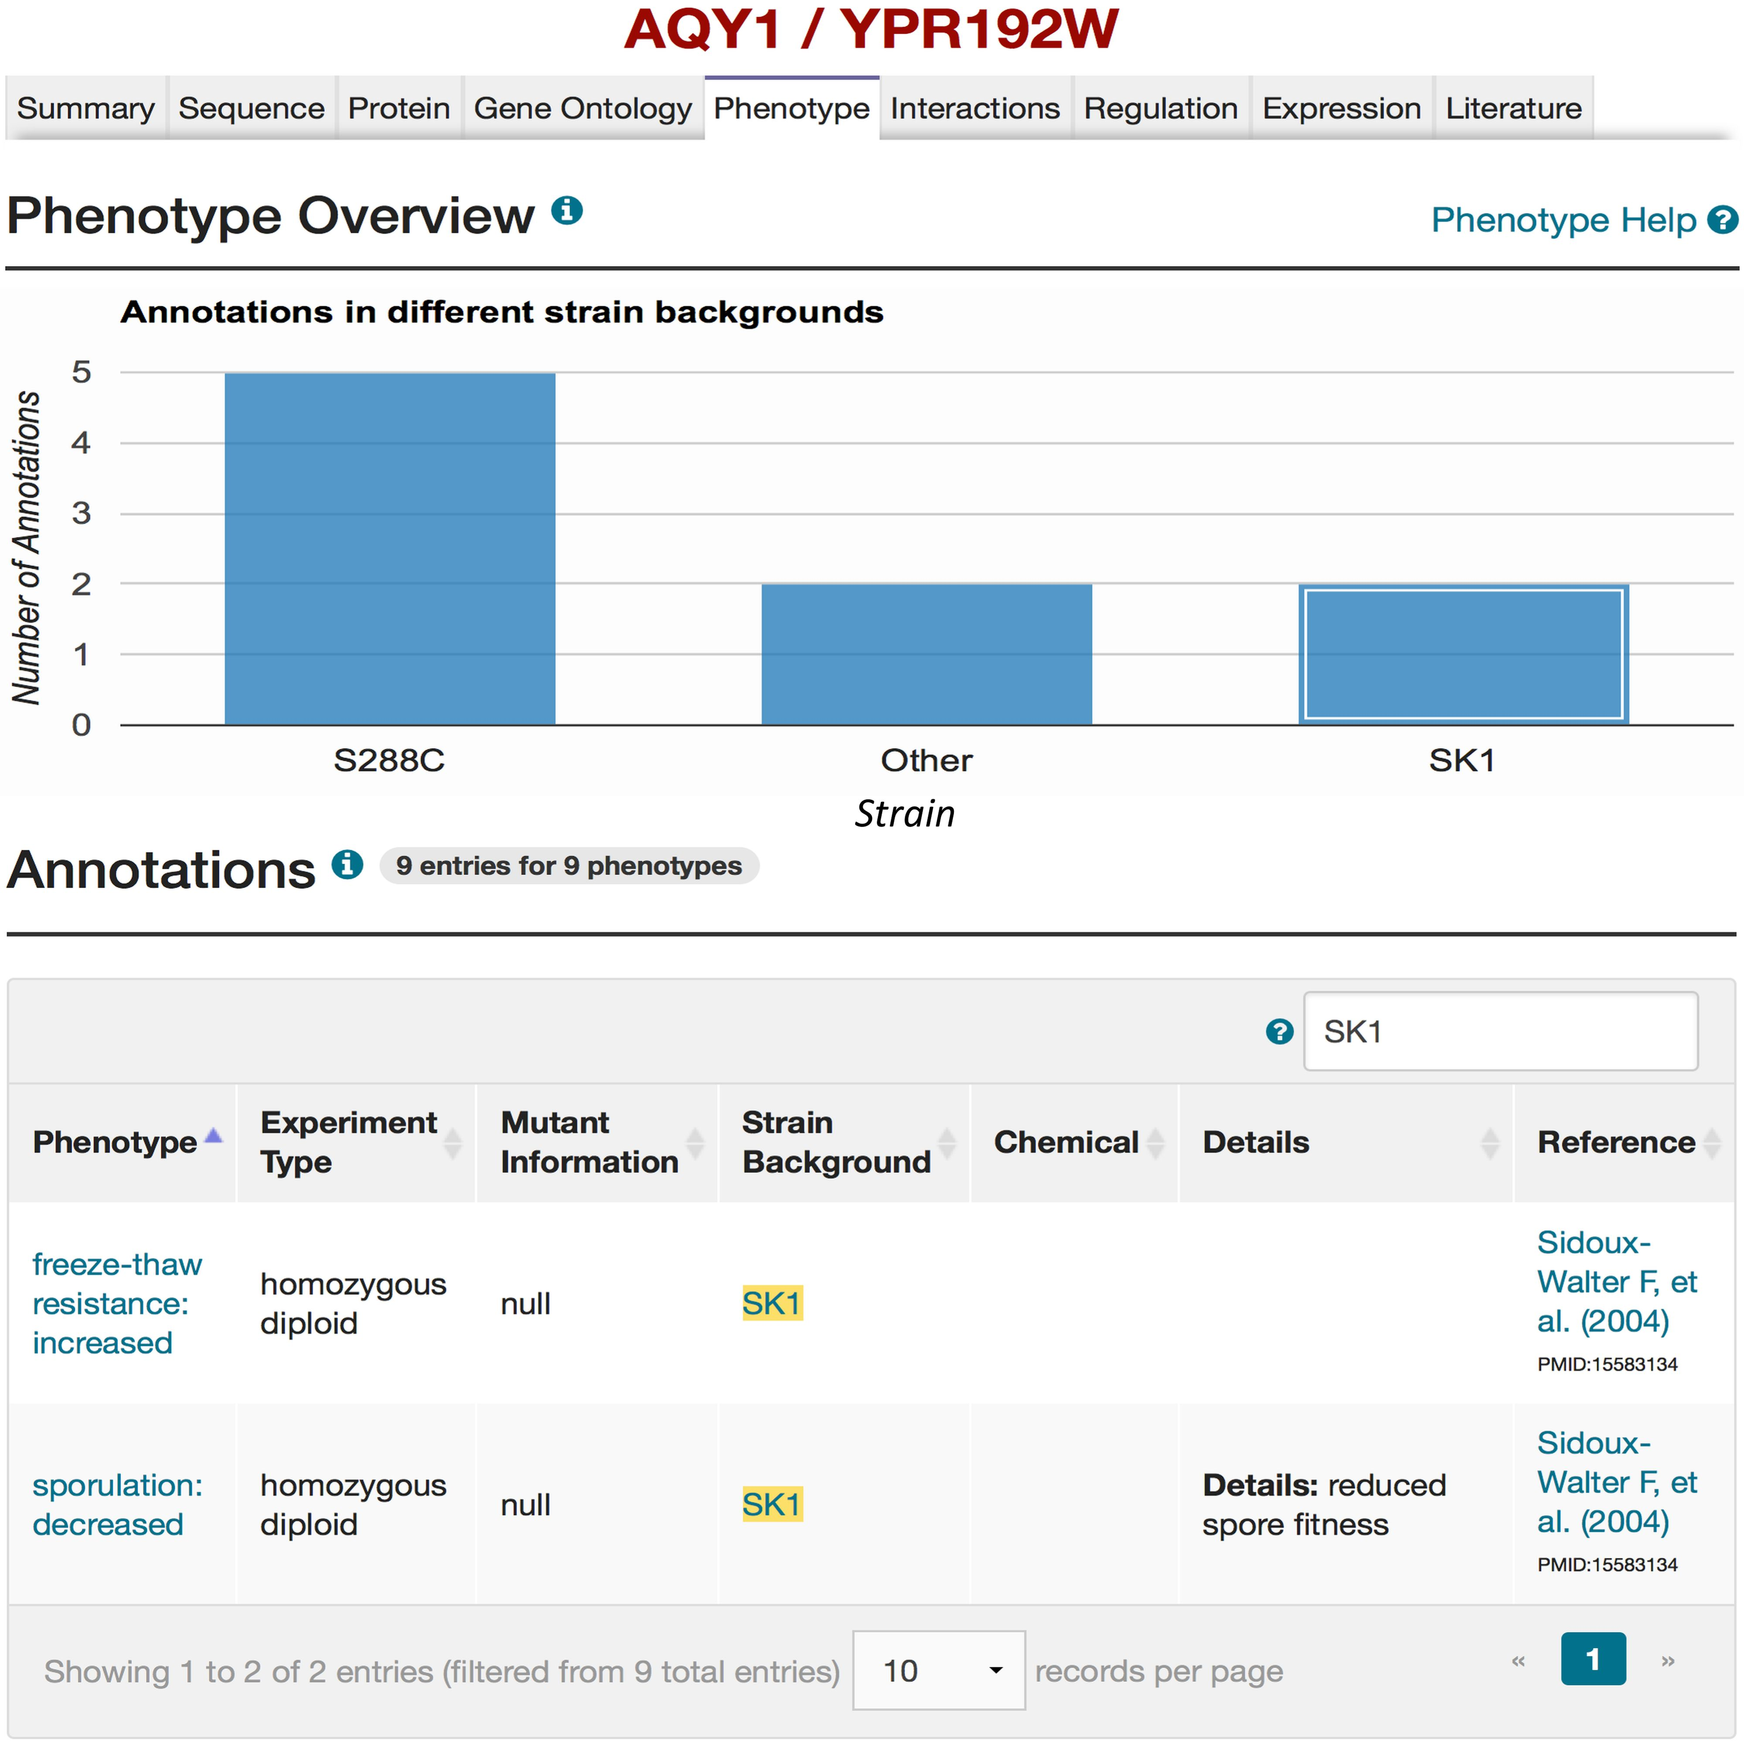
Figure 2. Mutant phenotypes for AQY1 gene in SGD. By querying for ‘ AQY1’ using the SGD search box, and selecting the ...
Notes:
Figure 2. Mutant phenotypes for AQY1 gene in SGD. By querying for ‘ AQY1’ using the SGD search box, and selecting the Phenotype tab on the AQY1 LSP, phenotype information for AQY1 can be viewed. A bar chart summarizes how many phenotypic annotations have been curated in different strain backgrounds (e.g. two mutant phenotypes in the SK1 strain background). If the box for SK1 in the bar chart is selected, the details of the two mutant phenotypes for AQY1 in the SK1 strain background will be listed in the Annotations section. Users also can refer to the relevant literature ( 27 ) that describes studies on the mutant phenotypes resulted from polymorphisms in the AQY1 gene in strain SK1 as shown in the “Reference” column of the table. Users can also access more information of the alternative strain (SK1) by selecting the strain name (highlighted in yellow) in the Annotations table (see Figure 3).
Unless provided in the caption above, the following copyright applies to the content of this slide: © The Author(s) 2016. Published by Oxford University Press. This is an Open Access article distributed under the terms of the Creative Commons Attribution License ( http://creativecommons.org/licenses/by/4.0/ ), which permits unrestricted reuse, distribution, and reproduction in any medium, provided the original work is properly cited.

Slide 3
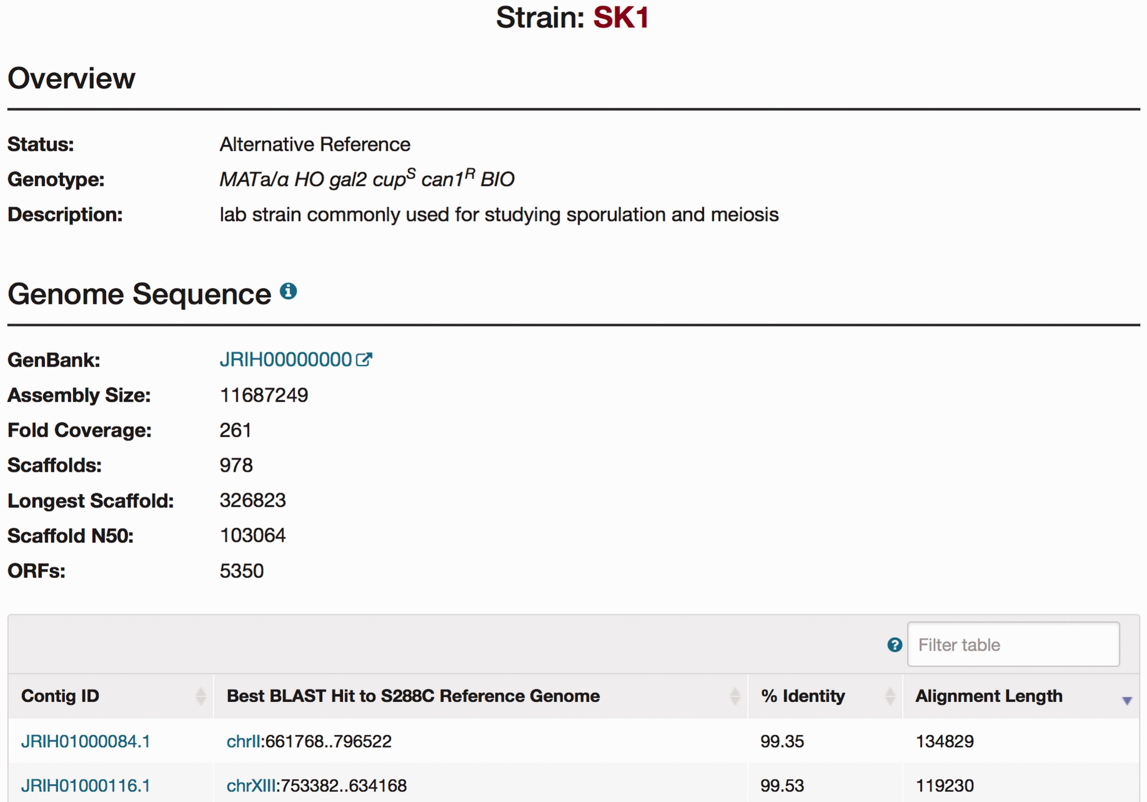
Figure 3. The SGD SK1 Strain page. Strain pages are available for each of the alternative strains. The Strain page ...
Notes:
Figure 3. The SGD SK1 Strain page. Strain pages are available for each of the alternative strains. The Strain page includes an Overview section for descriptive information of each strain, and a Genome Sequence section for brief statistics of the new sequence integrated in the database (NCBI accession number, the number of scaffolds, and the number of ORFs) and a table for information on each contig.
Unless provided in the caption above, the following copyright applies to the content of this slide: © The Author(s) 2016. Published by Oxford University Press. This is an Open Access article distributed under the terms of the Creative Commons Attribution License ( http://creativecommons.org/licenses/by/4.0/ ), which permits unrestricted reuse, distribution, and reproduction in any medium, provided the original work is properly cited.

Slide 4
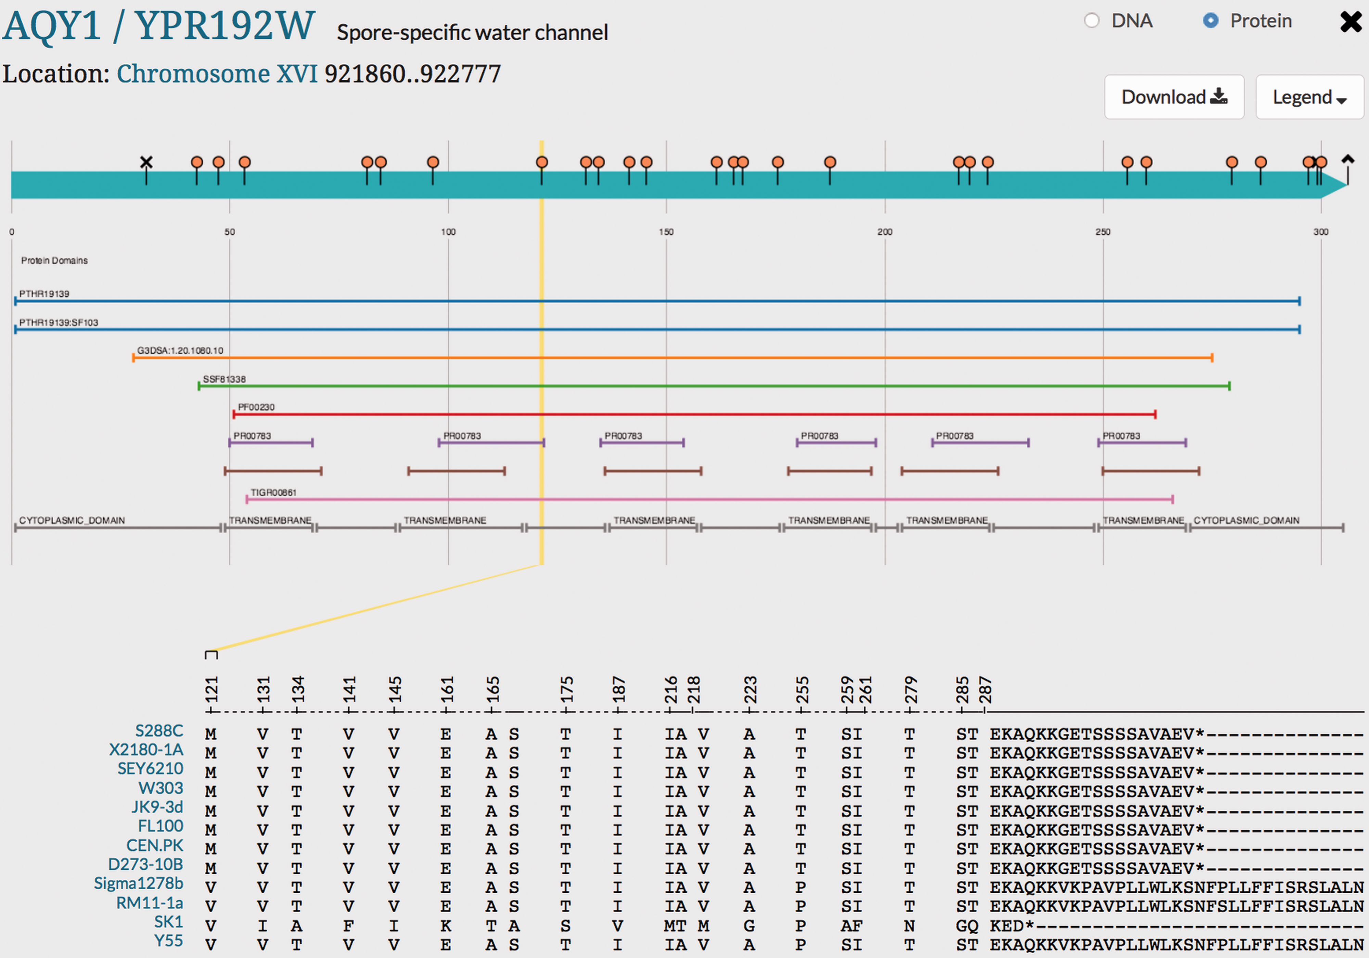
Figure 4. Visualization of genetic variation within AQY1 gene across alternative reference strains in SGD. Variations ...
Notes:
Figure 4. Visualization of genetic variation within AQY1 gene across alternative reference strains in SGD. Variations within AQY1 among 11 alternative strains and the S288C reference strain are depicted in the SGD Variant Viewer. Non-synonymous mutations and deletions/insertions with their location information in AQY1 are shown in the viewer. We can see that AQY1 is conserved in most laboratory strains. SK1 shows the most non-synonymous mutations relative to the S288C reference unlike the other strains. There are two common mutations that appear in four strains Sigma1278b, RM11-1a, SK1 and Y55: V121 (guided in a yellow line in the viewer) and P255. SK1 has a shorter C-terminus than other strains whereas Sigma1278b, RM11-1a and Y55 have longer C-termini than the eight laboratory strains. Other than the C-terminus and two mutations (V121 and P255), Sigma1278b, RM11-1a and Y55 show conserved amino acids with the eight laboratory strains unlike SK1.
Unless provided in the caption above, the following copyright applies to the content of this slide: © The Author(s) 2016. Published by Oxford University Press. This is an Open Access article distributed under the terms of the Creative Commons Attribution License ( http://creativecommons.org/licenses/by/4.0/ ), which permits unrestricted reuse, distribution, and reproduction in any medium, provided the original work is properly cited.

