Slide 1
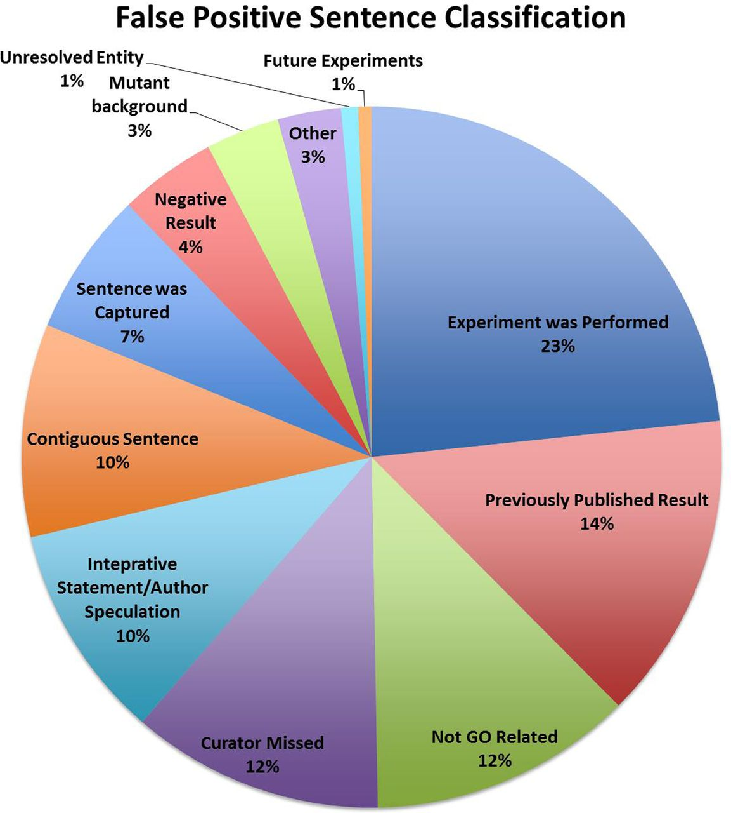
Figure 1. The classification of the FP sentences.
Notes:
Figure 1. The classification of the FP sentences.
Unless provided in the caption above, the following copyright applies to the content of this slide: Published by Oxford University Press 2014. This work is written by US Government employees and is in the public domain in the US.

