Slide 1
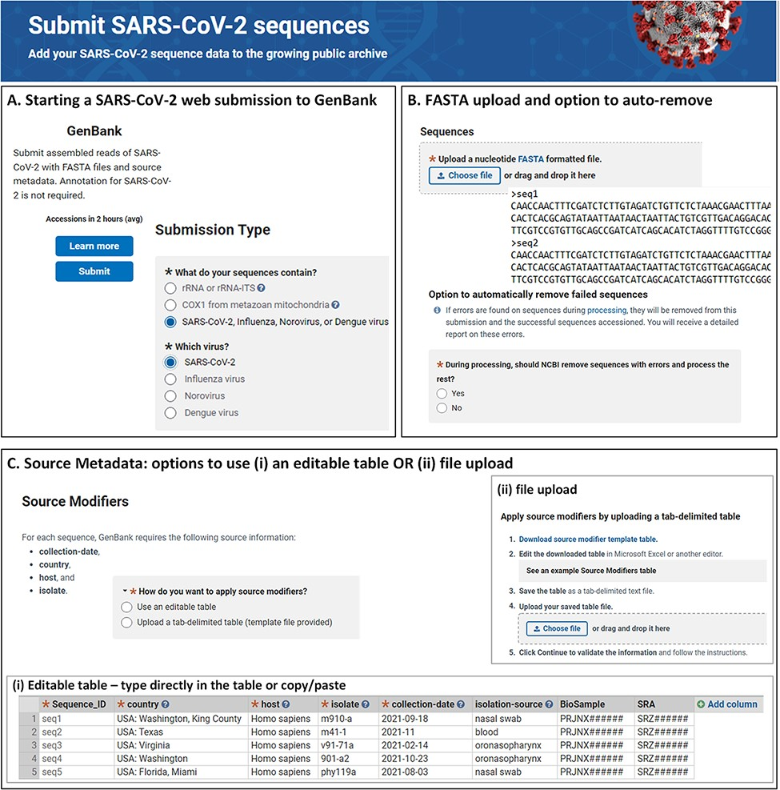
Figure 1. NLM/NCBI SARS-CoV-2 web submission forms for starting a submission (A), uploading sequences (B) and providing ...
Notes:
Figure 1. NLM/NCBI SARS-CoV-2 web submission forms for starting a submission (A), uploading sequences (B) and providing source metadata (C). Screenshots are from https://submit.ncbi.nlm.nih.gov/sarscov2/ and https://submit.ncbi.nlm.nih.gov/subs/genbank/.
Unless provided in the caption above, the following copyright applies to the content of this slide: Published by Oxford University Press 2022. This work is written by (a) US Government employee(s) and is in the public domain in the US.This work is written by (a) US Government employee(s) and is in the public domain in the US.

