Slide 1
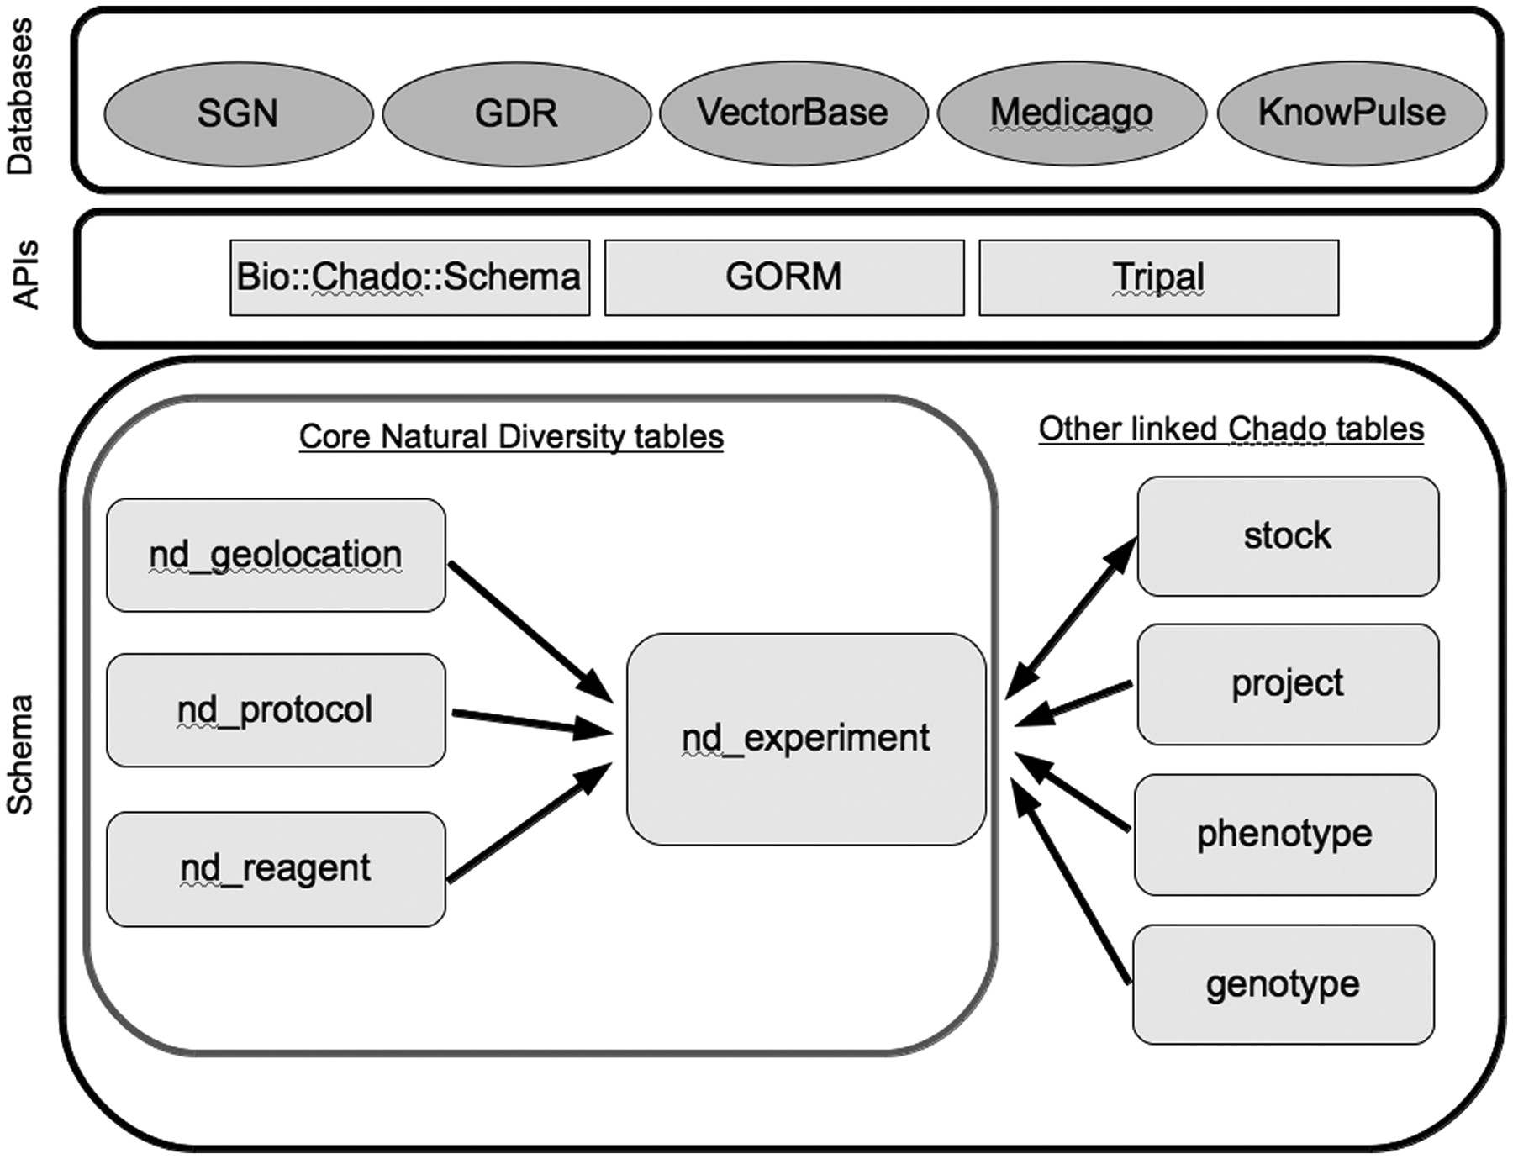
Figure 1. Core tables in the Natural Diversity module, and directly linked tables from other Chado modules. Databases ...
Notes:
Figure 1. Core tables in the Natural Diversity module, and directly linked tables from other Chado modules. Databases are the five member organizations of the Natural Diversity development working group, and the APIs are some of the solutions currently used for interacting with the Chado schema.
Unless provided in the caption above, the following copyright applies to the content of this slide: © The Author(s) 2011. Published by Oxford University Press.This is an Open Access article distributed under the terms of the Creative Commons Attribution Non-Commercial License (http://creativecommons.org/licenses/by-nc/3.0), which permits unrestricted non-commercial use, distribution, and reproduction in any medium, provided the original work is properly cited.

