Slide 1
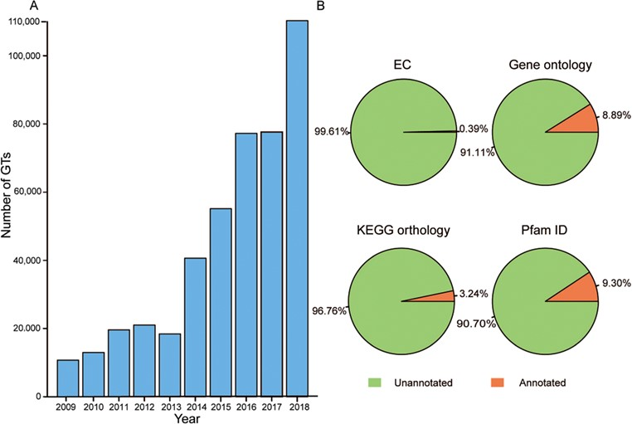
Figure 1 Growth of GT number over the past decade and the proportion of annotation data before predictions. (A) Number ...
Notes:
Figure 1 Growth of GT number over the past decade and the proportion of annotation data before predictions. (A) Number of GTs has increased rapidly in the past 10 years. (B) Orange represents GTs with the corresponding annotated data and green is GTs without the corresponding annotated data.
Unless provided in the caption above, the following copyright applies to the content of this slide: © The Author(s) 2020. Published by Oxford University Press.This is an Open Access article distributed under the terms of the Creative Commons Attribution License (http://creativecommons.org/licenses/by/4.0/), which permits unrestricted reuse, distribution, and reproduction in any medium, provided the original work is properly cited.

Slide 2
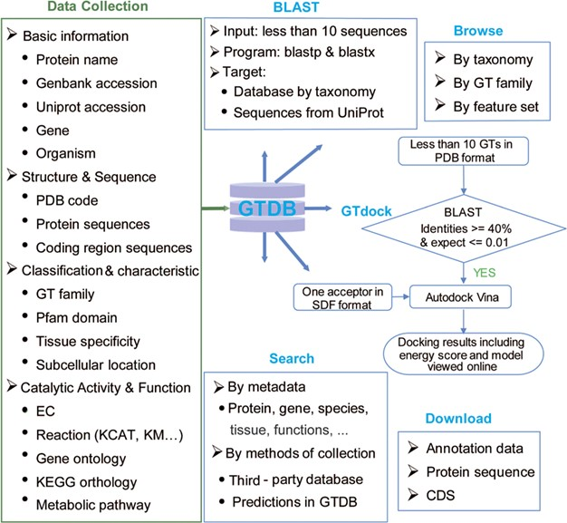
Figure 2 Content and services in GTDB. The left panel is the database content, which includes a variety of information ...
Notes:
Figure 2 Content and services in GTDB. The left panel is the database content, which includes a variety of information on GTs from well-known databases and predictions. The right panel is the web service provided by GTDB, including Search, Browse and Download models that can be used to access the database flexibly, as well as two useful tools for searching similar GTs by sequence (BLAST) or performing GT docking (GTdock).
Unless provided in the caption above, the following copyright applies to the content of this slide: © The Author(s) 2020. Published by Oxford University Press.This is an Open Access article distributed under the terms of the Creative Commons Attribution License (http://creativecommons.org/licenses/by/4.0/), which permits unrestricted reuse, distribution, and reproduction in any medium, provided the original work is properly cited.

Slide 3
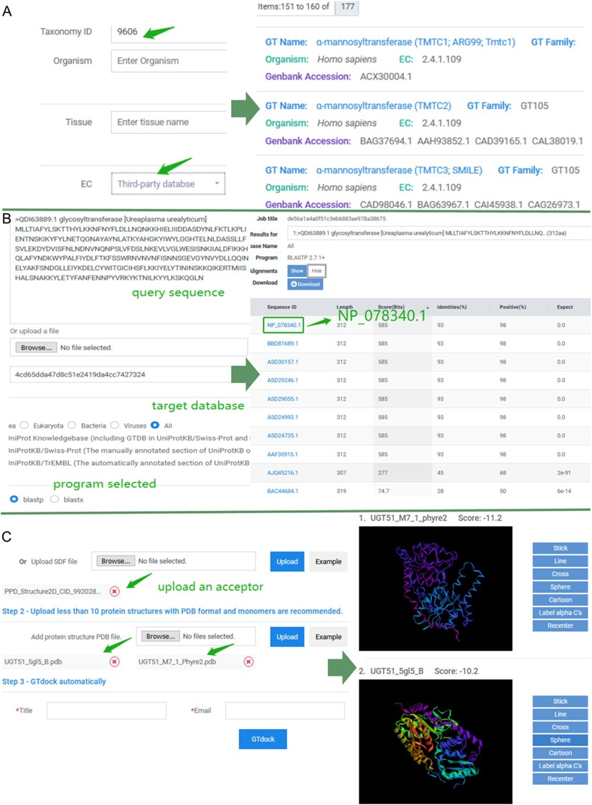
Figure 3 Examples of application of GTDB. (A) An example of advanced search. Input ‘9606’ into the ‘Taxonomy ID’ box ...
Notes:
Figure 3 Examples of application of GTDB. (A) An example of advanced search. Input ‘9606’ into the ‘Taxonomy ID’ box of taxonomy module and choose ‘Third-party database’ for EC in the function module. Subsequently, there were totally of 177 entries in GTDB. Users can select any of them to view the details. (B) An example of sequence search. Paste the sequence of ‘QDI63889.1’ and select the ‘All’ as the target database. The default 250 aligned sequences will be displayed on the BLAST results page. (C) An example of the use of GTdock. Enter the example data on the GTdock page and the result link is mailed to the user. Note that the docking algorithm is non-deterministic of Vina, so the minimum score of enzyme-acceptor pair will produce some nuances in different operations (23).
Unless provided in the caption above, the following copyright applies to the content of this slide: © The Author(s) 2020. Published by Oxford University Press.This is an Open Access article distributed under the terms of the Creative Commons Attribution License (http://creativecommons.org/licenses/by/4.0/), which permits unrestricted reuse, distribution, and reproduction in any medium, provided the original work is properly cited.

