Slide 1
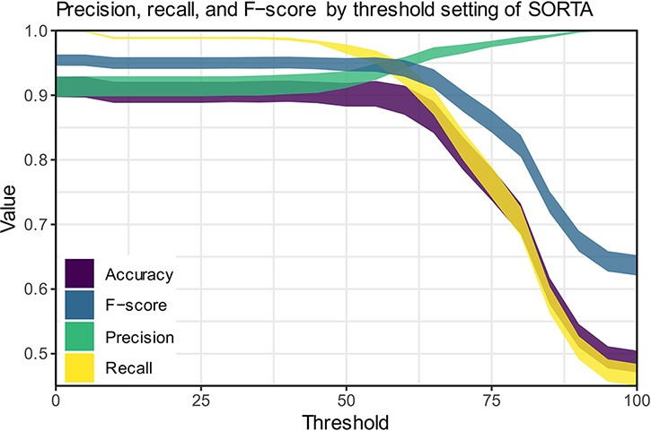
Figure 6. Precision, recall and F-scores for different threshold settings within SORTA. (Based on the automatic mapping ...
Notes:
Figure 6. Precision, recall and F-scores for different threshold settings within SORTA. (Based on the automatic mapping of the answers for question COVID24A2 by SORTA compared to manual curation).
Unless provided in the caption above, the following copyright applies to the content of this slide: © The Author(s) 2023. Published by Oxford University Press.This is an Open Access article distributed under the terms of the Creative Commons Attribution License (https://creativecommons.org/licenses/by/4.0/), which permits unrestricted reuse, distribution, and reproduction in any medium, provided the original work is properly cited.

