Slide 1
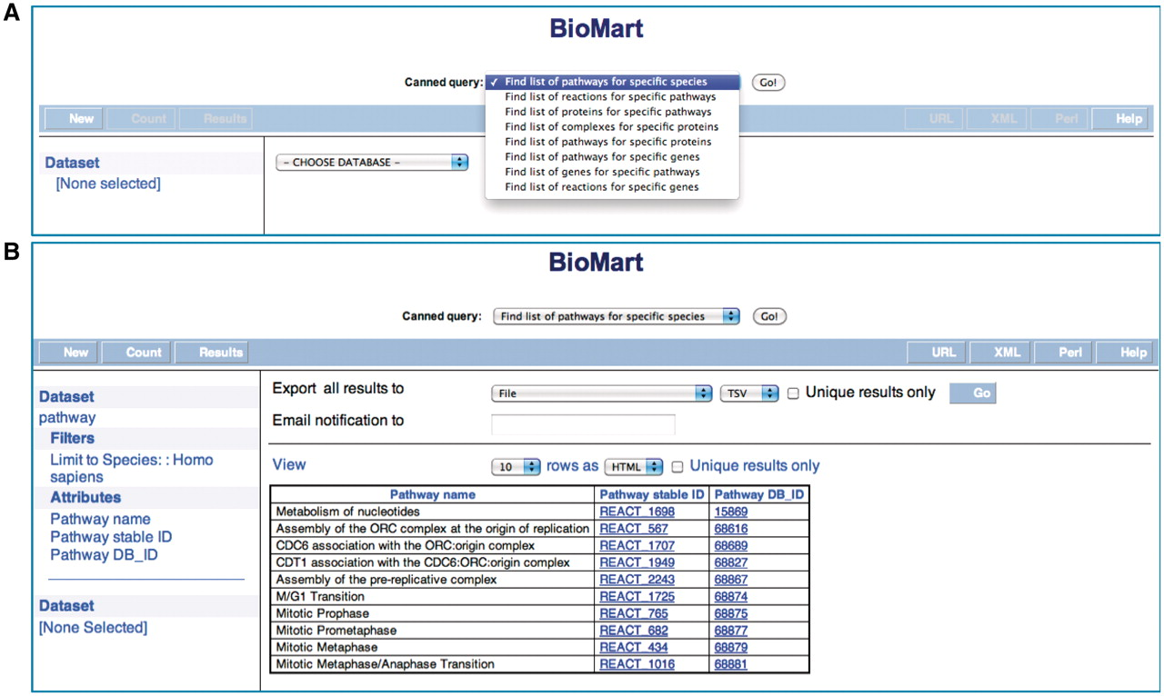
Figure 1. Reactome BioMart Canned Query. (A) The canned query selector allows the user to choose from one of the ...
Notes:
Figure 1. Reactome BioMart Canned Query. (A) The canned query selector allows the user to choose from one of the currently available queries. (B) The results table for the canned query.
Unless provided in the caption above, the following copyright applies to the content of this slide: © The Author(s) 2011. Published by Oxford University Press.This is Open Access article distributed under the terms of the Creative Commons Attribution Non-Commercial License (http://creativecommons.org/licenses/by-nc/2.5), which permits unrestricted non-commercial use, distribution, and reproduction in any medium, provided the original work is properly cited.

