Slide 1
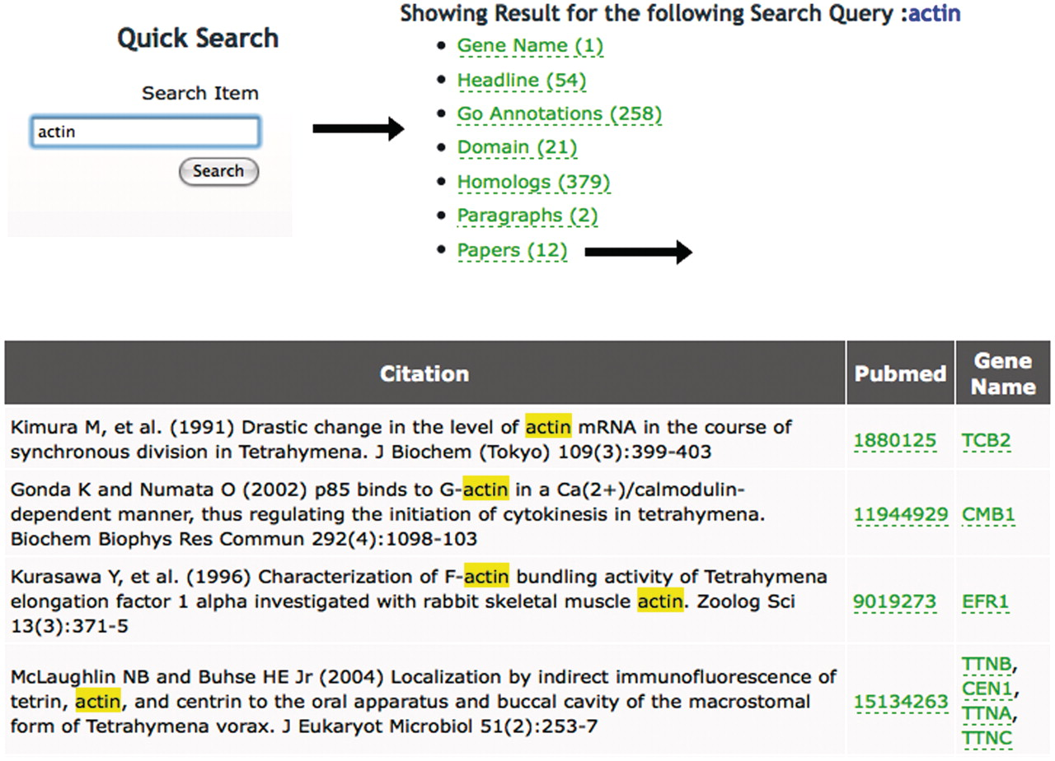
Figure 1. Using the Quick Search tool at TGD Wiki. Entering a search term (‘actin’ in this example) returns the list of ...
Notes:
Figure 1. Using the Quick Search tool at TGD Wiki. Entering a search term (‘actin’ in this example) returns the list of annotation types shown at TGD Wiki and the number of times the term appears in each category. Following the links to these annotation types shows the entry where this term is found and lists the genes it is used to annotate. In this case, 12 articles mention the word ‘actin’ in the title. Following the ‘Papers’ link shows their citation information, links to Pubmed and links to the Gene Pages of the specific genes mentioned in each paper.
Unless provided in the caption above, the following copyright applies to the content of this slide: © The Author(s) 2012. Published by Oxford University Press.This is an Open Access article distributed under the terms of the Creative Commons Attribution Non-Commercial License (http://creativecommons.org/licenses/by-nc/3.0), which permits unrestricted non-commercial use, distribution, and reproduction in any medium, provided the original work is properly cited.

