Slide 1
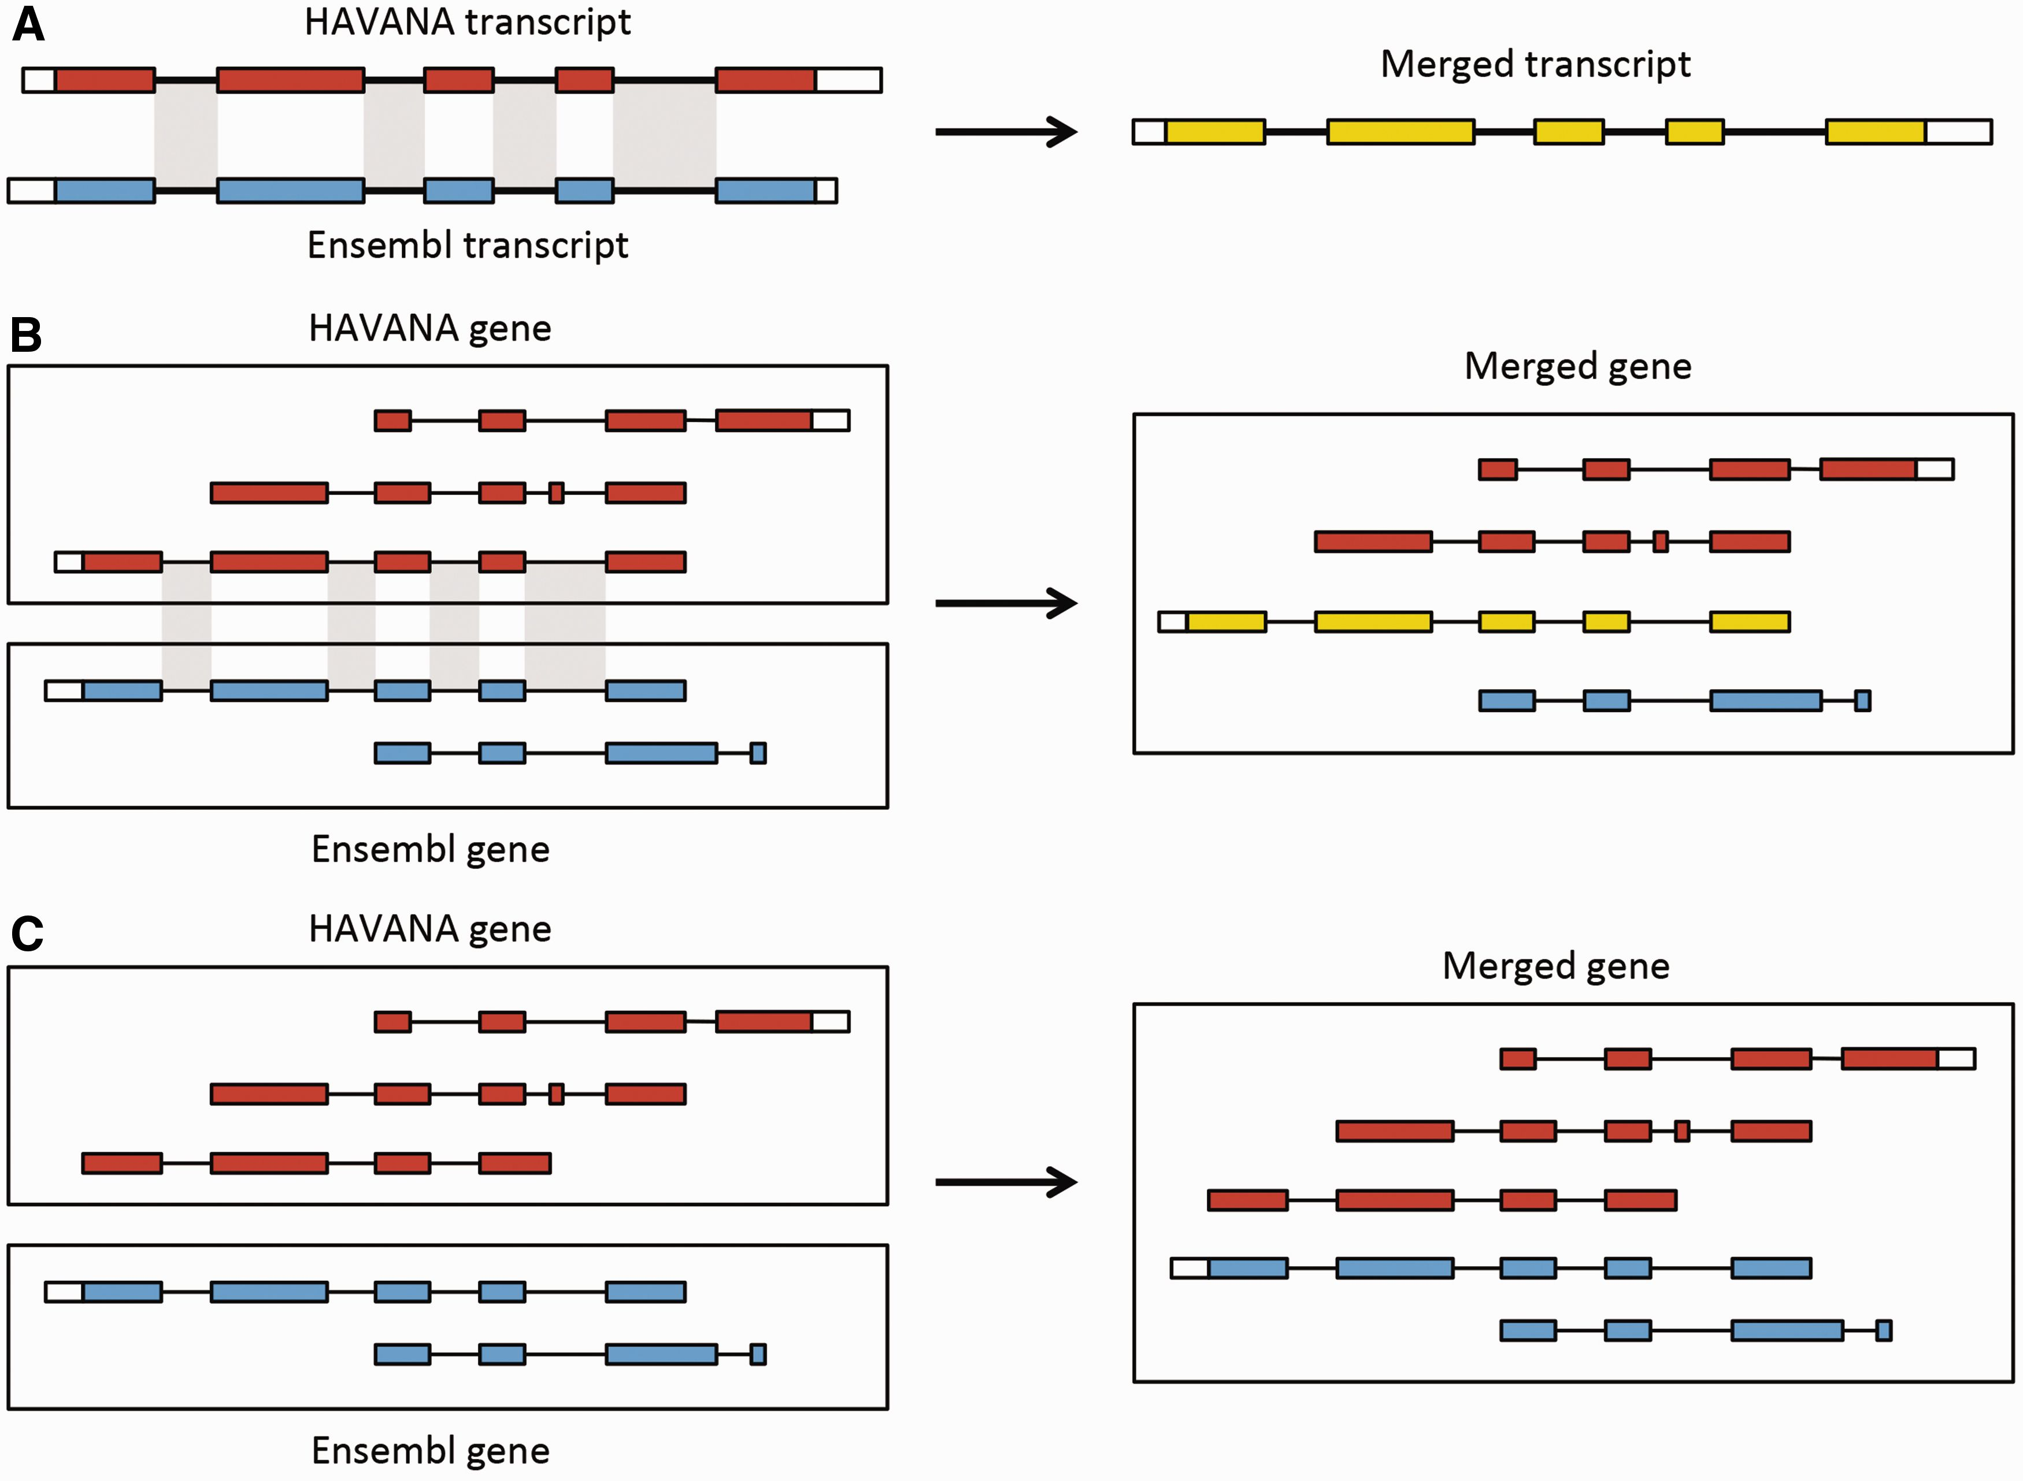
Figure 6. Merging gene and transcript models. For both Ensembl and HAVANA models, transcripts with overlapping exons ...
Notes:
Figure 6. Merging gene and transcript models. For both Ensembl and HAVANA models, transcripts with overlapping exons are grouped together into genes. ( A ) If the intron–exon boundaries, excluding UTRs, of a transcript from HAVANA completely match those of one from Ensembl the result is a merged transcript model, which is always based on the HAVANA annotation. If the intron–exon boundaries do not completely match then the two models are treated as separate transcripts belonging to the same gene. ( B ) Exons for a HAVANA gene overlap with those for an Ensembl gene. All transcripts are grouped together in the same merged gene. The intron–exon boundaries for one HAVANA and one Ensembl transcript match perfectly so they are merged to create the merged transcript shown in yellow. ( C ) Exons for Ensembl and HAVANA transcripts overlap but there are no transcripts with complete matching intron–exon boundaries. We still group the transcripts together into a merged gene but no transcripts are merged.
Unless provided in the caption above, the following copyright applies to the content of this slide: © The Author(s) 2016. Published by Oxford University Press. This is an Open Access article distributed under the terms of the Creative Commons Attribution License ( http://creativecommons.org/licenses/by/4.0/ ), which permits unrestricted reuse, distribution, and reproduction in any medium, provided the original work is properly cited.

