Slide 1
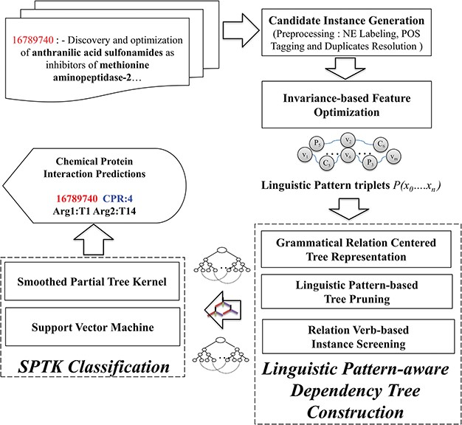
Figure 1 Overview of the CPI detection method.
Notes:
Figure 1 Overview of the CPI detection method.
Unless provided in the caption above, the following copyright applies to the content of this slide: © The Author(s) 2018. Published by Oxford University Press.This is an Open Access article distributed under the terms of the Creative Commons Attribution License (http://creativecommons.org/licenses/by/4.0/), which permits unrestricted reuse, distribution, and reproduction in any medium, provided the original work is properly cited.

Slide 2
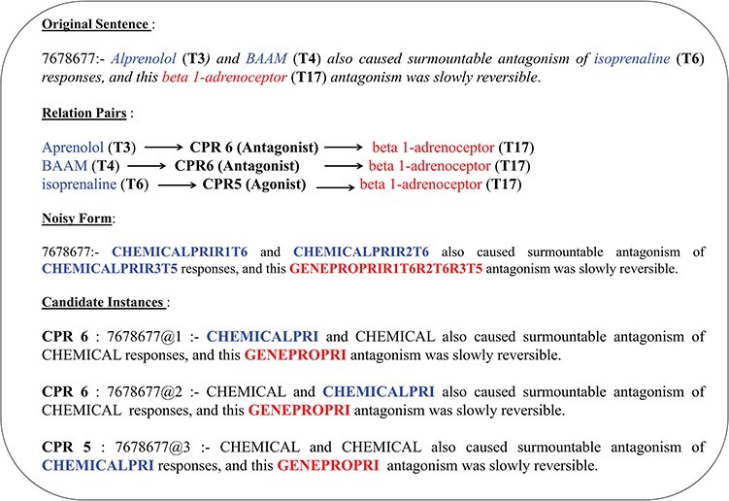
Figure 2 Candidate instance level entity normalization.
Notes:
Figure 2 Candidate instance level entity normalization.
Unless provided in the caption above, the following copyright applies to the content of this slide: © The Author(s) 2018. Published by Oxford University Press.This is an Open Access article distributed under the terms of the Creative Commons Attribution License (http://creativecommons.org/licenses/by/4.0/), which permits unrestricted reuse, distribution, and reproduction in any medium, provided the original work is properly cited.

Slide 3
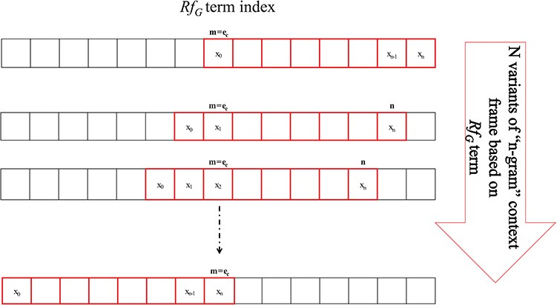
Figure 3 N-gram window-based `context-frame’ extraction.
Notes:
Figure 3 N-gram window-based `context-frame’ extraction.
Unless provided in the caption above, the following copyright applies to the content of this slide: © The Author(s) 2018. Published by Oxford University Press.This is an Open Access article distributed under the terms of the Creative Commons Attribution License (http://creativecommons.org/licenses/by/4.0/), which permits unrestricted reuse, distribution, and reproduction in any medium, provided the original work is properly cited.

Slide 4
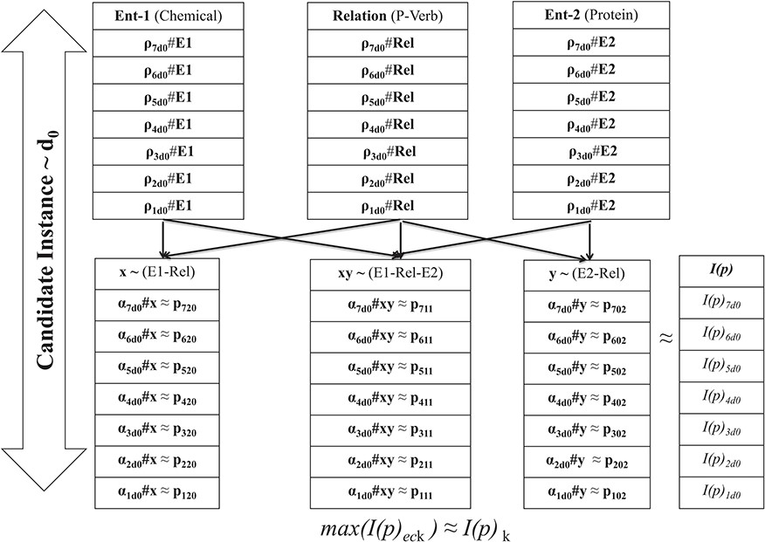
Figure 4 Schema for coefficient consolidation.
Notes:
Figure 4 Schema for coefficient consolidation.
Unless provided in the caption above, the following copyright applies to the content of this slide: © The Author(s) 2018. Published by Oxford University Press.This is an Open Access article distributed under the terms of the Creative Commons Attribution License (http://creativecommons.org/licenses/by/4.0/), which permits unrestricted reuse, distribution, and reproduction in any medium, provided the original work is properly cited.

Slide 5
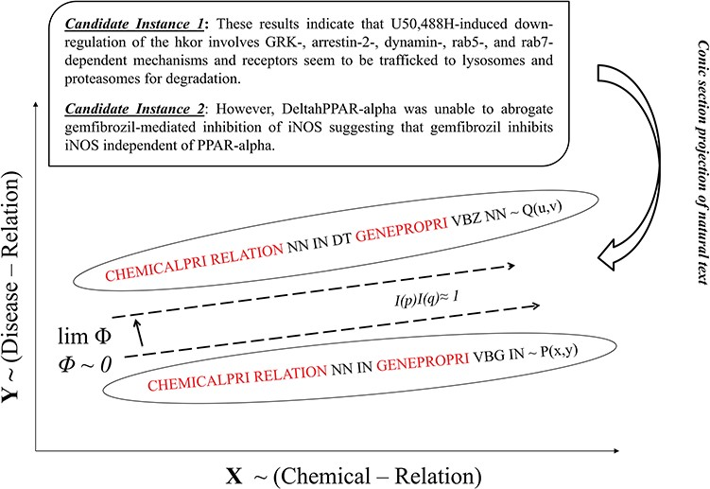
Figure 5 Polynomial-based spatial projection of text.
Notes:
Figure 5 Polynomial-based spatial projection of text.
Unless provided in the caption above, the following copyright applies to the content of this slide: © The Author(s) 2018. Published by Oxford University Press.This is an Open Access article distributed under the terms of the Creative Commons Attribution License (http://creativecommons.org/licenses/by/4.0/), which permits unrestricted reuse, distribution, and reproduction in any medium, provided the original work is properly cited.

Slide 6
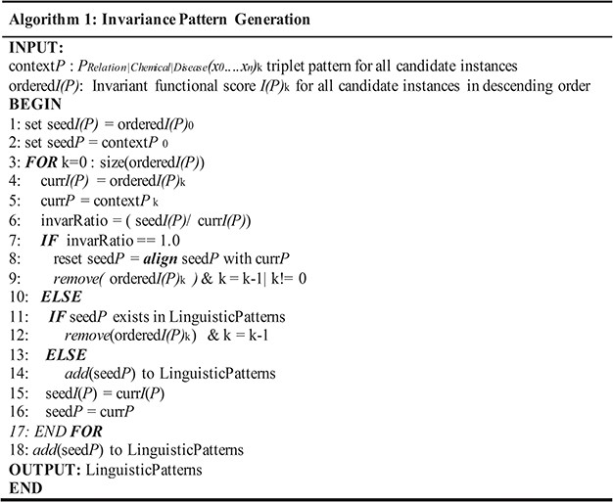
Figure 6 Algorithm for invariance-based linguistic pattern identification.
Notes:
Figure 6 Algorithm for invariance-based linguistic pattern identification.
Unless provided in the caption above, the following copyright applies to the content of this slide: © The Author(s) 2018. Published by Oxford University Press.This is an Open Access article distributed under the terms of the Creative Commons Attribution License (http://creativecommons.org/licenses/by/4.0/), which permits unrestricted reuse, distribution, and reproduction in any medium, provided the original work is properly cited.

Slide 7
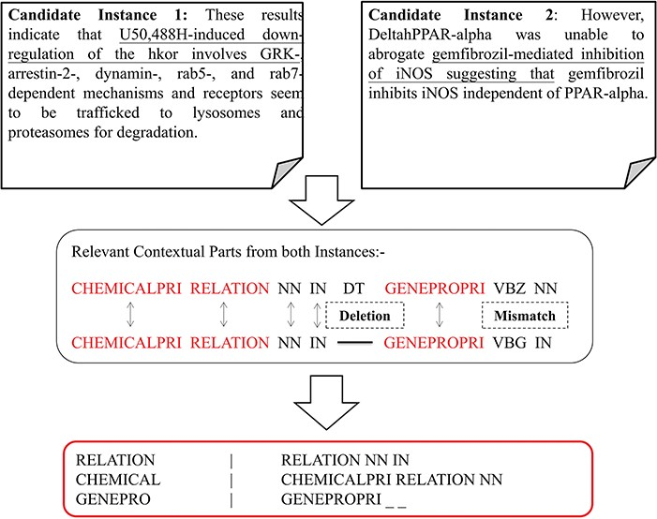
Figure 7 Context identification and prospective alignment of candidate instances.
Notes:
Figure 7 Context identification and prospective alignment of candidate instances.
Unless provided in the caption above, the following copyright applies to the content of this slide: © The Author(s) 2018. Published by Oxford University Press.This is an Open Access article distributed under the terms of the Creative Commons Attribution License (http://creativecommons.org/licenses/by/4.0/), which permits unrestricted reuse, distribution, and reproduction in any medium, provided the original work is properly cited.

Slide 8
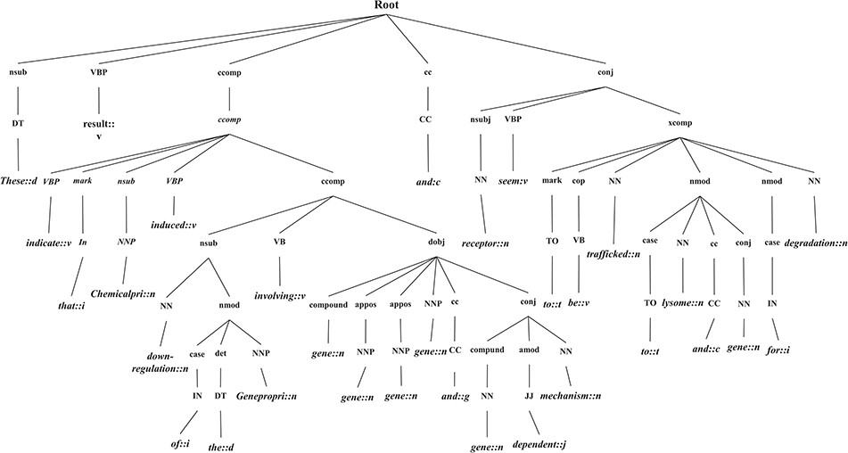
Figure 8 GRCT representation of a candidate instance.
Notes:
Figure 8 GRCT representation of a candidate instance.
Unless provided in the caption above, the following copyright applies to the content of this slide: © The Author(s) 2018. Published by Oxford University Press.This is an Open Access article distributed under the terms of the Creative Commons Attribution License (http://creativecommons.org/licenses/by/4.0/), which permits unrestricted reuse, distribution, and reproduction in any medium, provided the original work is properly cited.

Slide 9
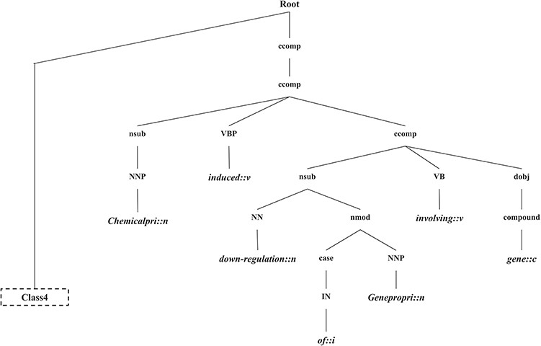
Figure 9 The generated CPI tree.
Notes:
Figure 9 The generated CPI tree.
Unless provided in the caption above, the following copyright applies to the content of this slide: © The Author(s) 2018. Published by Oxford University Press.This is an Open Access article distributed under the terms of the Creative Commons Attribution License (http://creativecommons.org/licenses/by/4.0/), which permits unrestricted reuse, distribution, and reproduction in any medium, provided the original work is properly cited.

