Slide 1
Figure 1. Home page of the FungiProteomeDB. It shows the basic information about the DB.
Notes:
Figure 1. Home page of the FungiProteomeDB. It shows the basic information about the DB.
Unless provided in the caption above, the following copyright applies to the content of this slide: © The Author(s) 2023. Published by Oxford University Press.This is an Open Access article distributed under the terms of the Creative Commons Attribution License (https://creativecommons.org/licenses/by/4.0/), which permits unrestricted reuse, distribution, and reproduction in any medium, provided the original work is properly cited.

Slide 2
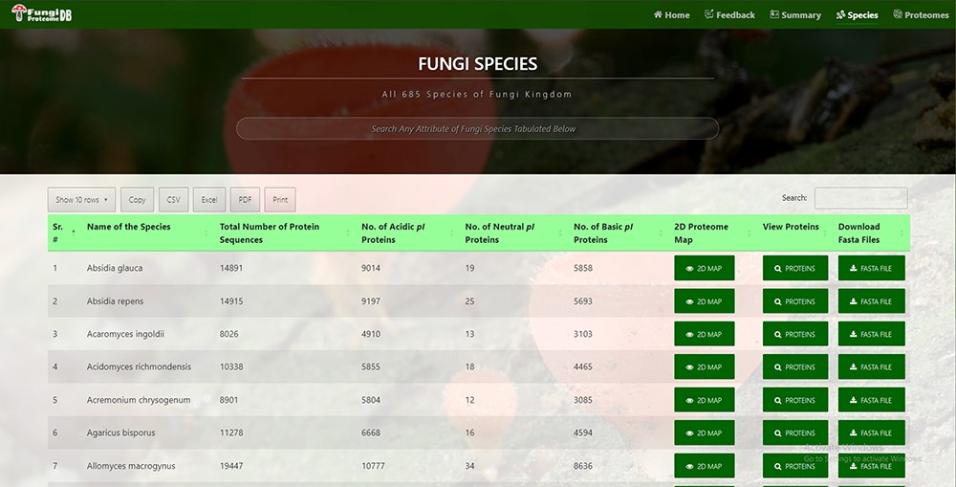
Figure 2. Time efficient search interface by species and their attribute.
Notes:
Figure 2. Time efficient search interface by species and their attribute.
Unless provided in the caption above, the following copyright applies to the content of this slide: © The Author(s) 2023. Published by Oxford University Press.This is an Open Access article distributed under the terms of the Creative Commons Attribution License (https://creativecommons.org/licenses/by/4.0/), which permits unrestricted reuse, distribution, and reproduction in any medium, provided the original work is properly cited.

Slide 3
Figure 3. Virtual 2D map of fungal proteome. A representative 2D proteome map of Sphaerobolus stellatus is presented ...
Notes:
Figure 3. Virtual 2D map of fungal proteome. A representative 2D proteome map of Sphaerobolus stellatus is presented here.
Unless provided in the caption above, the following copyright applies to the content of this slide: © The Author(s) 2023. Published by Oxford University Press.This is an Open Access article distributed under the terms of the Creative Commons Attribution License (https://creativecommons.org/licenses/by/4.0/), which permits unrestricted reuse, distribution, and reproduction in any medium, provided the original work is properly cited.

Slide 4
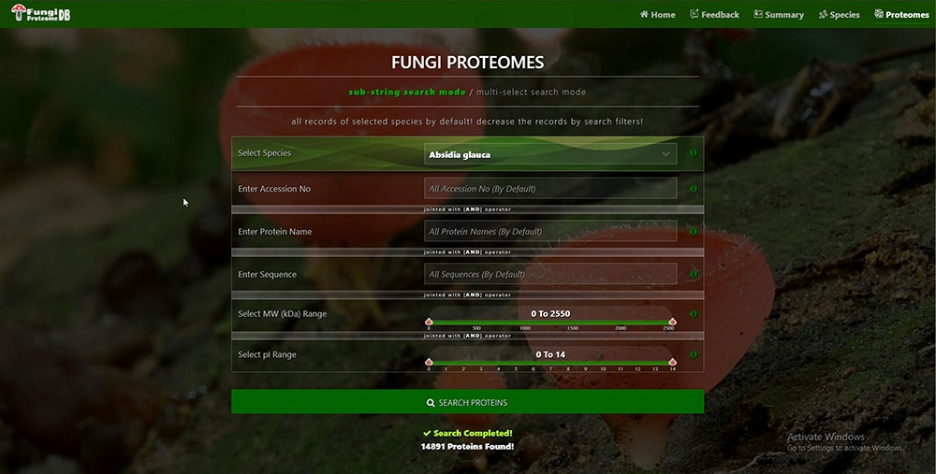
Figure 4. Proteome search interface of substring search mode. User can search the proteome data using any one option or ...
Notes:
Figure 4. Proteome search interface of substring search mode. User can search the proteome data using any one option or multiple options.
Unless provided in the caption above, the following copyright applies to the content of this slide: © The Author(s) 2023. Published by Oxford University Press.This is an Open Access article distributed under the terms of the Creative Commons Attribution License (https://creativecommons.org/licenses/by/4.0/), which permits unrestricted reuse, distribution, and reproduction in any medium, provided the original work is properly cited.

Slide 5
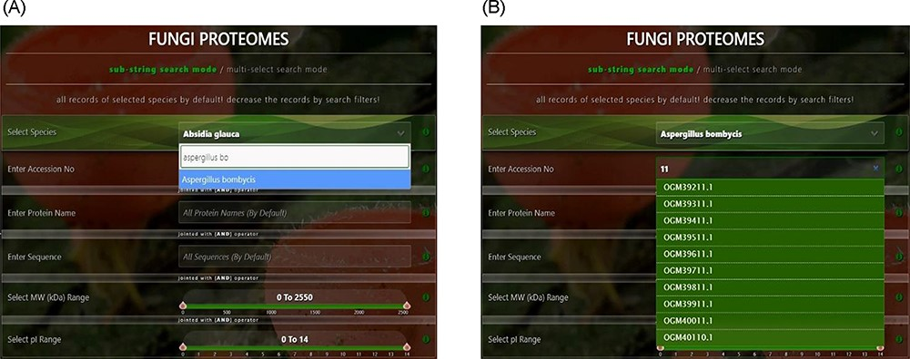
Figure 5. User-friendly interface with autofill option to (A) select species using auto-filling options or from a ...
Notes:
Figure 5. User-friendly interface with autofill option to (A) select species using auto-filling options or from a drop-down list and (B) search specific proteome using accession numbers.
Unless provided in the caption above, the following copyright applies to the content of this slide: © The Author(s) 2023. Published by Oxford University Press.This is an Open Access article distributed under the terms of the Creative Commons Attribution License (https://creativecommons.org/licenses/by/4.0/), which permits unrestricted reuse, distribution, and reproduction in any medium, provided the original work is properly cited.

Slide 6
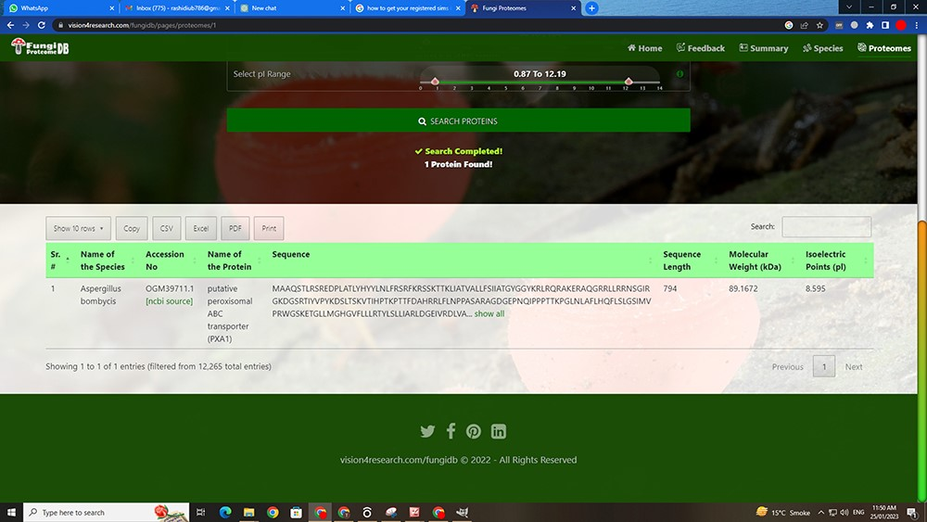
Figure 6. Customized search results using the substring search mode of proteome search interface.
Notes:
Figure 6. Customized search results using the substring search mode of proteome search interface.
Unless provided in the caption above, the following copyright applies to the content of this slide: © The Author(s) 2023. Published by Oxford University Press.This is an Open Access article distributed under the terms of the Creative Commons Attribution License (https://creativecommons.org/licenses/by/4.0/), which permits unrestricted reuse, distribution, and reproduction in any medium, provided the original work is properly cited.

Slide 7
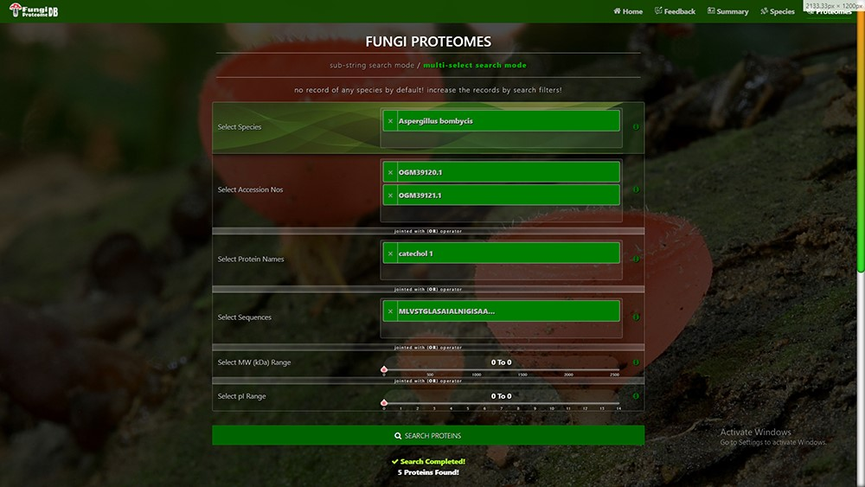
Figure 7. Proteome search interface of multi-select search mode. User can search the proteome data using any one option ...
Notes:
Figure 7. Proteome search interface of multi-select search mode. User can search the proteome data using any one option or multiple options.
Unless provided in the caption above, the following copyright applies to the content of this slide: © The Author(s) 2023. Published by Oxford University Press.This is an Open Access article distributed under the terms of the Creative Commons Attribution License (https://creativecommons.org/licenses/by/4.0/), which permits unrestricted reuse, distribution, and reproduction in any medium, provided the original work is properly cited.

Slide 8
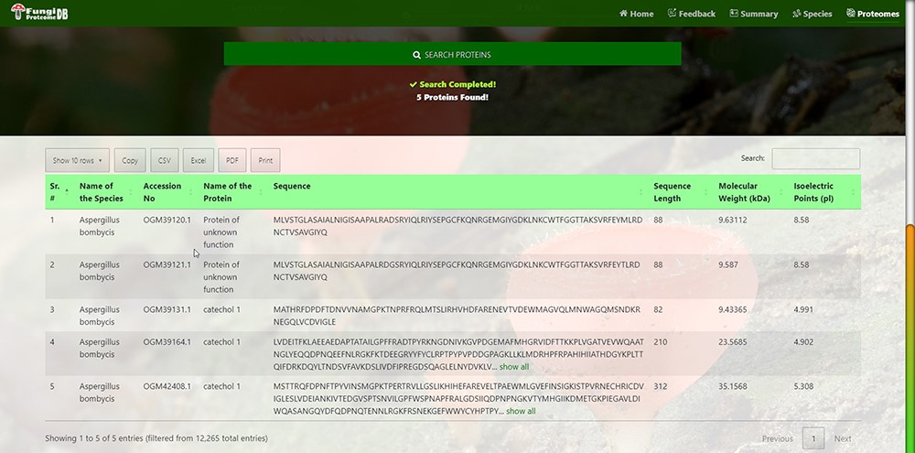
Figure 8. Customized search results using the multi-string search mode of proteome search interface.
Notes:
Figure 8. Customized search results using the multi-string search mode of proteome search interface.
Unless provided in the caption above, the following copyright applies to the content of this slide: © The Author(s) 2023. Published by Oxford University Press.This is an Open Access article distributed under the terms of the Creative Commons Attribution License (https://creativecommons.org/licenses/by/4.0/), which permits unrestricted reuse, distribution, and reproduction in any medium, provided the original work is properly cited.

