Slide 1
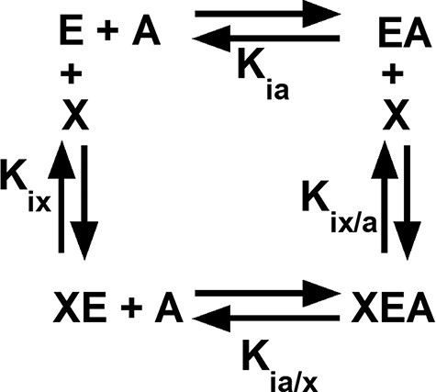
Figure 1. An allosteric energy cycle in which an enzyme (E) binds one substrate (A) and one allosteric effector (X). ...
Notes:
Figure 1. An allosteric energy cycle in which an enzyme (E) binds one substrate (A) and one allosteric effector (X). Kia is the binding of the substrate to the enzyme in the absence of the effector; when initial data are derived from kinetic measurements, this parameter is designated as Ka. Kia/x is the binding of the substrate to the enzyme in the presence of saturating concentrations of the effector. Kix is the binding of the effector to the enzyme when the substrate is absent. Kix/a is the binding of the effector to the enzyme in the presence of saturating concentrations of the substrate. Allosteric coupling is defined as Qax = Ka/Ka/x = Kix/Kix/a (34, 36, 37, 223). A description of hLPYK’s allosteric regulation requires two such functional cycles—one for activation by Fru-1,6-BP and one for inhibition by alanine.
Unless provided in the caption above, the following copyright applies to the content of this slide: © The Author(s) 2023. Published by Oxford University Press.This is an Open Access article distributed under the terms of the Creative Commons Attribution License (https://creativecommons.org/licenses/by/4.0/), which permits unrestricted reuse, distribution, and reproduction in any medium, provided the original work is properly cited.

