Slide 1
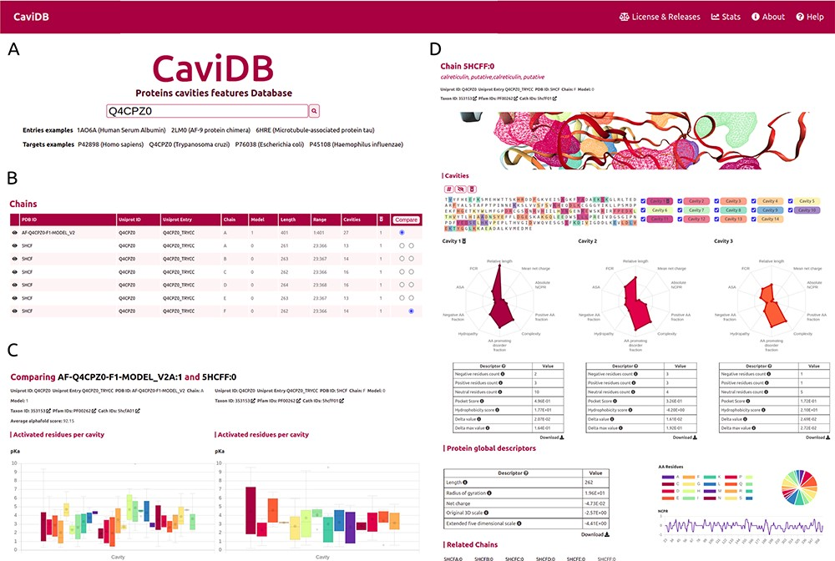
Figure 1. Overview of the CaviDB web application. (A) CaviDB search allows users to search for a specific PDB or ...
Notes:
Figure 1. Overview of the CaviDB web application. (A) CaviDB search allows users to search for a specific PDB or UniProt identifier. A selector is also provided to focus the search on AlphaFold models. (B, C) Cavity dynamics can be explored using the comparison tool provided by CaviDB, where predicted cavities and their features can be selected and displayed for different protein conformations simultaneously. (D) Schematic example of chain feature display. The information of each entry is divided into two main sections, one containing the general cavity descriptors (top) and the other containing the global protein descriptors (bottom).
Unless provided in the caption above, the following copyright applies to the content of this slide: © The Author(s) 2023. Published by Oxford University Press.This is an Open Access article distributed under the terms of the Creative Commons Attribution License (https://creativecommons.org/licenses/by/4.0/), which permits unrestricted reuse, distribution, and reproduction in any medium, provided the original work is properly cited.

