Slide 1
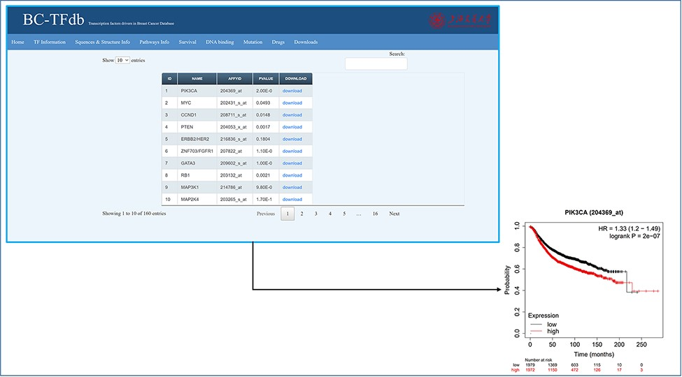
Figure 5. Representative image of the Survival information tab, including a list of all TFs and their downloadable KM ...
Notes:
Figure 5. Representative image of the Survival information tab, including a list of all TFs and their downloadable KM (kaplan-meier plot) plots. The bottom panel shows the sample survival KM plot for PIK3CA.
Unless provided in the caption above, the following copyright applies to the content of this slide: © Crown copyright 2021.This Open Access article contains public sector information licensed under the Open Government Licence v3.0 (http://www.nationalarchives.gov.uk/doc/open-government-licence/version/3/).

