Slide 1
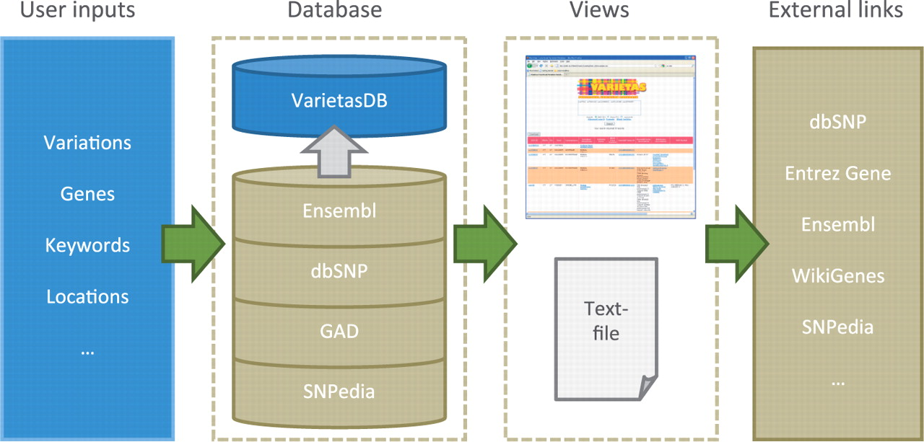
Figure 1. Overview of Varietas. Users can enter variety of different features such as SNPs, genes, keywords or ...
Notes:
Figure 1. Overview of Varietas. Users can enter variety of different features such as SNPs, genes, keywords or locations, or any combination of them. These inputs are queried against VarietasDB that contains integrated data from various biological databases. Users can browse through the results using the web user-interface or download them as a tab-delimited text file. Links to external databases and resources are also provided for further exploration.
Unless provided in the caption above, the following copyright applies to the content of this slide: © The Author(s) 2010. Published by Oxford University Press.This is Open Access article distributed under the terms of the Creative Commons Attribution Non-Commercial License (http://creativecommons.org/licenses/by-nc/2.5), which permits unrestricted non-commercial use, distribution, and reproduction in any medium, provided the original work is properly cited.

Slide 2
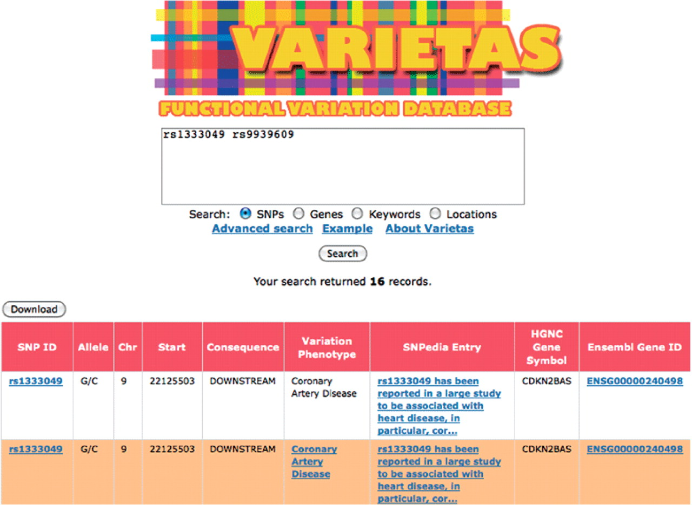
Figure 2. Screenshot of Varietas’ user interface showing partial results for basic query for a set of SNPs. Queries can ...
Notes:
Figure 2. Screenshot of Varietas’ user interface showing partial results for basic query for a set of SNPs. Queries can be performed based on given set of variations, genes, keywords or genomic locations. Links in the results table can be followed to external information resources.
Unless provided in the caption above, the following copyright applies to the content of this slide: © The Author(s) 2010. Published by Oxford University Press.This is Open Access article distributed under the terms of the Creative Commons Attribution Non-Commercial License (http://creativecommons.org/licenses/by-nc/2.5), which permits unrestricted non-commercial use, distribution, and reproduction in any medium, provided the original work is properly cited.

