Slide 1
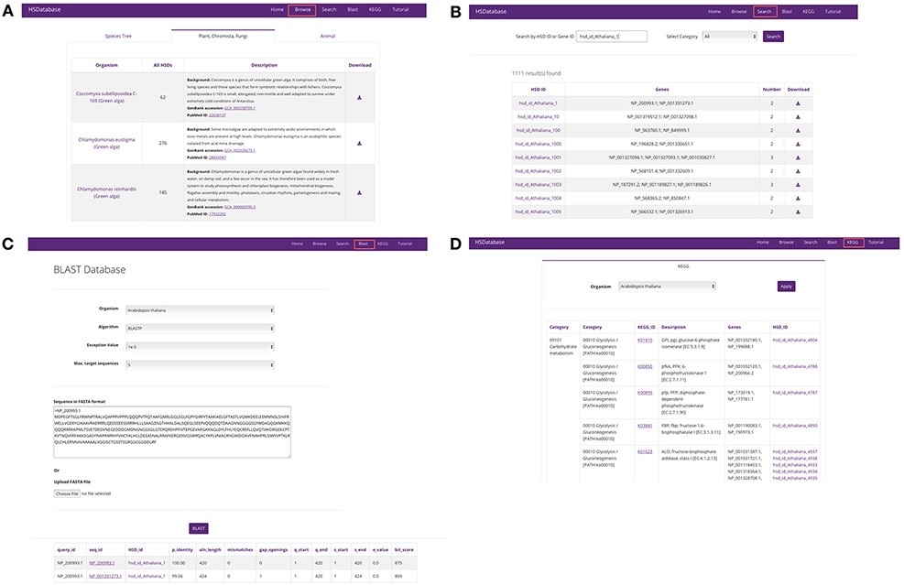
Figure 3. Screenshots of the HSDatabase interface. There are four main functions in the menu page: (A) Browse the ...
Notes:
Figure 3. Screenshots of the HSDatabase interface. There are four main functions in the menu page: (A) Browse the database via species entries; (B) search the database via the HSDatabase unique ID (e.g. hsd_id_Athaliana_1) or gene ID (e.g. NP_200993.1); (C) use BLAST to search the database via amino acid sequence in FASTA format; and (D) categorize the gene copies and HSDs under the KEGG pathway functional categories.
Unless provided in the caption above, the following copyright applies to the content of this slide: © The Author(s) 2022. Published by Oxford University Press.This is an Open Access article distributed under the terms of the Creative Commons Attribution-NonCommercial License (https://creativecommons.org/licenses/by-nc/4.0/), which permits non-commercial re-use, distribution, and reproduction in any medium, provided the original work is properly cited. For commercial re-use, please contact journals.permissions@oup.com

