Slide 1
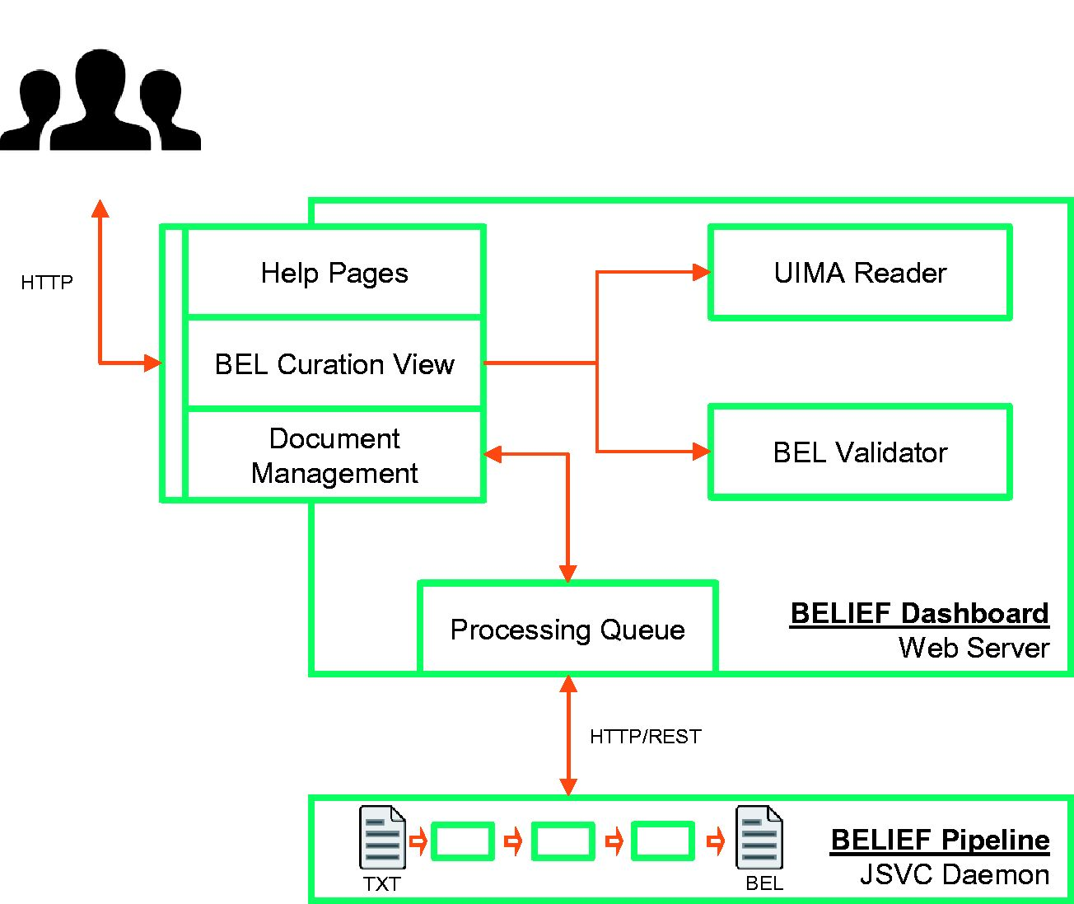
Figure 2 Architecture of semiautomatic information extraction workflow BELIEF. The workflow consists of a text mining ...
Notes:
Figure 2 Architecture of semiautomatic information extraction workflow BELIEF. The workflow consists of a text mining pipeline (BELIEF Pipeline) and a web-based biocuration tool (BELIEF Dashboard). ( Note : UIMA: Unstructured Information Management Architecture. UIMA Reader: A reader component to parse and extr act information from UIMA XCAS documents. JSVC Daemon: A Java library that allows applications to run as daemons.).
Unless provided in the caption above, the following copyright applies to the content of this slide: © The Author(s) 2016. Published by Oxford University Press. All rights reserved. For permissions, please e-mail: journals.permissions@oup.com This is an Open Access article distributed under the terms of the Creative Commons Attribution License ( http://creativecommons.org/licenses/by/4.0/ ), which permits unrestricted reuse, distribution, and reproduction in any medium, provided the original work is properly cited.

