Slide 1
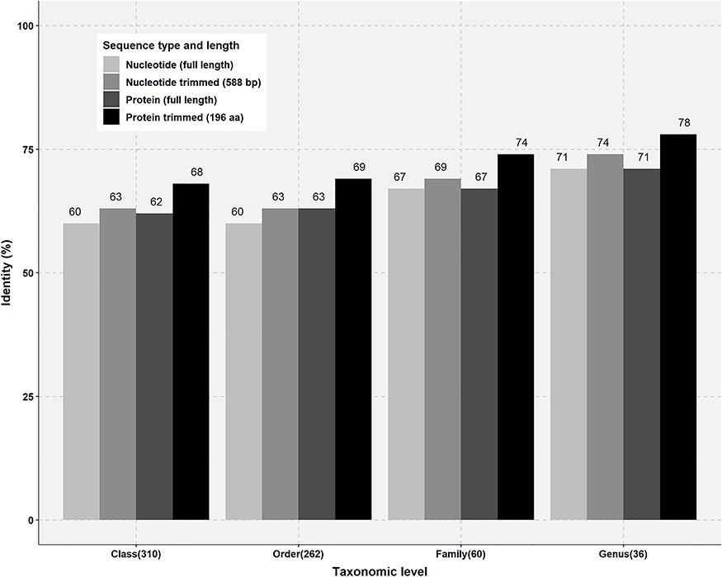
Figure 3 Percentage identity thresholds of FTHFS sequences at different taxonomic levels. Full-length and trimmed ...
Notes:
Figure 3 Percentage identity thresholds of FTHFS sequences at different taxonomic levels. Full-length and trimmed sequences of known taxonomy for class (310), order (262), family (60) and genus (36) level were compared with clone sequences of 588 bp and translated sequences of 196 aa.
Unless provided in the caption above, the following copyright applies to the content of this slide: © The Author(s) 2019. Published by Oxford University Press.This is an Open Access article distributed under the terms of the Creative Commons Attribution Non-Commercial License (http://creativecommons.org/licenses/by-nc/4.0/), which permits non-commercial re-use, distribution, and reproduction in any medium, provided the original work is properly cited. For commercial re-use, please contact journals.permissions@oup.com

