Slide 1
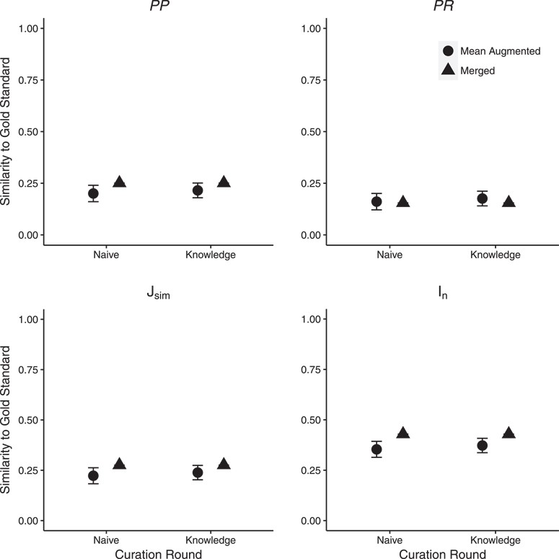
Figure 4 Effect of ontology completeness on SCP performance as measured by similarity to the gold standard. ‘Mean ...
Notes:
Figure 4 Effect of ontology completeness on SCP performance as measured by similarity to the gold standard. ‘Mean Augmented’ is the mean of similarity scores from the three curator augmented ontologies; error bars show two standard errors of the mean. Significant differences in similarity between SCP and the gold standard were found for the majority of statistics across the two rounds. Detailed results are shown in Supplementary Materials, Table 2.
Unless provided in the caption above, the following copyright applies to the content of this slide: © The Author(s) 2018. Published by Oxford University Press.This is an Open Access article distributed under the terms of the Creative Commons Attribution License (http://creativecommons.org/licenses/by/4.0/), which permits unrestricted reuse, distribution, and reproduction in any medium, provided the original work is properly cited.

