Slide 1
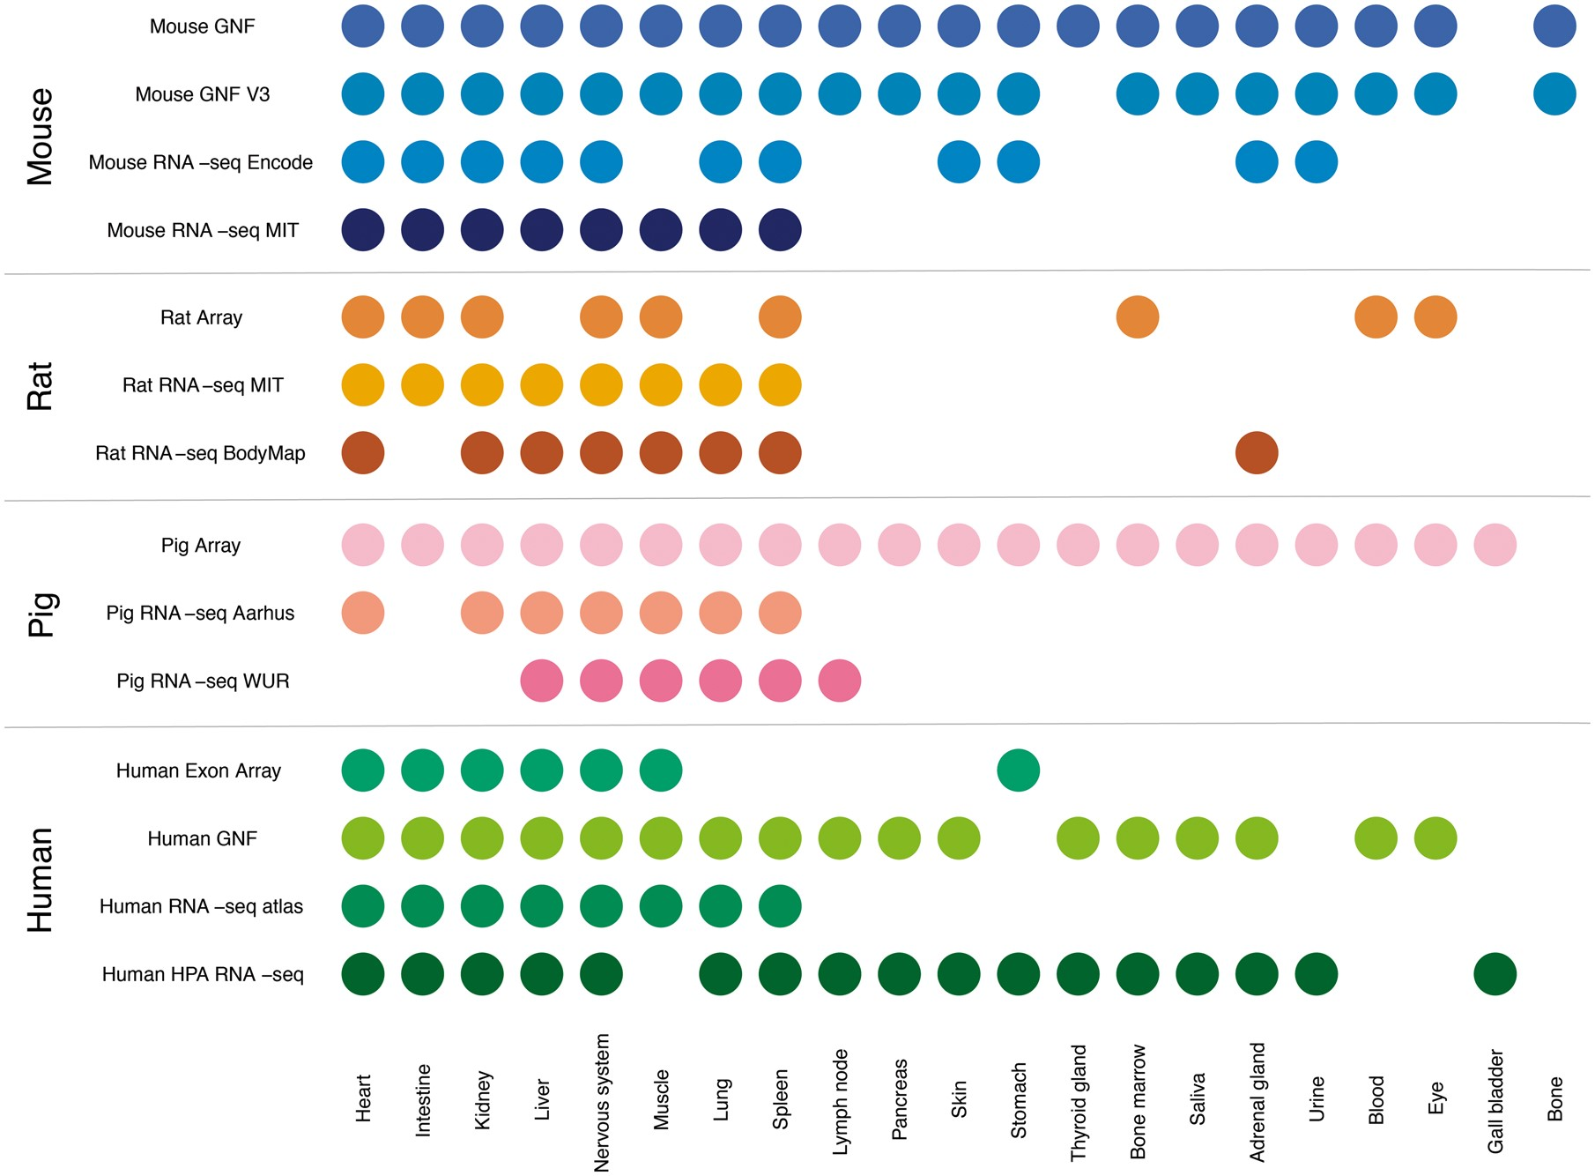
Figure 2. Summary of tissues present in each dataset. We mapped the newly integrated datasets from mouse, rat and pig, ...
Notes:
Figure 2. Summary of tissues present in each dataset. We mapped the newly integrated datasets from mouse, rat and pig, as well as the already existing human datasets, to 21 major tissues of interest. This figure shows which of these tissues are covered by which datasets.
Unless provided in the caption above, the following copyright applies to the content of this slide: © The Author(s) 2018. Published by Oxford University Press.This is an Open Access article distributed under the terms of the Creative Commons Attribution License (http://creativecommons.org/licenses/by/4.0/), which permits unrestricted reuse, distribution, and reproduction in any medium, provided the original work is properly cited.

