Slide 1
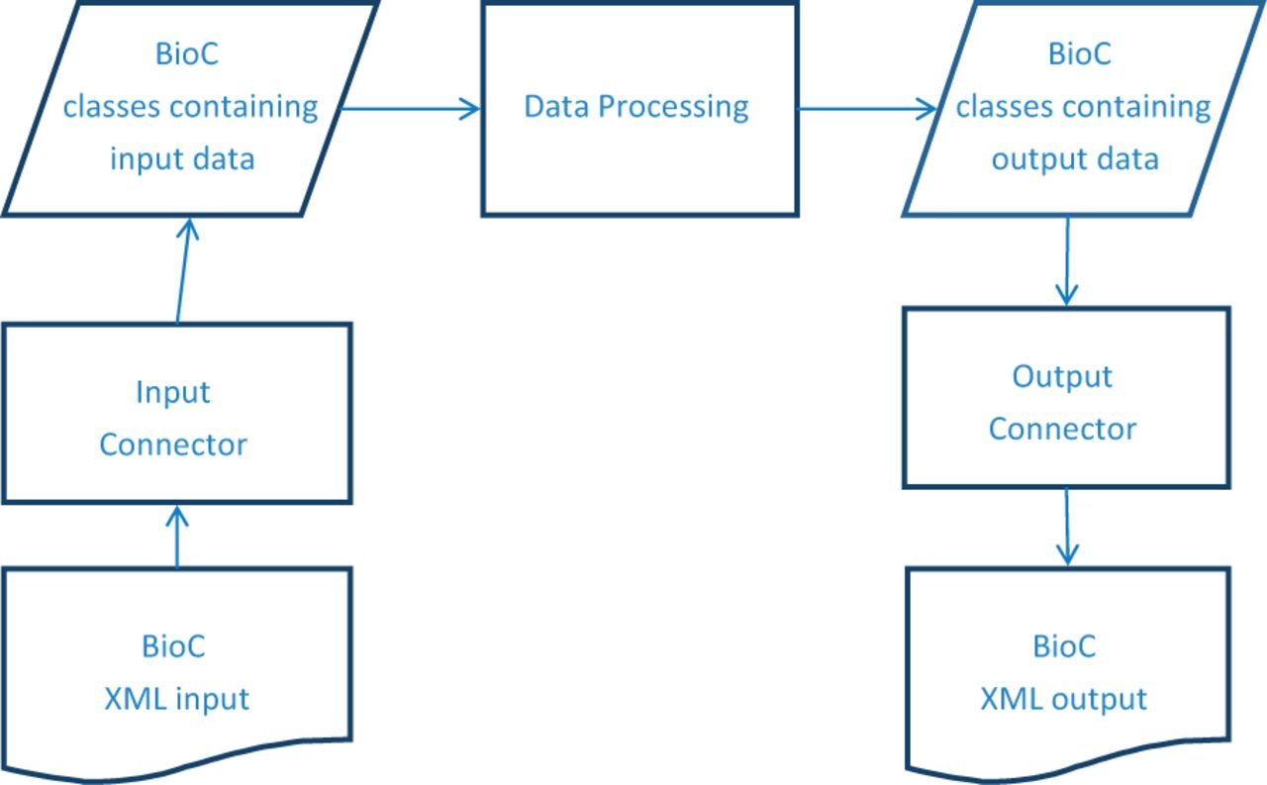
Figure 1. BioC process sequence. The BioC workflow allows data in the BioC format, from a file or any other stream, to ...
Notes:
Figure 1. BioC process sequence. The BioC workflow allows data in the BioC format, from a file or any other stream, to be read into the BioC data classes via the Input Connector, or written into a new stream, via the Output Connector. The Data Processing module stands for any kind of NLP or text mining process that uses these data. Several processing modules may be chained together between input and output.
Unless provided in the caption above, the following copyright applies to the content of this slide: Published by Oxford University 2014. This work is written by US Government employees and is in the public domain in the US.

