Slide 1
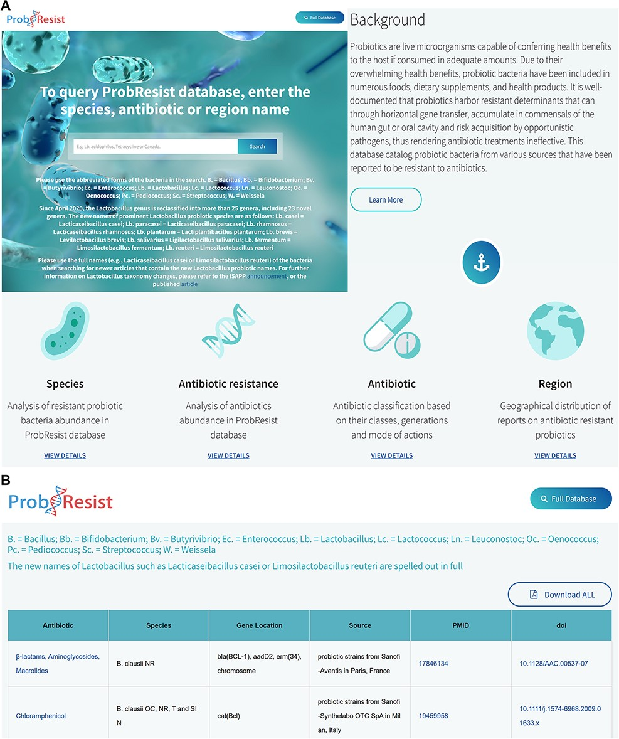
Figure 2. Layout of the ProbResist webserver. (A) Top panel: screenshot of the home page beginning with a text search ...
Notes:
Figure 2. Layout of the ProbResist webserver. (A) Top panel: screenshot of the home page beginning with a text search bar that allows experienced users to quickly query the database from three search options: bacteria species, antibiotic or region/country name. The search bar is accompanied by a detailed instruction and species abbreviation legend to aid user input. Following that, an introduction section containing a brief description of probiotics and antibiotic resistance is provided to aid first time users navigate and extract information from the database. Bottom panel: the next part of the webserver contains general information of the antibiotics as well as a brief analysis of the database organized based on the frequency of the respective species, drug resistance, antibiotic classes and region/country of study. (B) In the result page, retrieved results contain the name of antibiotic, bacteria species, gene name and location, source of isolates, country of study and the unique digital article identifiers PMID and DOI, hyperlinked to the original sources. The website allows users to export their results as Excel.
Unless provided in the caption above, the following copyright applies to the content of this slide: © The Author(s) 2022. Published by Oxford University Press.This is an Open Access article distributed under the terms of the Creative Commons Attribution-NonCommercial License (https://creativecommons.org/licenses/by-nc/4.0/), which permits non-commercial re-use, distribution, and reproduction in any medium, provided the original work is properly cited. For commercial re-use, please contact journals.permissions@oup.com

Slide 2
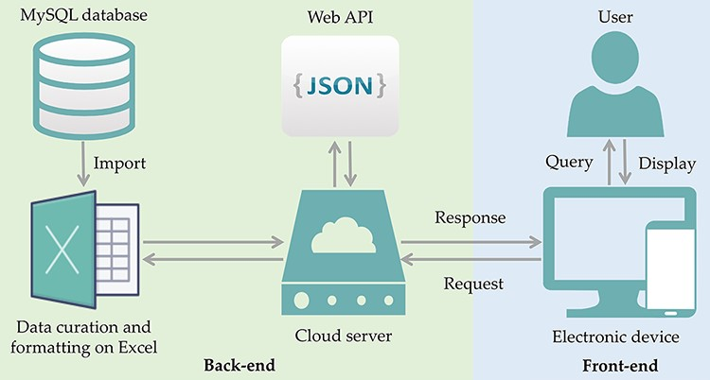
Figure 1. ProbResist database and interface. Information extracted from articles retrieved from PubMed database was ...
Notes:
Figure 1. ProbResist database and interface. Information extracted from articles retrieved from PubMed database was manually curated and formatted offline on Excel before importing into MySQL database in the following format: antibiotic, species, gene location, country, PMID and DOI. The database website structure was designed and developed using the front-end (blue box) and back-end (green box) separation where the website front-end will query the database when user invoked either the search function by species, antibiotic or country name, in the search bar. At the back-end, data are provided by restful web API in JSON format. For website development, an online web template provided by HTML design (https://html.design) was adopted and modulated. Front-end only requires the setting up of the user query input as a parameter to specify API URL and then displayed in appropriate table HTML format. Users have the option to export their retrieved results into Excel format.
Unless provided in the caption above, the following copyright applies to the content of this slide: © The Author(s) 2022. Published by Oxford University Press.This is an Open Access article distributed under the terms of the Creative Commons Attribution-NonCommercial License (https://creativecommons.org/licenses/by-nc/4.0/), which permits non-commercial re-use, distribution, and reproduction in any medium, provided the original work is properly cited. For commercial re-use, please contact journals.permissions@oup.com

