Slide 1
Figure 1 Example sentence illustrating biochemical entities and their relations.
Notes:
Figure 1 Example sentence illustrating biochemical entities and their relations.
Unless provided in the caption above, the following copyright applies to the content of this slide: © The Author(s) 2019. Published by Oxford University Press.This is an Open Access article distributed under the terms of the Creative Commons Attribution License (http://creativecommons.org/licenses/by/4.0/), which permits unrestricted reuse, distribution, and reproduction in any medium, provided the original work is properly cited.

Slide 2
Figure 2 Example illustrating the dependency structure of a sentence from the CHEMPROT training dataset (PMID ...
Notes:
Figure 2 Example illustrating the dependency structure of a sentence from the CHEMPROT training dataset (PMID 10340919). In this example, we considered the relation between the ‘meloxicam’ chemical mention and the ‘COX’ protein mention. The SDP is highlighted in bold and blue color.
Unless provided in the caption above, the following copyright applies to the content of this slide: © The Author(s) 2019. Published by Oxford University Press.This is an Open Access article distributed under the terms of the Creative Commons Attribution License (http://creativecommons.org/licenses/by/4.0/), which permits unrestricted reuse, distribution, and reproduction in any medium, provided the original work is properly cited.

Slide 3
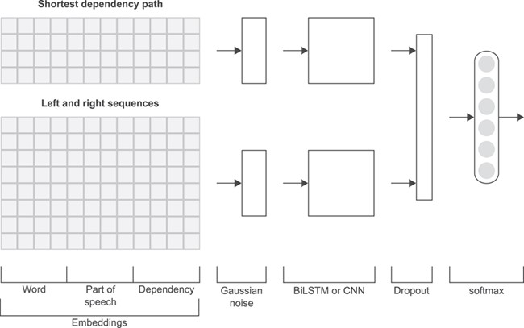
Figure 3 Neural network structure.
Notes:
Figure 3 Neural network structure.
Unless provided in the caption above, the following copyright applies to the content of this slide: © The Author(s) 2019. Published by Oxford University Press.This is an Open Access article distributed under the terms of the Creative Commons Attribution License (http://creativecommons.org/licenses/by/4.0/), which permits unrestricted reuse, distribution, and reproduction in any medium, provided the original work is properly cited.

