Slide 1
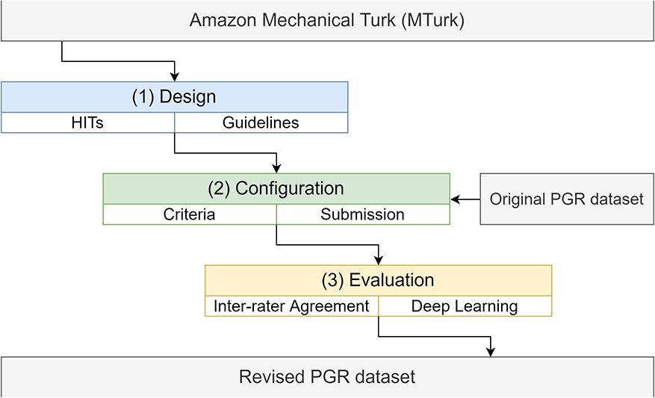
Figure 1. The pipeline to incorporate the PGR dataset into the Amazon MTurk platform, including the design, ...
Notes:
Figure 1. The pipeline to incorporate the PGR dataset into the Amazon MTurk platform, including the design, configuration and evaluation stages.
Unless provided in the caption above, the following copyright applies to the content of this slide: © The Author(s) 2020. Published by Oxford University Press.This is an Open Access article distributed under the terms of the Creative Commons Attribution License (http://creativecommons.org/licenses/by/4.0/), which permits unrestricted reuse, distribution, and reproduction in any medium, provided the original work is properly cited.

Slide 2
Figure 2. Examples of the two types of relations (‘Known’ and ‘Unknown’) in the PGR dataset (partial figure from (28)). ...
Notes:
Figure 2. Examples of the two types of relations (‘Known’ and ‘Unknown’) in the PGR dataset (partial figure from (28)). The sentence of abstract PMID:23 669 344 was simplified to capture more clearly the ‘Known’ relation.
Unless provided in the caption above, the following copyright applies to the content of this slide: © The Author(s) 2020. Published by Oxford University Press.This is an Open Access article distributed under the terms of the Creative Commons Attribution License (http://creativecommons.org/licenses/by/4.0/), which permits unrestricted reuse, distribution, and reproduction in any medium, provided the original work is properly cited.

Slide 3
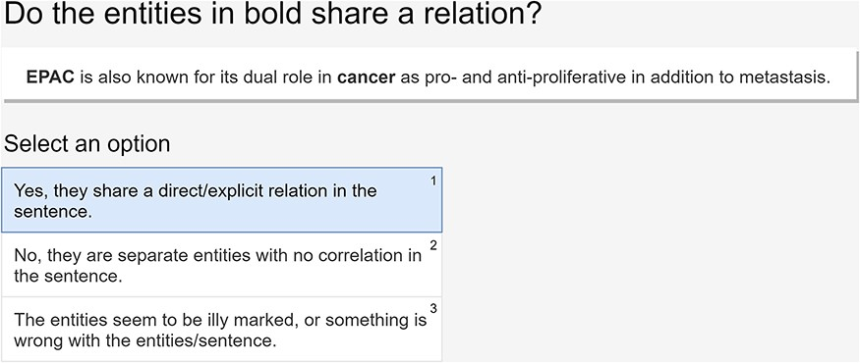
Figure 3. An example of a HIT presented to the workers and the available options.
Notes:
Figure 3. An example of a HIT presented to the workers and the available options.
Unless provided in the caption above, the following copyright applies to the content of this slide: © The Author(s) 2020. Published by Oxford University Press.This is an Open Access article distributed under the terms of the Creative Commons Attribution License (http://creativecommons.org/licenses/by/4.0/), which permits unrestricted reuse, distribution, and reproduction in any medium, provided the original work is properly cited.

Slide 4
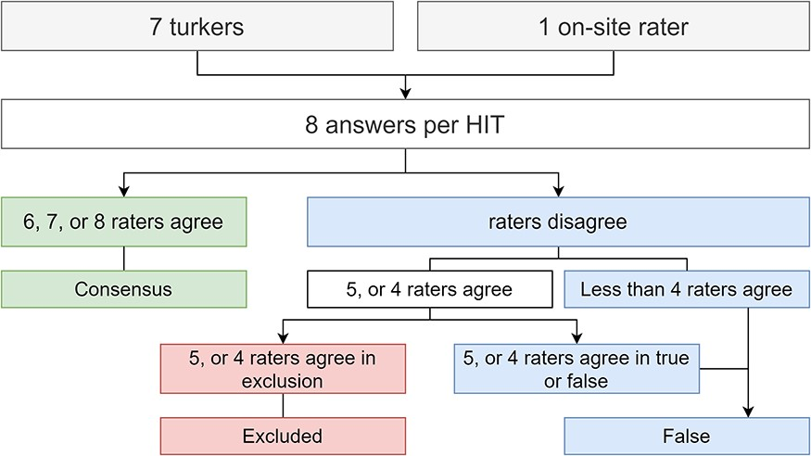
Figure 4. Flowchart illustrating how to reach majority consensus, according to the answers provided by the workers plus ...
Notes:
Figure 4. Flowchart illustrating how to reach majority consensus, according to the answers provided by the workers plus our extra rater on-site.
Unless provided in the caption above, the following copyright applies to the content of this slide: © The Author(s) 2020. Published by Oxford University Press.This is an Open Access article distributed under the terms of the Creative Commons Attribution License (http://creativecommons.org/licenses/by/4.0/), which permits unrestricted reuse, distribution, and reproduction in any medium, provided the original work is properly cited.

Slide 5
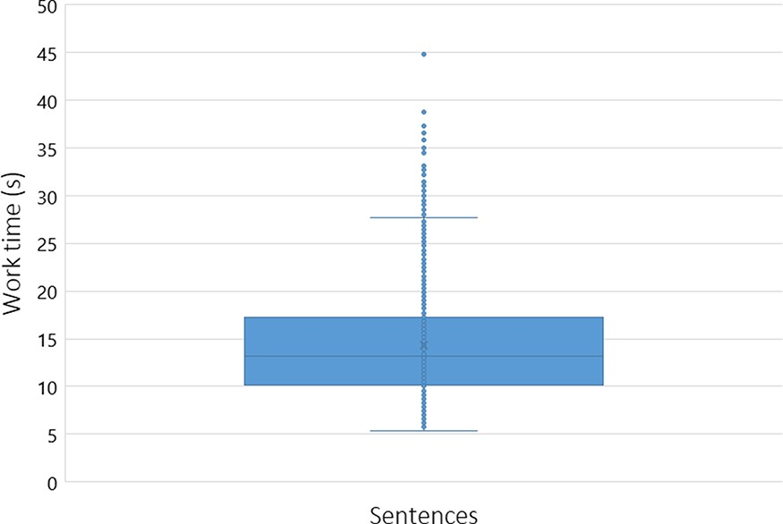
Figure 5. Box plot expressing the average worker work time distribution (in seconds) per sentence (with a cutoff of 50 ...
Notes:
Figure 5. Box plot expressing the average worker work time distribution (in seconds) per sentence (with a cutoff of 50 seconds).
Unless provided in the caption above, the following copyright applies to the content of this slide: © The Author(s) 2020. Published by Oxford University Press.This is an Open Access article distributed under the terms of the Creative Commons Attribution License (http://creativecommons.org/licenses/by/4.0/), which permits unrestricted reuse, distribution, and reproduction in any medium, provided the original work is properly cited.

Slide 6
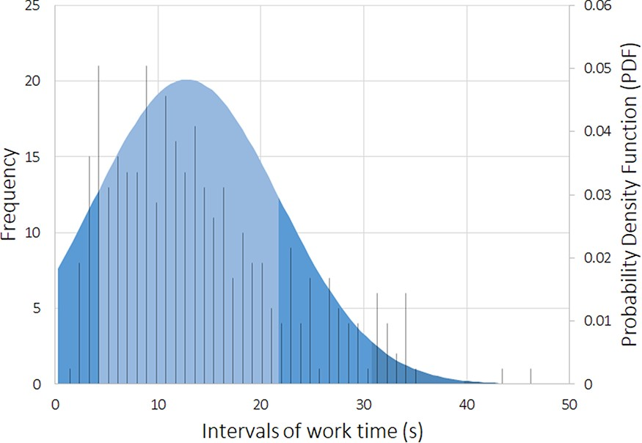
Figure 6. Standard deviation expressing the average worker work time distribution (in seconds), and the histogram of ...
Notes:
Figure 6. Standard deviation expressing the average worker work time distribution (in seconds), and the histogram of the occurrence events (with a cutoff of 50 seconds).
Unless provided in the caption above, the following copyright applies to the content of this slide: © The Author(s) 2020. Published by Oxford University Press.This is an Open Access article distributed under the terms of the Creative Commons Attribution License (http://creativecommons.org/licenses/by/4.0/), which permits unrestricted reuse, distribution, and reproduction in any medium, provided the original work is properly cited.

