Slide 1
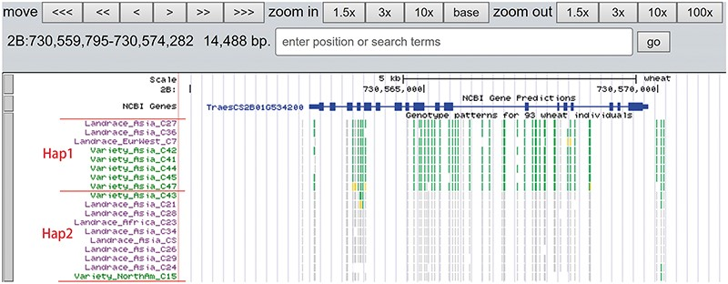
Figure 8. Two haplotypes (Hap1 and Hap2) for gene TraesCS2B01G534200 region among bread wheat based on the genotype ...
Notes:
Figure 8. Two haplotypes (Hap1 and Hap2) for gene TraesCS2B01G534200 region among bread wheat based on the genotype pattern with homozygous reference in gray, heterozygous variant in yellow and homozygous variant in green.
Unless provided in the caption above, the following copyright applies to the content of this slide: © The Author(s) 2020. Published by Oxford University Press.This is an Open Access article distributed under the terms of the Creative Commons Attribution License (http://creativecommons.org/licenses/by/4.0/), which permits unrestricted reuse, distribution, and reproduction in any medium, provided the original work is properly cited.

