Slide 1
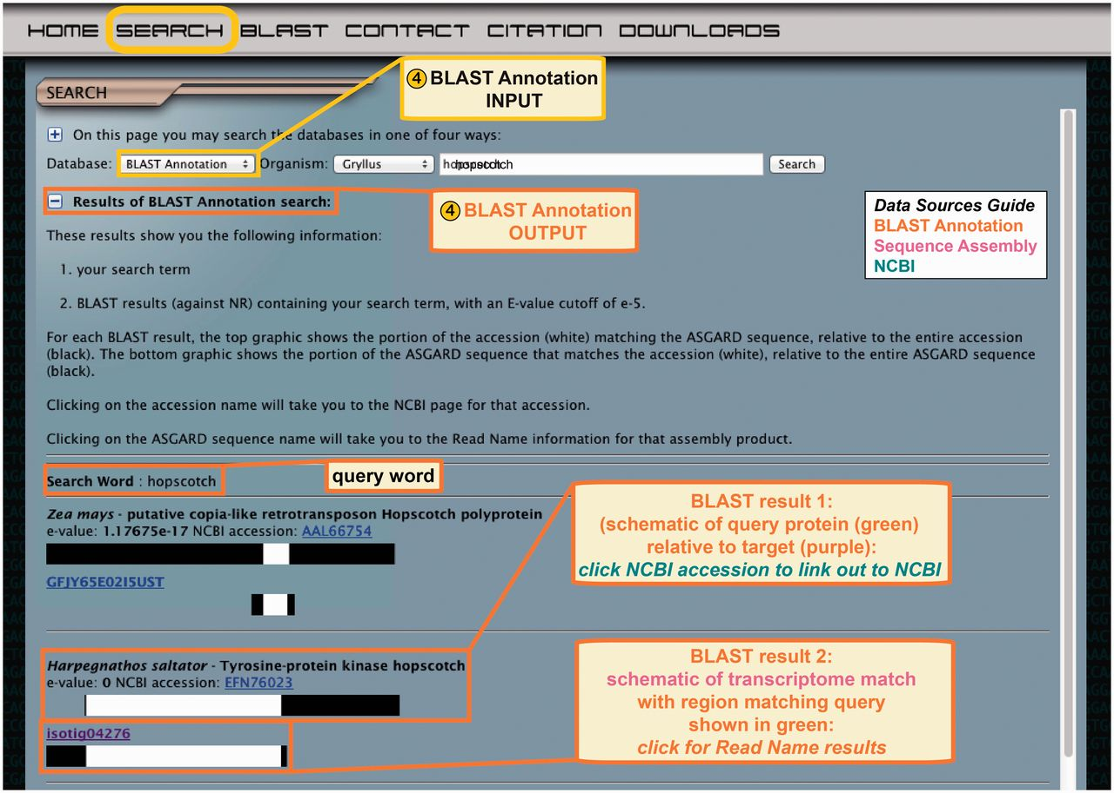
Figure 6 ASGARD BLAST Annotation search. Top: the input user interface allows users to select an organism of interest ...
Notes:
Figure 6 ASGARD BLAST Annotation search. Top: the input user interface allows users to select an organism of interest and enter queries based on gene names from any organism. This example shows what a user might enter to search for G. bimaculatus transcripts similar to JAK orthologs from any organism in nr. Bottom: the output of this search lists BLAST hits against nr whose text descriptions contain the search term, with links to the NCBI accession for each hit, schematic representations of matching transcriptome sequences and links to read name data.
Unless provided in the caption above, the following copyright applies to the content of this slide: © The Author(s) 2012. Published by Oxford University Press.This is an Open Access article distributed under the terms of the Creative Commons Attribution License (http://creativecommons.org/licenses/by-nc/3.0/), which permits non-commercial reuse, distribution, and reproduction in any medium, provided the original work is properly cited. For commercial re-use, please contact journals.permissions@oup.com.

