Slide 1
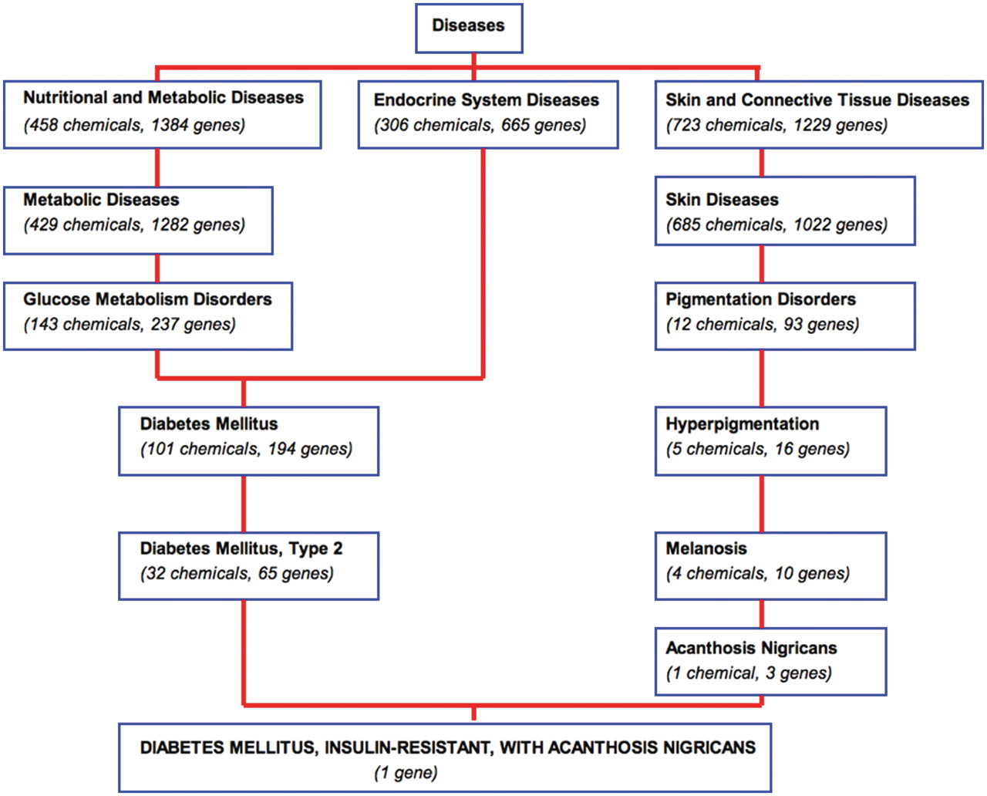
Figure 5. Navigating MEDIC and its curated data. A bird's eye view of a section of MEDIC provides users with the ...
Notes:
Figure 5. Navigating MEDIC and its curated data. A bird's eye view of a section of MEDIC provides users with the ability to navigate and explore disease terms, relationships, and their associated CTD data. The disease ‘DIABETES MELLITUS, INSULIN-RESISTANT, WITH ACANTHOSIS NIGRICANS’ (OMIM:610549) is a leaf of ‘Diabetes Mellitus, Type 2’ (MESH:D003924) and ‘Acanthosis Nigricans’ (MESH:D000052). Chemicals and genes annotated to each MEDIC term are cumulated as the user navigates up to more broad concepts.
Unless provided in the caption above, the following copyright applies to the content of this slide: © The Author(s) 2012. Published by Oxford University Press.This is an Open Access article distributed under the terms of the Creative Commons Attribution Non-Commercial License (http://creativecommons.org/licenses/by-nc/3.0), which permits unrestricted non-commercial use, distribution, and reproduction in any medium, provided the original work is properly cited.

