Slide 1
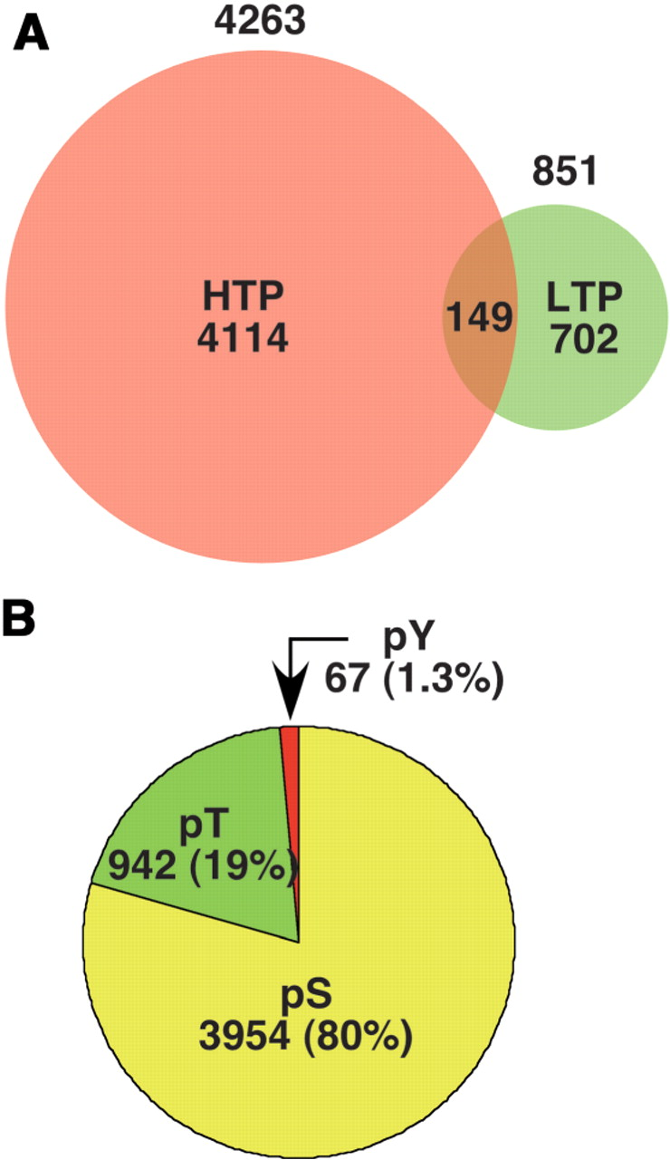
Figure 3. (A). The number of individual phosphorylation sites listed in PhosphoGRID version 1.0 identified by HTP mass ...
Notes:
Figure 3. (A). The number of individual phosphorylation sites listed in PhosphoGRID version 1.0 identified by HTP mass spectrometry-based studies (red) and focused LTP studies on individual proteins (green). (B). The proportion of PhosphoGRID entries representing phosphoserine, phosphothreonine and phosphotyrosine residues.
Unless provided in the caption above, the following copyright applies to the content of this slide: © The Author(s) 2010. Published by Oxford University Press.This is Open Access article distributed under the terms of the Creative Commons Attribution Non-Commercial License (http://creativecommons.org/licenses/by-nc/2.5), which permits unrestricted non-commercial use, distribution, and reproduction in any medium, provided the original work is properly cited.

