Slide 1
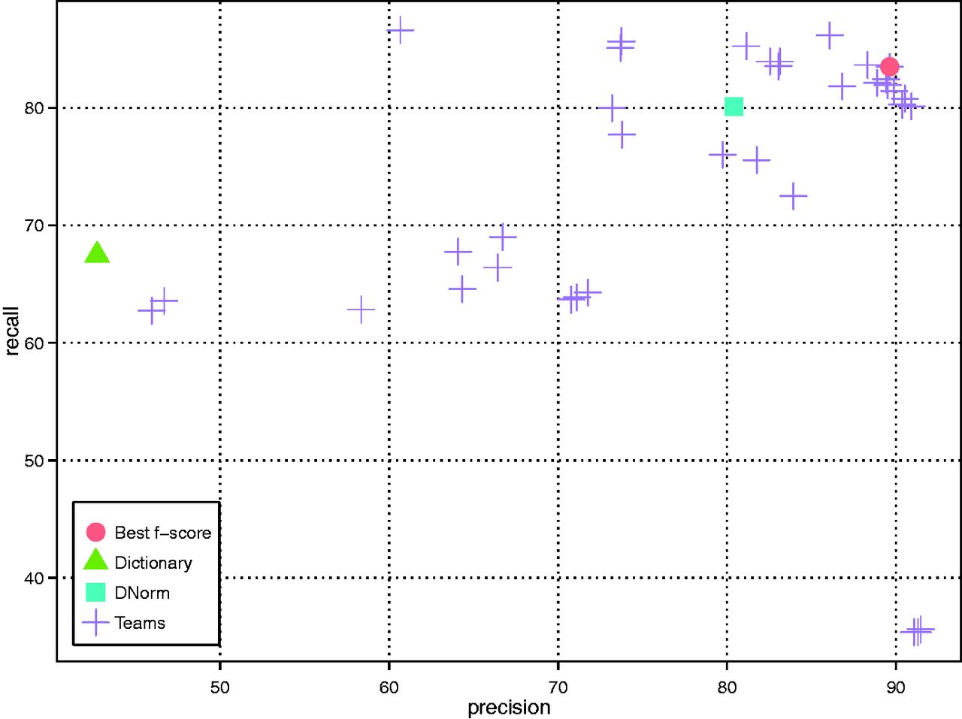
Figure 2. DNER results of all teams as well as the baseline (dictionary look up) and DNorm systems.
Notes:
Figure 2. DNER results of all teams as well as the baseline (dictionary look up) and DNorm systems.
Unless provided in the caption above, the following copyright applies to the content of this slide: Published by Oxford University Press 2016. This work is written by US Government employees and is in the public domain in the US.

