Slide 1
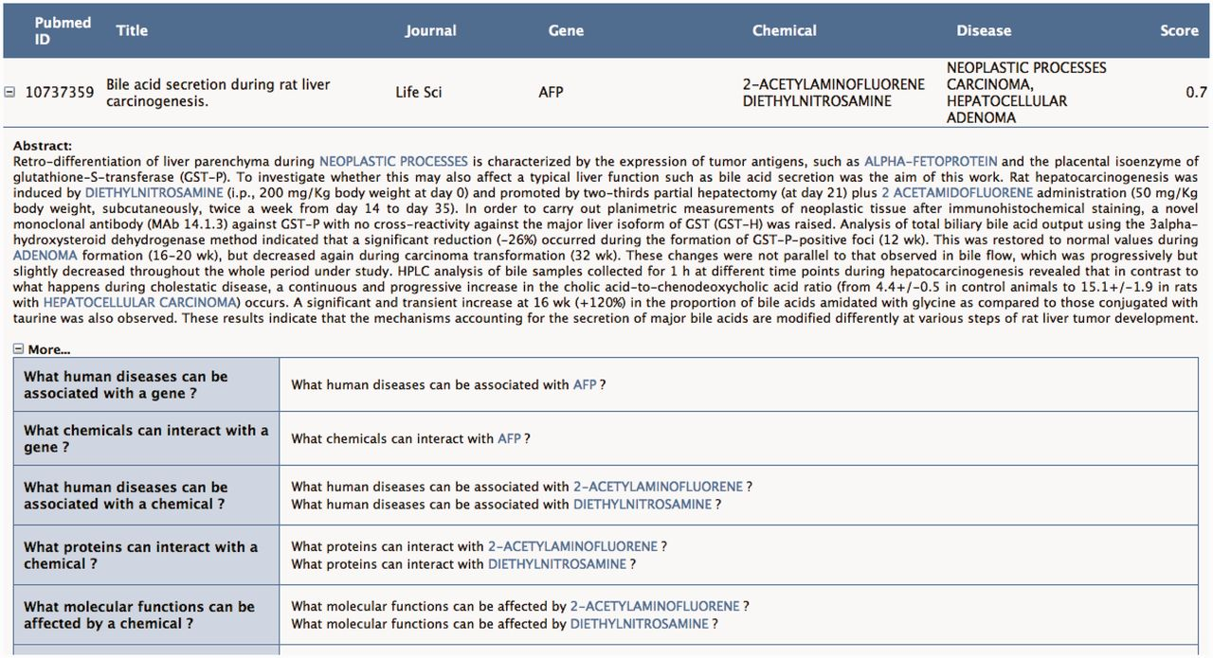
Figure 5 The user can request to visualize in the abstract the context of the annotation proposed in Figure 4. Toxicat ...
Notes:
Figure 5 The user can request to visualize in the abstract the context of the annotation proposed in Figure 4. Toxicat tags genes/proteins, chemicals and diseases in the abstract, providing a direct link to the CTD database for each of these entities. Finally, ToxiCat generates a set of questions (‘More…’) based on the entities that were earlier extracted. Optionally, the user can then return to the EAGLi’s question-answering engine to obtain more information. The user can also obtain a list of Gene Ontology descriptors proposed by the GOCat Gene Ontology categorizer (http://eagl.unige.ch/GOCat/) based on the content of the PMID, cf. last line of the table.
Unless provided in the caption above, the following copyright applies to the content of this slide: © The Author(s) 2012. Published by Oxford University Press.This is an Open Access article distributed under the terms of the Creative Commons Attribution License (http://creativecommons.org/licenses/by-nc/3.0/), which permits non-commercial reuse, distribution, and reproduction in any medium, provided the original work is properly cited. For commercial re-use, please contact journals.permissions@oup.com.

