Slide 1
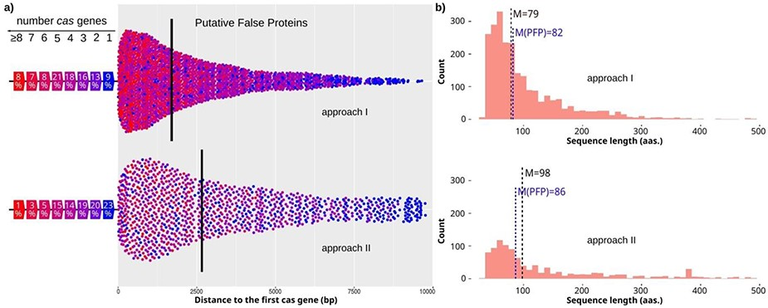
Figure 3. Characteristics of candidates with cas genes nearby. (a) Distances from candidates to the closest cas gene ...
Notes:
Figure 3. Characteristics of candidates with cas genes nearby. (a) Distances from candidates to the closest cas gene for approach I and II (top and bottom, respectively). The color of the dot shows the number of cas genes found close to the candidate. The percentage of candidates found close to a specific number of cas genes is shown on the left. Median value is shown by a vertical line. (b) Length distribution of candidates for approach I and II (top and bottom, respectively). The median value is highlighted for all candidates with one or more cas genes (M), and for the final PFPs (M(PFP) in blue color).
Unless provided in the caption above, the following copyright applies to the content of this slide: © The Author(s) 2020. Published by Oxford University Press.This is an Open Access article distributed under the terms of the Creative Commons Attribution License (http://creativecommons.org/licenses/by/4.0/), which permits unrestricted reuse, distribution, and reproduction in any medium, provided the original work is properly cited.

