Slide 1
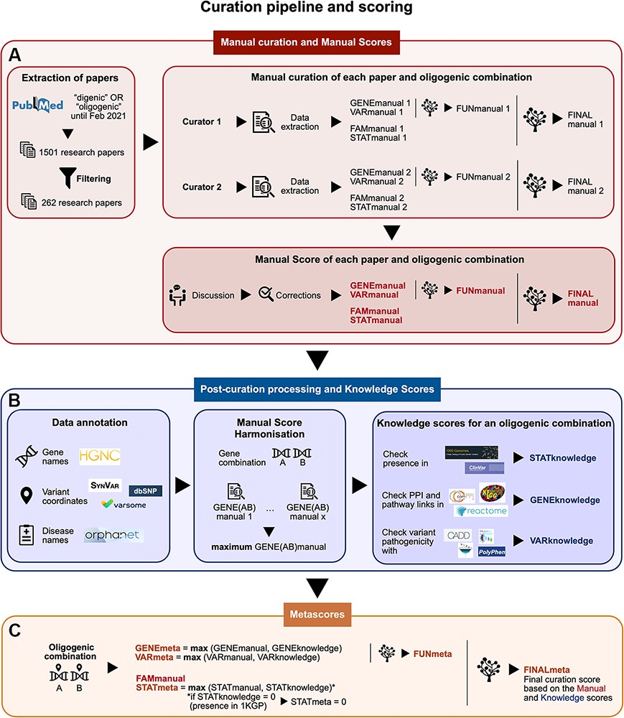
Figure 1. Summary of the curation pipeline for the creation of the (A) Manual scores, (B) Knowledge scores and (C) ...
Notes:
Figure 1. Summary of the curation pipeline for the creation of the (A) Manual scores, (B) Knowledge scores and (C) Metascores for each oligogenic combination. (A) Research articles were selected using the keywords ‘digenic OR oligogenic’ in PubMed (https://pubmed.ncbi.nlm.nih.gov/), leading from a total of 1501 articles to 262 articles after filtering (see Materials and Methods, Supplementary Data, File 1). Two different curators independently extracted information and curated each article, assigning Manual scores. These scores include the FAMmanual, STATmanual, GENEmanual and VARmanual scores. The last two are used in a decision tree to assign the FUNmanual score, while all of the scores are used in another decision tree to create the FINALmanual score (see Materials and Methods, Supplementary Data, File 1). A discussion then took place to reach a consensus for the Manual Scores. All oligogenic variant combinations were evaluated as separate entities with their own evidence, regardless of whether they were described in the same or different articles. (B) The data were then processed to formalize the available information (see Materials and Methods, Supplementary Data, File 1). The disease names were formalized using the Orphanet database (https://www.orpha.net/). The gene names were formalized according to the gene nomenclature guidelines from the HGNC database (33). The variants were processed by the software Synvar (http://goldorak.hesge.ch/synvar/), and the databases Varsome (34) and dbSNP (35), to obtain genomic coordinates. To correct for the literature bias, the GENEmanual score for each gene pair was harmonized among all articles by assigning the maximum GENEmanual found for that gene pair, and all affected scores (FUNmanual and FINALmanual) were recalculated. To compensate for missing information in the articles due to no prior access to current knowledge, Knowledge scores were assigned per oligogenic combination: the STATknowledge score by checking the presence of the oligogenic combination in the 1000 Genomes project (30) and ClinVar (36), the GENEknowledge score by checking the PPI and KEGG (38) or Reactome (39) pathway links of the involved genes and the VARknowledge score by using variant pathogenicity information from different pathogenicity predictors: SIFT (40), MutationTaster2 (41), CADD (42) and Polyphen2 (43). (C) Finally, both Manual and Knowledge scores are combined in order to create the confidence Metascores for each type of evidence STATmeta, GENEmeta and VARmeta scores—by assigning the maximum score found between their corresponding Manual and Knowledge score (see Materials and Methods, Supplementary Data, File 1). One exception occurs in this rule: if the STATknowledge is 0 due to the fact that the combination is found in an individual of the 1000 Genomes project, then it replaces the STATmanual and, therefore, the STATmeta is also 0. The same procedure as in the manual curation is then followed when decision trees were used to define the FUNmeta and FINALmeta scores.
Unless provided in the caption above, the following copyright applies to the content of this slide: © The Author(s) 2022. Published by Oxford University Press.This is an Open Access article distributed under the terms of the Creative Commons Attribution License (https://creativecommons.org/licenses/by/4.0/), which permits unrestricted reuse, distribution, and reproduction in any medium, provided the original work is properly cited.

Slide 2
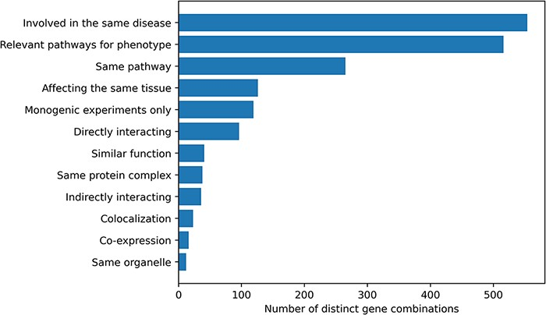
Figure 2. Histogram of the different gene relationship types found between the genes involved in an oligogenic variant ...
Notes:
Figure 2. Histogram of the different gene relationship types found between the genes involved in an oligogenic variant combination. The types of gene relationship were obtained either directly from the articles or from public databases (for the ‘Relevant pathways for phenotype’, ‘Same Pathway’ and ‘Directly Interacting’ relationships). Genes are ‘Involved in the same disease’ if patients with the same phenotype described or referenced in the manuscript carried mutations in those genes, together or independently. Pathway information for each gene was either described in the article or found in the KEGG (38) or Reactome (39) databases and was then manually screened to check if the genes belong to ‘Relevant pathways for the phenotype’ (e.g. glucose metabolism pathway for a diabetic phenotype) or in the ‘Same pathway’. Similarly, genes ‘Affecting the same tissue’ must also be expressed in the same relevant tissue for the phenotype. The ‘Directly interacting’ denotes a PPI, either described in the article or retrieved from the comPPI database (37). It is distinguished from the ‘Same protein complex’ relation where the gene products are considered to only fulfil their function when linked together (e.g. the subunits of a channel). ‘Indirectly interacting’ genes are those whose products indirectly interact with an intermediate protein or are involved in a gene regulation mechanism with other gene products (e.g. transcription factors). ‘Similar function’ indicates that genes have the same function (e.g. motor proteins). ‘Co-localization’ implies a direct overlap of the location of the gene products in the cell (e.g. shown using immunofluorescence), while ‘Same organelle’ implies that the protein products exercise their function in the same organelle (e.g. cilia proteins). The ‘Co-expression’ relationship implies a positive correlation of the mRNA expression of the genes in a temporal fashion shown or referenced in the article. Finally the ‘Monogenic experiments only’ notes the fact that the experimental evidence and the assessment of their pathogenicity were done on the genes independently (e.g. single knockouts).
Unless provided in the caption above, the following copyright applies to the content of this slide: © The Author(s) 2022. Published by Oxford University Press.This is an Open Access article distributed under the terms of the Creative Commons Attribution License (https://creativecommons.org/licenses/by/4.0/), which permits unrestricted reuse, distribution, and reproduction in any medium, provided the original work is properly cited.

Slide 3
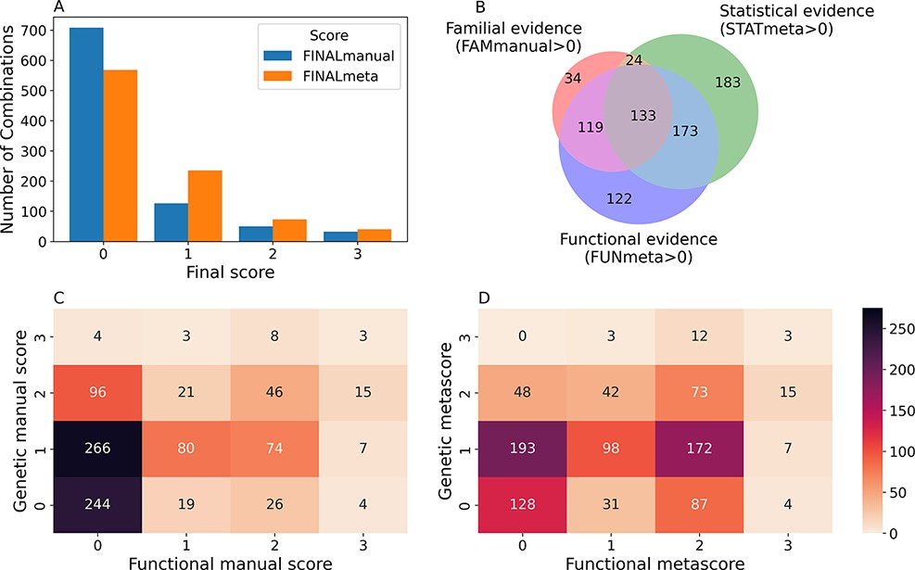
Figure 3. Confidence scores and types of evidence present in the OLIDA combinations. (A) Distribution of the ...
Notes:
Figure 3. Confidence scores and types of evidence present in the OLIDA combinations. (A) Distribution of the FINALmanual and FINALmeta scores. (B) Venn diagram of the number of oligogenic combinations carrying a score of 1 or higher in the different main types of evidence metascores. The 130 oligogenic combinations whose FAMmanual, STATmeta and FUNmeta scores are all 0 are not shown in this diagram. (C) Heatmap of the number of combinations and their confidence functional and genetic scores based on the evidence collected via manual curation (Manual scores) only and (D) when adjusted using the external database information (Meta scores). The genetic score here represents the maximum score between the FAMmanual and STAT (manual or meta for plots a and b, respectively) and the functional score is the FUN (manual or meta for plots a and b, respectively), which are described in the Materials and Methods.
Unless provided in the caption above, the following copyright applies to the content of this slide: © The Author(s) 2022. Published by Oxford University Press.This is an Open Access article distributed under the terms of the Creative Commons Attribution License (https://creativecommons.org/licenses/by/4.0/), which permits unrestricted reuse, distribution, and reproduction in any medium, provided the original work is properly cited.

Slide 4
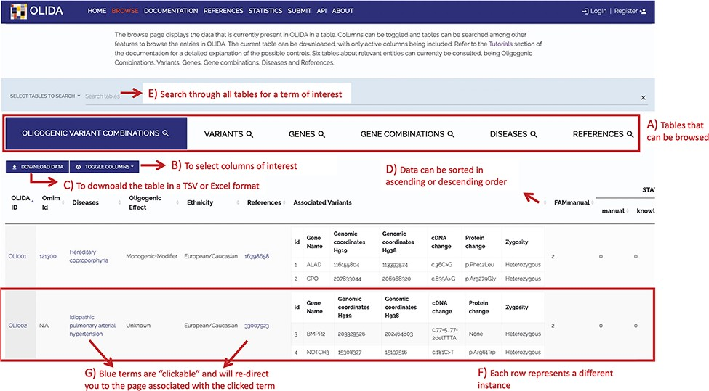
Figure 4. Screenshot of the Browse page of OLIDA with the Oligogenic Variant Combinations selected showing the ...
Notes:
Figure 4. Screenshot of the Browse page of OLIDA with the Oligogenic Variant Combinations selected showing the different possibilities that the database offers. Six different tables can be browsed (A) with the currently selected one shown in blue. (B) The user can then select the columns of interest to be displayed in the table and (C) download the table with the selected columns. (D) In a particular table, data can be sorted in ascending or descending order based on a particular column’s data. (E) A specific term (e.g. gene name and disease name) can be used to search all tables. (F) Each row represents a specific instance and (G) clicking on specific terms in blue will bring the user to the detail page for that specific instance.
Unless provided in the caption above, the following copyright applies to the content of this slide: © The Author(s) 2022. Published by Oxford University Press.This is an Open Access article distributed under the terms of the Creative Commons Attribution License (https://creativecommons.org/licenses/by/4.0/), which permits unrestricted reuse, distribution, and reproduction in any medium, provided the original work is properly cited.

Slide 5
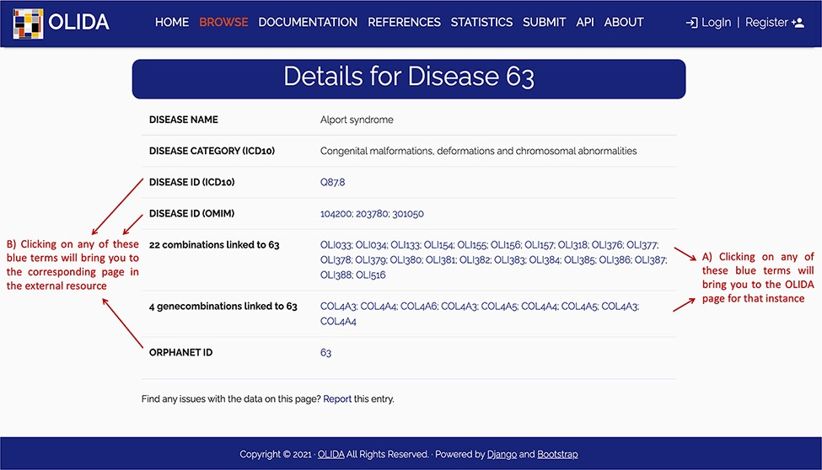
Figure 5. Screenshot of the detailed page for Alport syndrome. This page allows the user to visualize in more detail ...
Notes:
Figure 5. Screenshot of the detailed page for Alport syndrome. This page allows the user to visualize in more detail any instance of the database. It provides (A) links between this instance and the other entities of the database, as well as (B) clickable links towards corresponding pages in external databases where information about this entity was retrieved.
Unless provided in the caption above, the following copyright applies to the content of this slide: © The Author(s) 2022. Published by Oxford University Press.This is an Open Access article distributed under the terms of the Creative Commons Attribution License (https://creativecommons.org/licenses/by/4.0/), which permits unrestricted reuse, distribution, and reproduction in any medium, provided the original work is properly cited.

