Slide 1
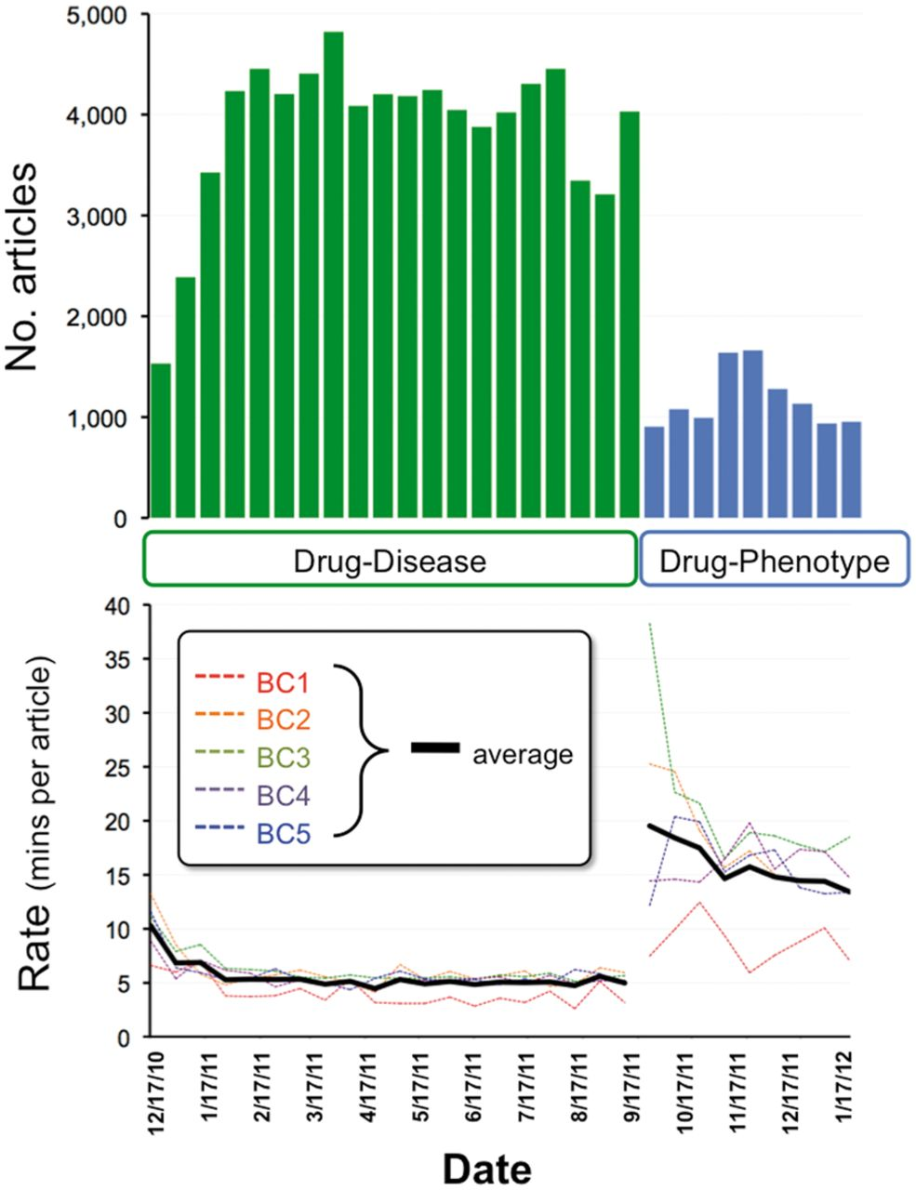
Figure 1. Project metrics. From December 2010 to September 2011, five CTD biocurators reviewed 78 263 articles for ...
Notes:
Figure 1. Project metrics. From December 2010 to September 2011, five CTD biocurators reviewed 78 263 articles for drug–disease information (top graph, green bars). Biocurators curated from just the abstract whenever possible, but examined the full text if necessary to resolve any relevant issues mentioned in the abstract. Review rates for each individual biocurator (bottom graph, BC1–BC5, dotted colored lines) were calculated based upon billing invoices, and the biweekly average of all five biocurators is also shown (solid black line). In September 2011, biocurators transitioned to reviewing 10366 articles for drug–phenotype information (top graph, blue bars). An increase in performance (as reflected by a decrease in rate) is seen as both projects progressed. For drug–disease curation, the average rate initiated at 10.3 min per article (17 December 2010) and ultimately improved to an average rate of 5.5 min per article over the entire period. For drug–phenotype curation, the average initial rate was 19.5 min per article (17 September 2011), improving to 13.4 min per article (13 January 2012), with an aggregate average rate of 15.9 min per article over the period.
Unless provided in the caption above, the following copyright applies to the content of this slide: © The Author(s) 2013. Published by Oxford University Press.This is an Open Access article distributed under the terms of the Creative Commons Attribution License (http://creativecommons.org/licenses/by/3.0/), which permits unrestricted reuse, distribution, and reproduction in any medium, provided the original work is properly cited.

Slide 2
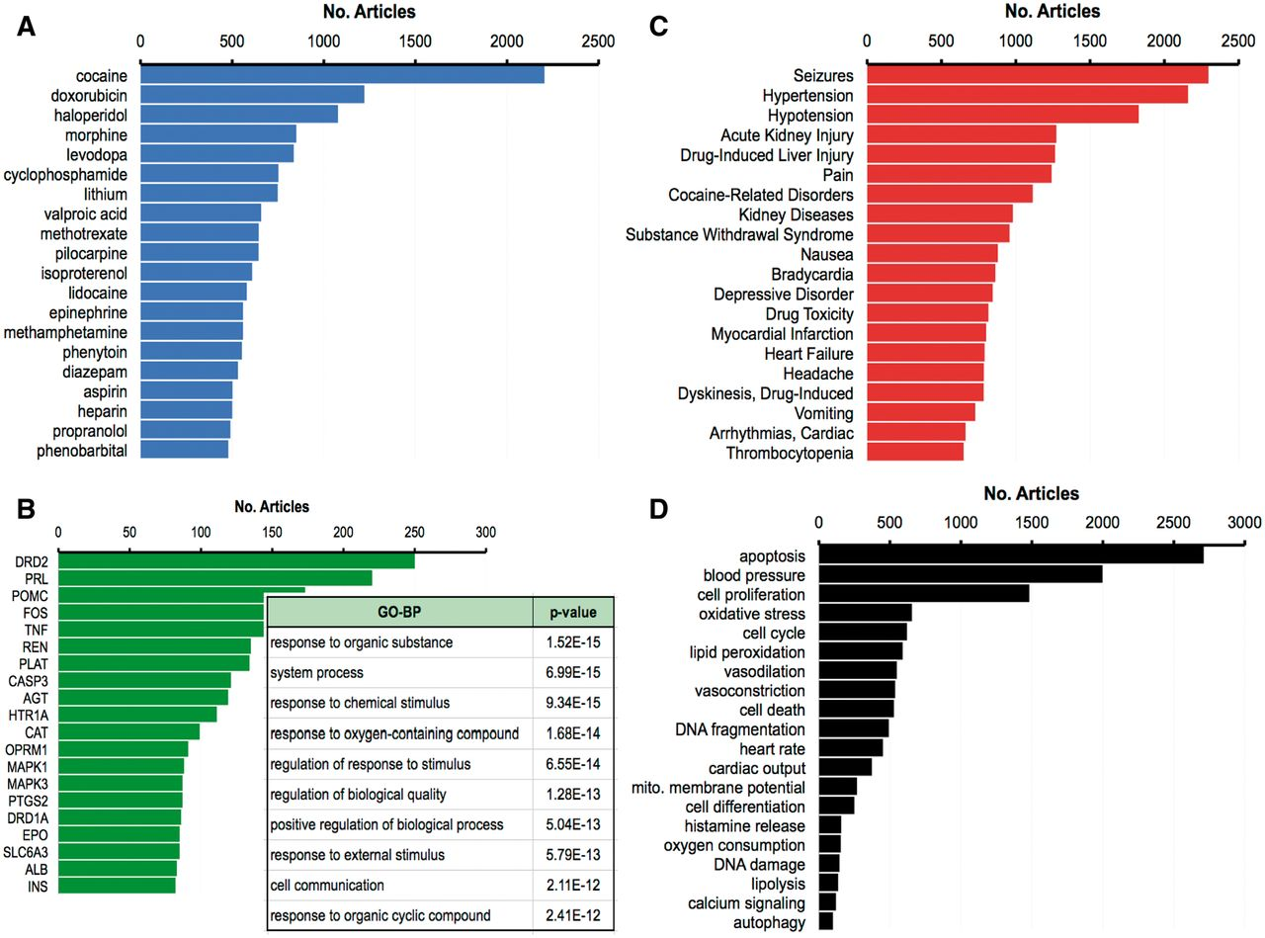
Figure 2. Top 20 curated terms. The 20 most frequently curated chemicals (A, blue), genes (B, green) and diseases (C, ...
Notes:
Figure 2. Top 20 curated terms. The 20 most frequently curated chemicals (A, blue), genes (B, green) and diseases (C, red) from the drug–disease corpus, as measured by the number of articles from whence the term was curated, out of 51 884 total curated articles for this corpus. The inset in (B) lists the 10 most significantly enriched GO-BP and their corrected p-value (Bonferroni multiple testing adjustment) for the top 20 genes. (D) The 20 most frequently curated phenotypes (black) from the drug–phenotype corpus (out of a total of 9646 curated articles).
Unless provided in the caption above, the following copyright applies to the content of this slide: © The Author(s) 2013. Published by Oxford University Press.This is an Open Access article distributed under the terms of the Creative Commons Attribution License (http://creativecommons.org/licenses/by/3.0/), which permits unrestricted reuse, distribution, and reproduction in any medium, provided the original work is properly cited.

Slide 3
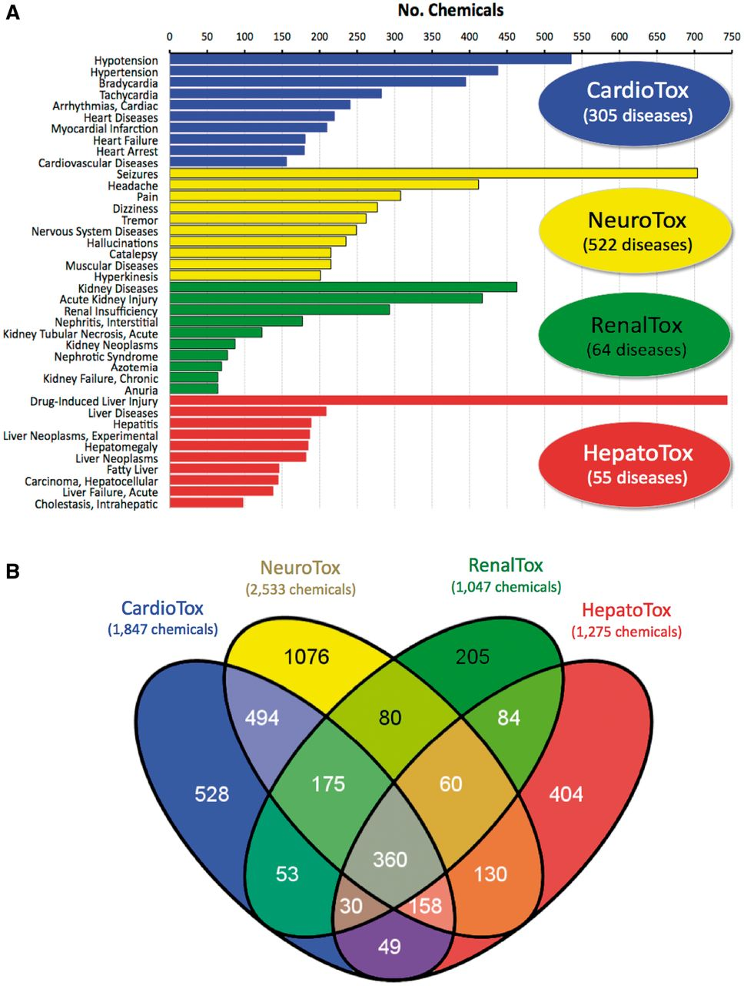
Figure 3. Diseases and chemicals for four system toxicity profiles. (A) The top 10 curated diseases are ranked by the ...
Notes:
Figure 3. Diseases and chemicals for four system toxicity profiles. (A) The top 10 curated diseases are ranked by the number of chemicals curated to each disease for cardiovascular toxicity (CardioTox, blue; 305 diseases), neurological toxicity (NeuroTox, yellow; 522 diseases), kidney toxicity (RenalTox, green; 64 diseases) and liver toxicity (HepatoTox, red; 55 diseases). (B) Venn diagram of 3 886 chemicals associated with CardioTox (blue; 1847 chemicals), NeuroTox (yellow; 2533 chemicals), RenalTox (green; 1047 chemicals) and HepatoTox (red; 1275 chemicals). There are 360 chemicals (center gray subset) common to all four systems.
Unless provided in the caption above, the following copyright applies to the content of this slide: © The Author(s) 2013. Published by Oxford University Press.This is an Open Access article distributed under the terms of the Creative Commons Attribution License (http://creativecommons.org/licenses/by/3.0/), which permits unrestricted reuse, distribution, and reproduction in any medium, provided the original work is properly cited.

Slide 4
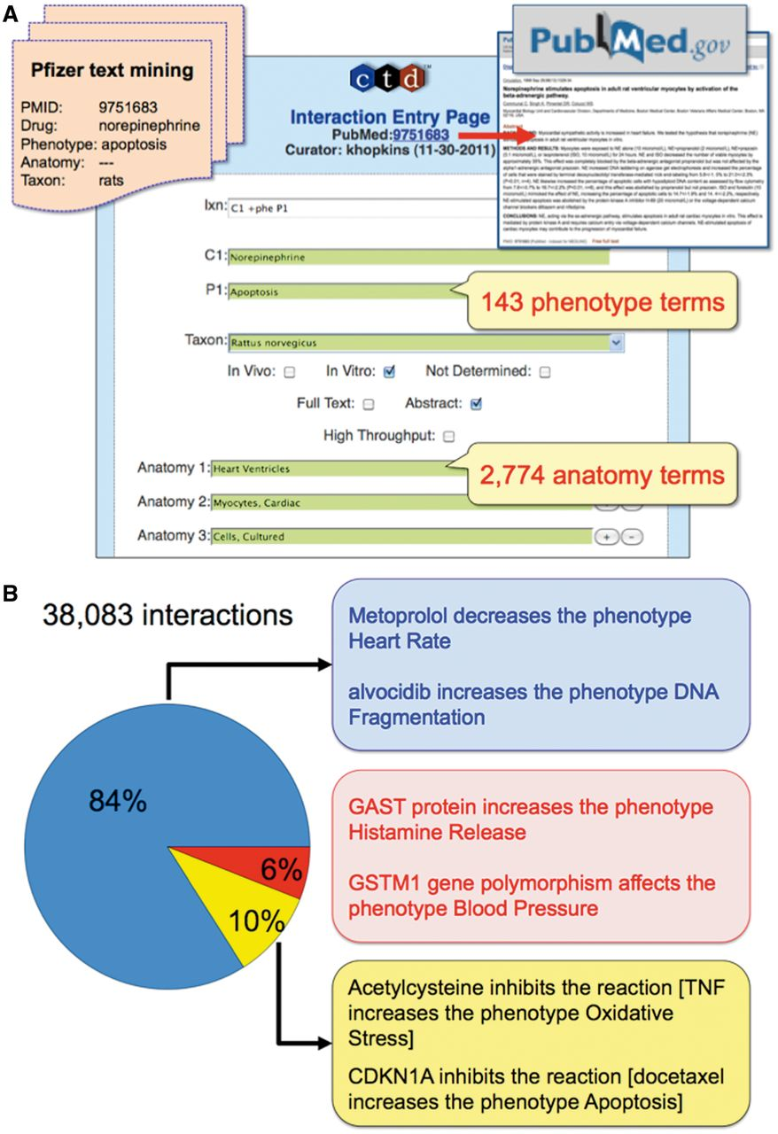
Figure 4. CTD’s phenotype curation module. (A) Pfizer provided CTD with 10 366 articles text mined for a ...
Notes:
Figure 4. CTD’s phenotype curation module. (A) Pfizer provided CTD with 10 366 articles text mined for a drug-of-interest, phenotype, anatomy and taxon (orange file, upper-left corner). Biocurators entered each article’s PMID into the CTD Curation Tool and retrieved the PubMed abstract for curatorial review (red arrow and box, upper-right corner). Biocurators curated from just the abstract whenever possible, but examined the full text if necessary to resolve any relevant issues mentioned in the abstract. Drug–phenotype interactions were generated using CTD’s structured notation, codes and controlled vocabularies in the Curation Tool (blue panel). In this prototype, 143 phenotype terms and 2774 anatomy terms were available. Here, the biocurator coded an interaction (Ixn field) describing how the drug norepinephrine (C1 field) resulted in increased apoptosis (P1 field) using an in vitro system from rats (Taxon field) of cultured ventricular myocytes (Anatomy 1–3 fields). The Curation Tool validates terms entered by the biocurator in real-time, and the green color of the text boxes indicates the terms are valid for curation. (B) Examples of CTD’s curated phenotype interactions. Of the total 38 083 interactions, 84% describe chemical–phenotype interactions (blue box), 6% gene–phenotype interactions (red box) and 10% complex chemical–gene–phenotype interactions (yellow box).
Unless provided in the caption above, the following copyright applies to the content of this slide: © The Author(s) 2013. Published by Oxford University Press.This is an Open Access article distributed under the terms of the Creative Commons Attribution License (http://creativecommons.org/licenses/by/3.0/), which permits unrestricted reuse, distribution, and reproduction in any medium, provided the original work is properly cited.

Slide 5
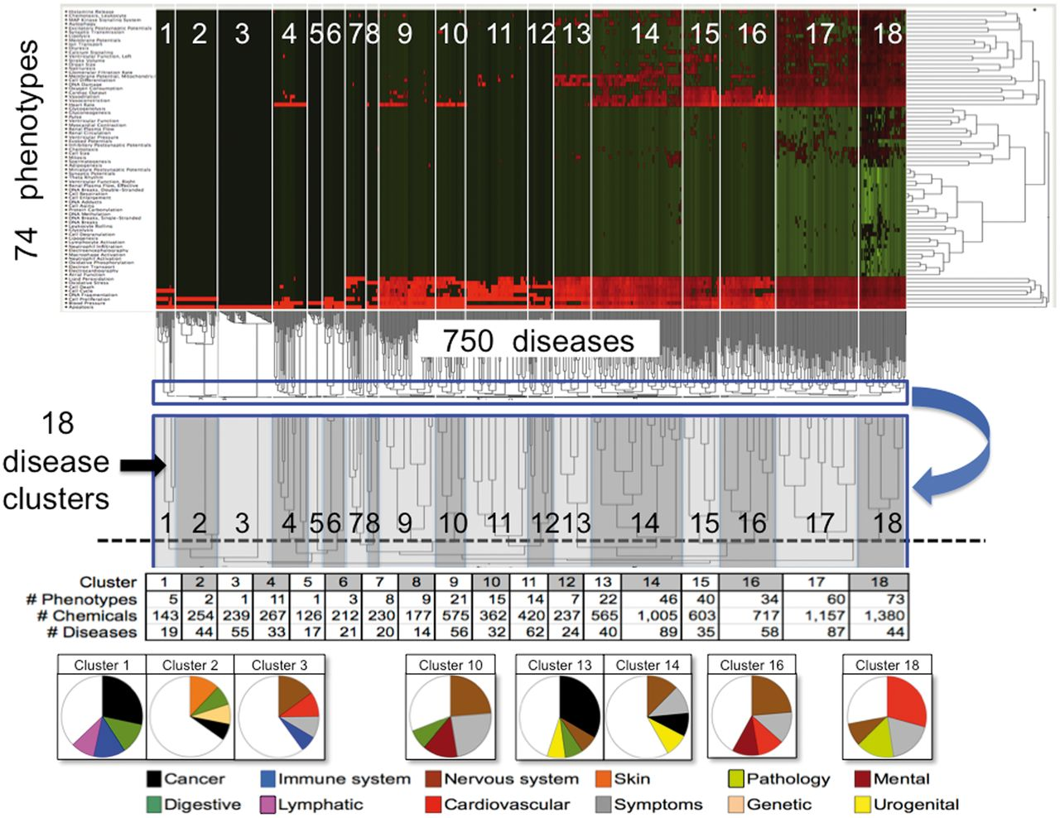
Figure 5. CTD phenotypes inferred to diseases through shared chemicals. A matrix of 74 phenotypes (rows) by 750 ...
Notes:
Figure 5. CTD phenotypes inferred to diseases through shared chemicals. A matrix of 74 phenotypes (rows) by 750 diseases (columns) was constructed where each cell represented the number of shared chemicals. The matrix was analysed by two-dimensional hierarchical clustering and visualized as a heatmap where the normalized number of shared chemicals are colored (green = low; black = medium; red = high). The similarities among the number of shared chemicals for diseases across all phenotypes are shown in the dendrogram beneath the heatmap, where the lengths of the lines are inversely proportional to the similarity (i.e., short = highly similar, long = dissimilar). An enlargement (blue boxes, blue arrow) shows how the disease dendrogram was trimmed to select 18 disease clusters (dotted line, with clusters numbered), and these boundaries are also represented on the heatmap (numbered white boxes). Below, the number of unique phenotypes, chemicals and diseases are charted for each cluster. In pie charts at the very bottom, predominant disease classes for some of the clusters are shown (only the top four disease classes are graphed). For example, of the 19 diseases in cluster 1, 28% of them represent cancers, 13% digestive system diseases, 13% immune system diseases and 9% lymphatic diseases. To the right of the heatmap, the similarities among the number of shared chemicals for phenotypes across all diseases are also shown in another dendrogram, where the lengths of the lines are inversely proportional to the similarity.
Unless provided in the caption above, the following copyright applies to the content of this slide: © The Author(s) 2013. Published by Oxford University Press.This is an Open Access article distributed under the terms of the Creative Commons Attribution License (http://creativecommons.org/licenses/by/3.0/), which permits unrestricted reuse, distribution, and reproduction in any medium, provided the original work is properly cited.

Slide 6
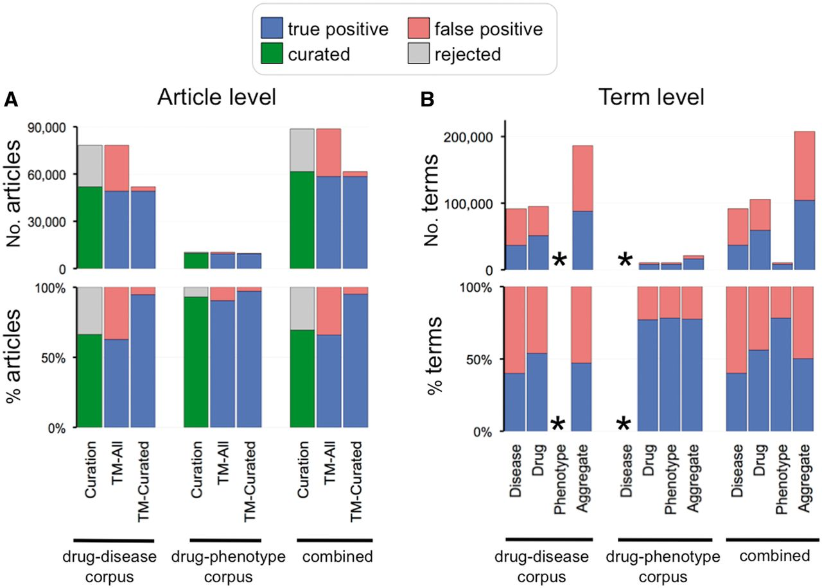
Figure 6. Curation and text-mining metrics. (A) Curation and text-mining metrics at the article level. The top graph ...
Notes:
Figure 6. Curation and text-mining metrics. (A) Curation and text-mining metrics at the article level. The top graph shows the number of articles and the bottom graph shows the percentage for each corpus (drug–disease, drug–phenotype and combined). Curation metrics are measured by the number of curated articles (green bars) vs. number of rejected articles (gray bars). Text-mining metrics are measured by true positives (blue bars) vs. false positives (red bars) and measured against all the articles in the corpus (TM-All) as well as against solely the curated articles in the corpus (TM-Curated). (B) Text-mining metrics at the term level. The top graph shows the number of text-mined terms and the bottom graph shows the percentage for each term category (disease, drug, phenotype and aggregate of all the text-mined terms) from each corpus. Phenotype terms were not text mined for the drug–disease corpus and disease terms were not text mined for the drug–phenotype corpus (indicated by asterisks).
Unless provided in the caption above, the following copyright applies to the content of this slide: © The Author(s) 2013. Published by Oxford University Press.This is an Open Access article distributed under the terms of the Creative Commons Attribution License (http://creativecommons.org/licenses/by/3.0/), which permits unrestricted reuse, distribution, and reproduction in any medium, provided the original work is properly cited.

Slide 7
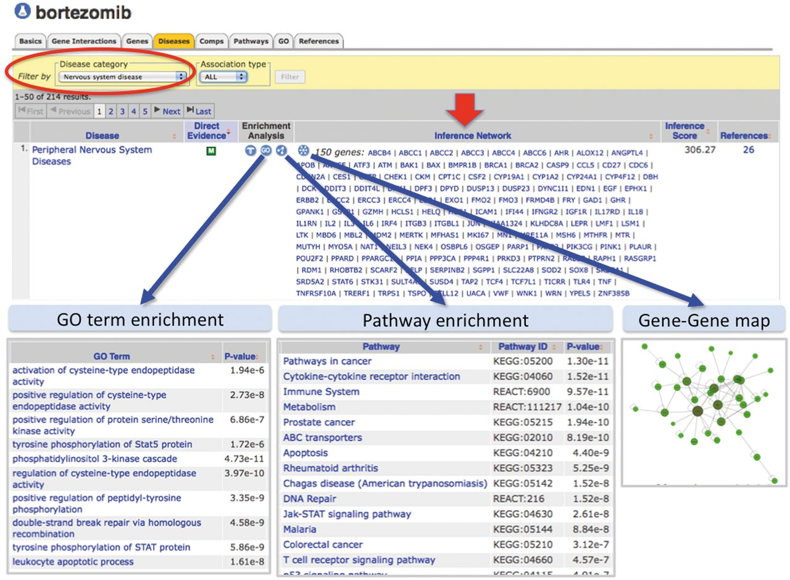
Figure 7. Enhanced content helps develop testable hypotheses for known drug–disease events. CTD’s page for the drug ...
Notes:
Figure 7. Enhanced content helps develop testable hypotheses for known drug–disease events. CTD’s page for the drug bortezomib is selected for ‘Diseases’ data (orange tab), and the results have been filtered for the category ‘Nervous system disease’ (red circle) to focus on NeuroTox events. Bortezomib is inferred to peripheral neuropathy by 150 genes (red arrow, ‘Inference Network’). Embedded web tools automatically generate lists of enriched GO terms, pathway annotations and gene–gene interaction maps (blue arrows).
Unless provided in the caption above, the following copyright applies to the content of this slide: © The Author(s) 2013. Published by Oxford University Press.This is an Open Access article distributed under the terms of the Creative Commons Attribution License (http://creativecommons.org/licenses/by/3.0/), which permits unrestricted reuse, distribution, and reproduction in any medium, provided the original work is properly cited.

