Slide 1
Figure 1. Dependency parse for the sentence ‘For the ACS [Acute Coronary Syndromes], the duration of the IV depends on ...
Notes:
Figure 1. Dependency parse for the sentence ‘For the ACS [Acute Coronary Syndromes], the duration of the IV depends on the way the ACS should be treated: it can last a maximum of 72 h for patients who need to take drugs’ [In the original French: ‘Pour les SCA, la durée de la perfusion dépend de la manière dont le SCA doit être traité: elle peut durer jusqu’à 72 heures au maximum chez les patients devant recevoir des médicaments.’].
Unless provided in the caption above, the following copyright applies to the content of this slide: © The Author(s) 2016. Published by Oxford University Press.This is an Open Access article distributed under the terms of the Creative Commons Attribution License (http://creativecommons.org/licenses/by/4.0/), which permits unrestricted reuse, distribution, and reproduction in any medium, provided the original work is properly cited.

Slide 2
Figure 2. ZombiLingo Interface [Instruction: ‘Find the head of what is introduced by the highlighted preposition’). ...
Notes:
Figure 2. ZombiLingo Interface [Instruction: ‘Find the head of what is introduced by the highlighted preposition’). Sentence: ‘For the ACS [Acute Coronary Syndromes], the duration of the IV depends on the way the ACS should be treated: it can last a maximum of 72 h for patients who need to take drugs’, the right answer is ‘perfusion’ (IV)].
Unless provided in the caption above, the following copyright applies to the content of this slide: © The Author(s) 2016. Published by Oxford University Press.This is an Open Access article distributed under the terms of the Creative Commons Attribution License (http://creativecommons.org/licenses/by/4.0/), which permits unrestricted reuse, distribution, and reproduction in any medium, provided the original work is properly cited.

Slide 3
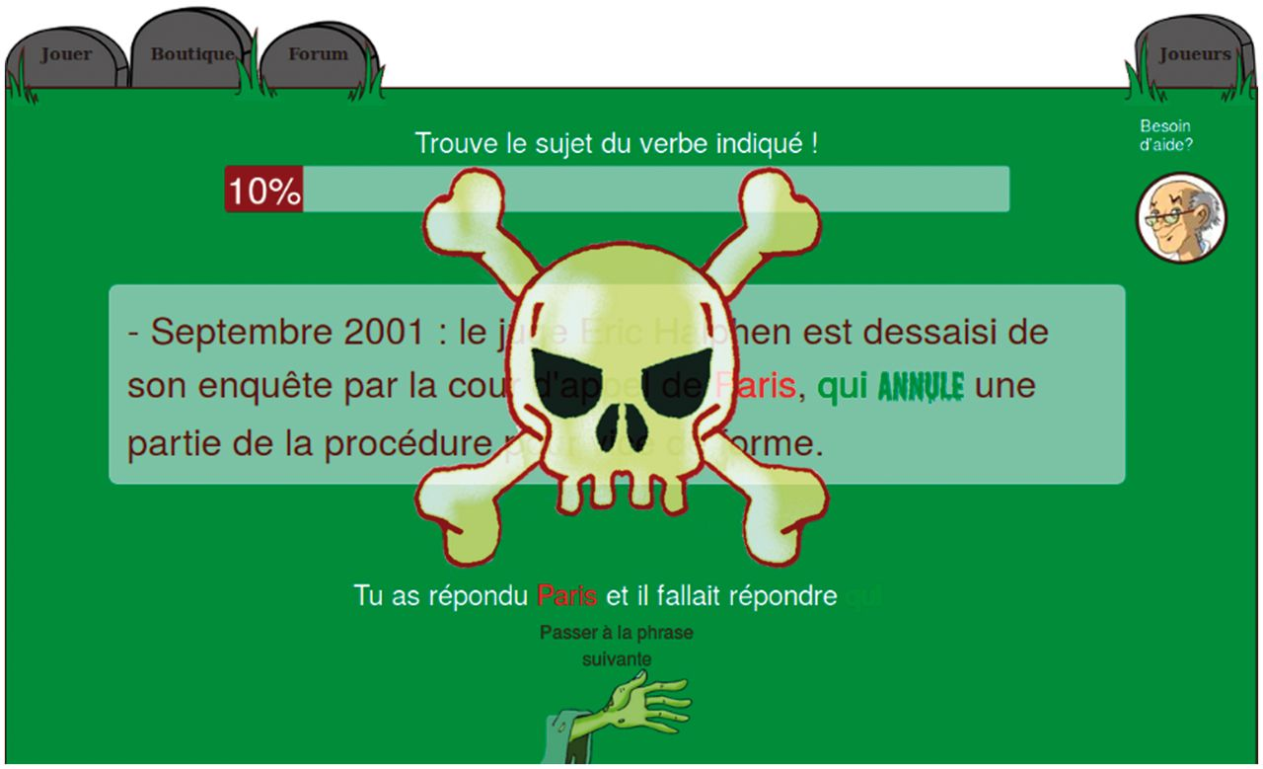
Figure 3. ZombiLingo Training Phase: Correction of a Wrong Answer [Instruction: ‘Find the subject of the highlighted ...
Notes:
Figure 3. ZombiLingo Training Phase: Correction of a Wrong Answer [Instruction: ‘Find the subject of the highlighted verb’). Correction: ‘You selected Paris while you should have answered qui (who)’].
Unless provided in the caption above, the following copyright applies to the content of this slide: © The Author(s) 2016. Published by Oxford University Press.This is an Open Access article distributed under the terms of the Creative Commons Attribution License (http://creativecommons.org/licenses/by/4.0/), which permits unrestricted reuse, distribution, and reproduction in any medium, provided the original work is properly cited.

Slide 4
Figure 4. Screenshot of Interface for Judging Gene-Mutation Relations.
Notes:
Figure 4. Screenshot of Interface for Judging Gene-Mutation Relations.
Unless provided in the caption above, the following copyright applies to the content of this slide: © The Author(s) 2016. Published by Oxford University Press.This is an Open Access article distributed under the terms of the Creative Commons Attribution License (http://creativecommons.org/licenses/by/4.0/), which permits unrestricted reuse, distribution, and reproduction in any medium, provided the original work is properly cited.

Slide 5
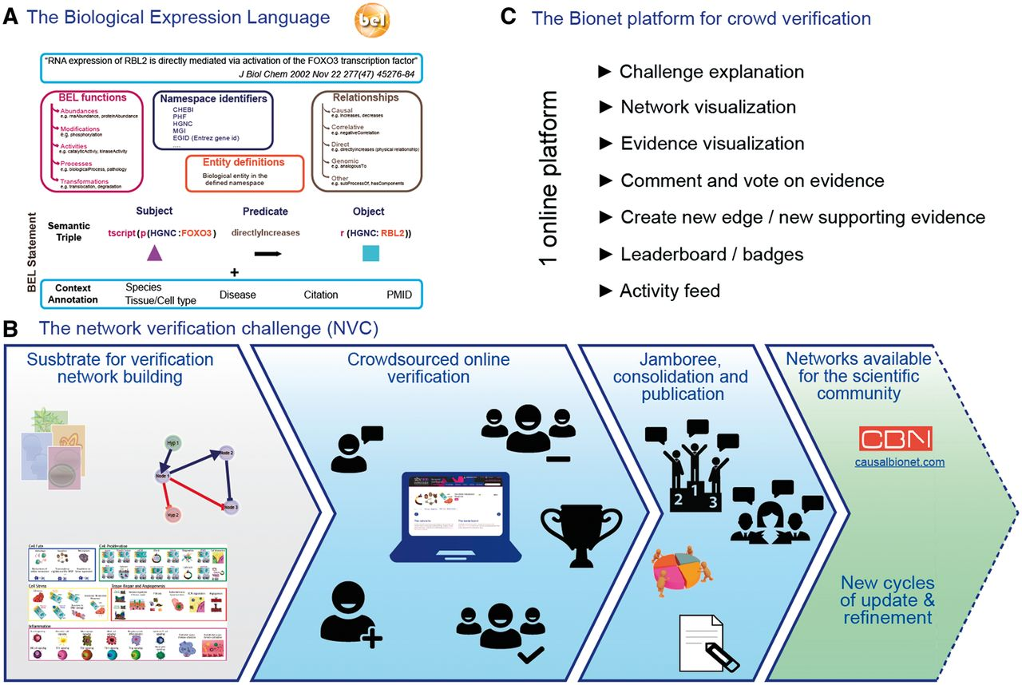
Figure 5. sbv IMPROVER framework.
Notes:
Figure 5. sbv IMPROVER framework.
Unless provided in the caption above, the following copyright applies to the content of this slide: © The Author(s) 2016. Published by Oxford University Press.This is an Open Access article distributed under the terms of the Creative Commons Attribution License (http://creativecommons.org/licenses/by/4.0/), which permits unrestricted reuse, distribution, and reproduction in any medium, provided the original work is properly cited.

