Slide 1
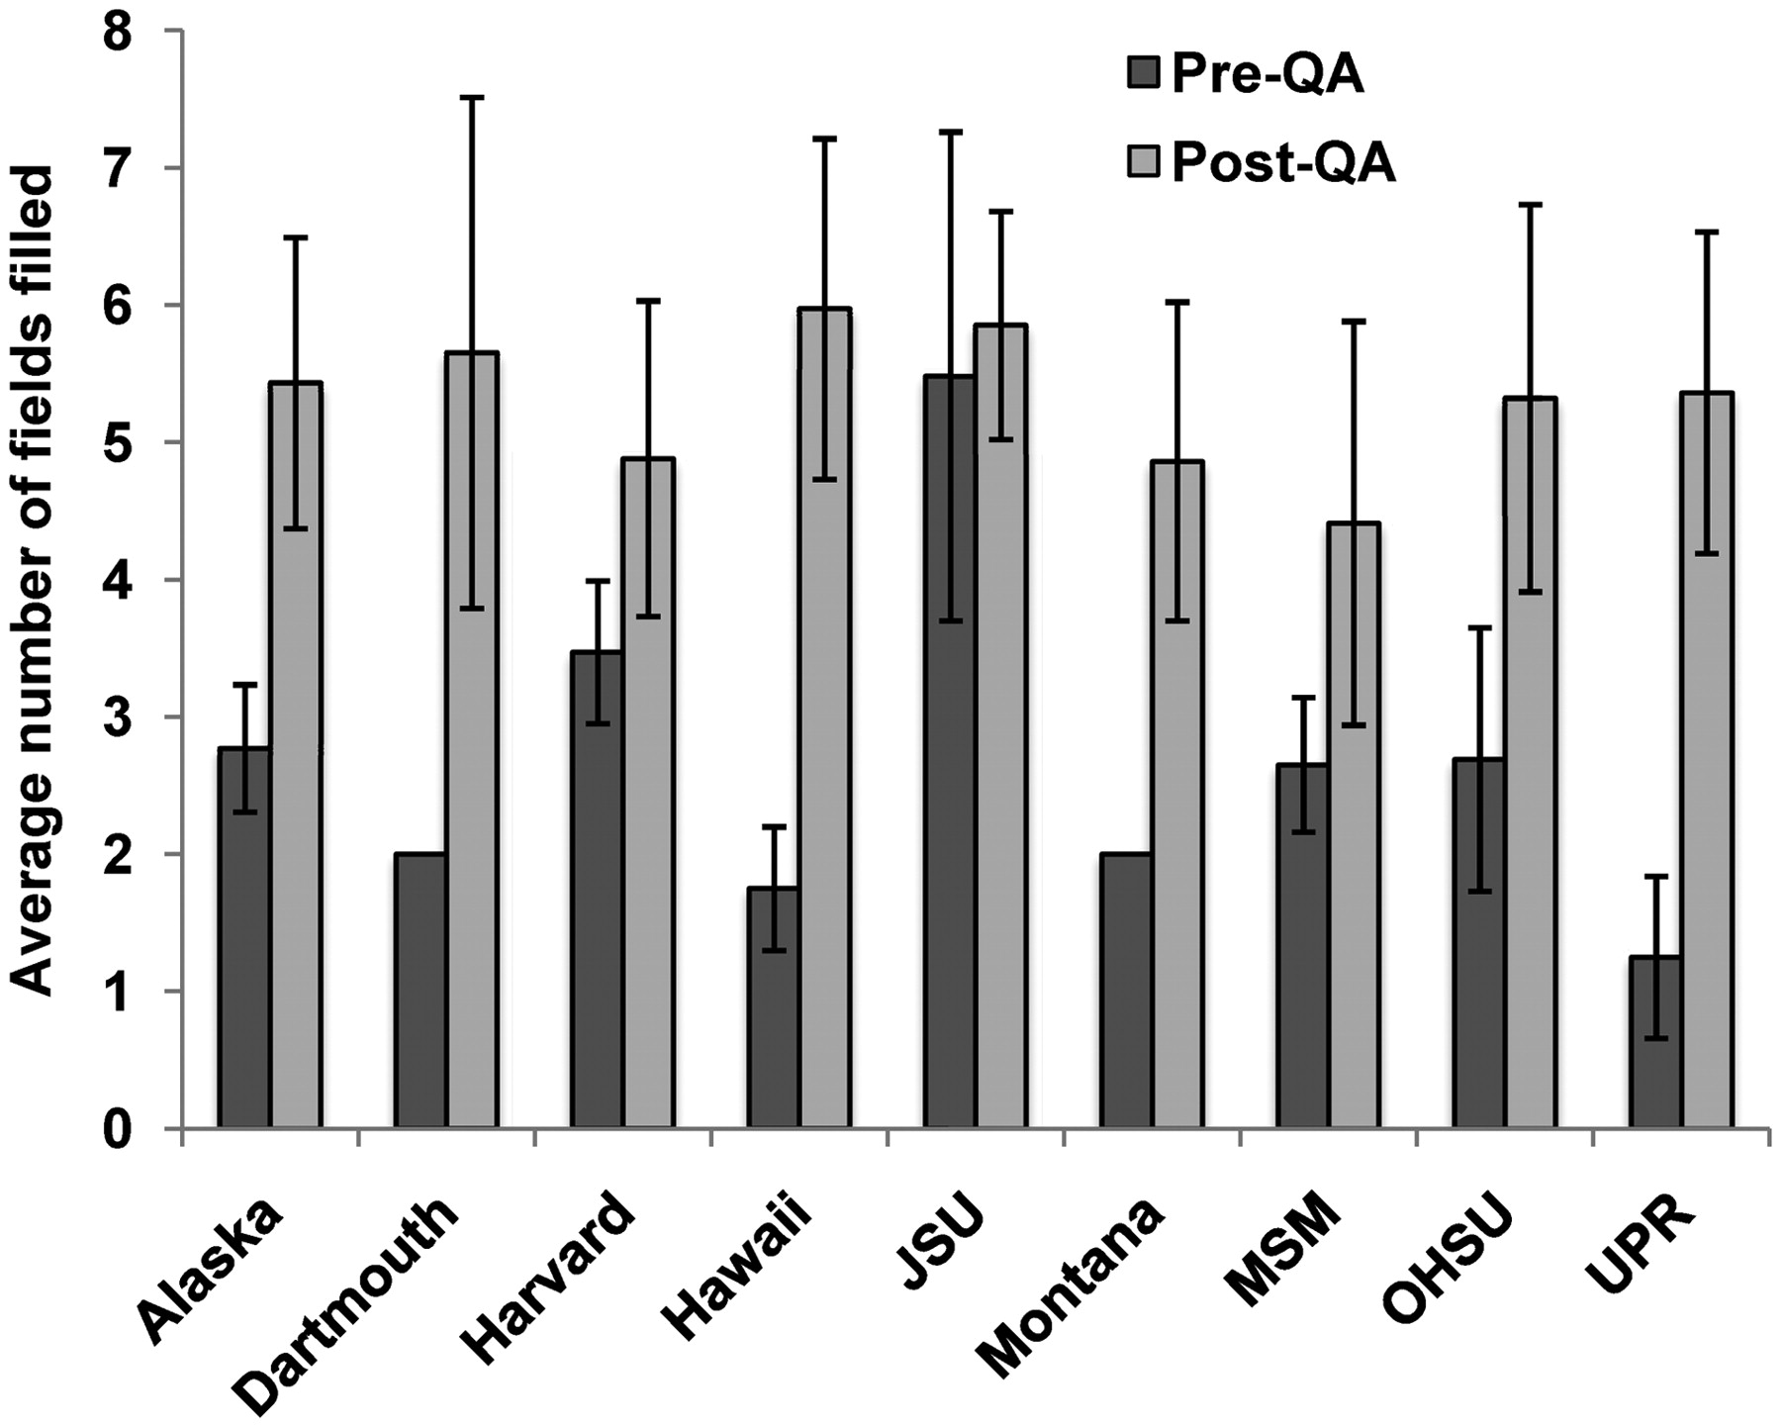
Figure 4. Average number of fields recorded for instruments before and after a QA effort. There was a 1.1–4.3-fold ...
Notes:
Figure 4. Average number of fields recorded for instruments before and after a QA effort. There was a 1.1–4.3-fold increase in the average number of filled fields after the QA effort. Error bars indicate standard deviation.
Unless provided in the caption above, the following copyright applies to the content of this slide: © The Author(s) 2012. Published by Oxford University Press.This is an Open Access article distributed under the terms of the Creative Commons Attribution Non-Commercial License (http://creativecommons.org/licenses/by-nc/3.0), which permits unrestricted non-commercial use, distribution, and reproduction in any medium, provided the original work is properly cited.

