Slide 1
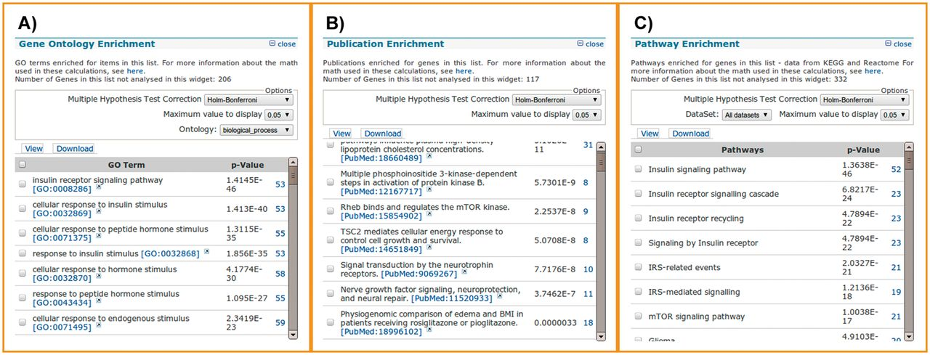
Figure 3. List analysis tools. List analysis pages contain a number of graphical and statistical analysis tools ...
Notes:
Figure 3. List analysis tools. List analysis pages contain a number of graphical and statistical analysis tools (‘widgets’). Here, we show examples of the tools available, using 450 randomly selected genes with 50 insulin receptor signalling pathway genes spiked in. (A) The GO enrichment analysis correctly identifies the 50 genes involved in the insulin receptor signalling pathway, along with 3 others that happened to be in the random gene list. (B) The publication enrichment widget identifies a number of articles describing members of the insulin signalling cascade, such as PI3 kinase and mTOR. (C) The pathway enrichment widget identifies the insulin signalling pathway from KEGG as the top result. This highlights how list analysis can be used to identify relevant target genes from a larger original gene set, for instance, one derived from a gene expression study.
Unless provided in the caption above, the following copyright applies to the content of this slide: © Crown copyright 2013.

