Slide 1
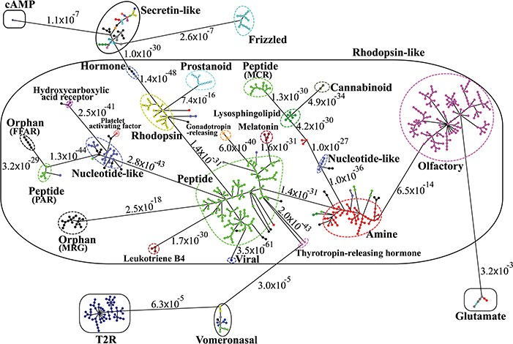
Figure 4 Minimum spanning tree diagram of the GPCR network in the dataset GPCR2841 (outliers not shown). Each circle ...
Notes:
Figure 4 Minimum spanning tree diagram of the GPCR network in the dataset GPCR2841 (outliers not shown). Each circle represents an MSC cluster, which is colored according to the functions of its constituents. The lengths of the edges are not proportional to their distances, but the distances between subfamilies and classes are labeled to visualize their sequence similarities.
Unless provided in the caption above, the following copyright applies to the content of this slide: © The Author(s) 2019. Published by Oxford University Press.This is an Open Access article distributed under the terms of the Creative Commons Attribution License (http://creativecommons.org/licenses/by/4.0/), which permits unrestricted reuse, distribution, and reproduction in any medium, provided the original work is properly cited.

