Slide 1
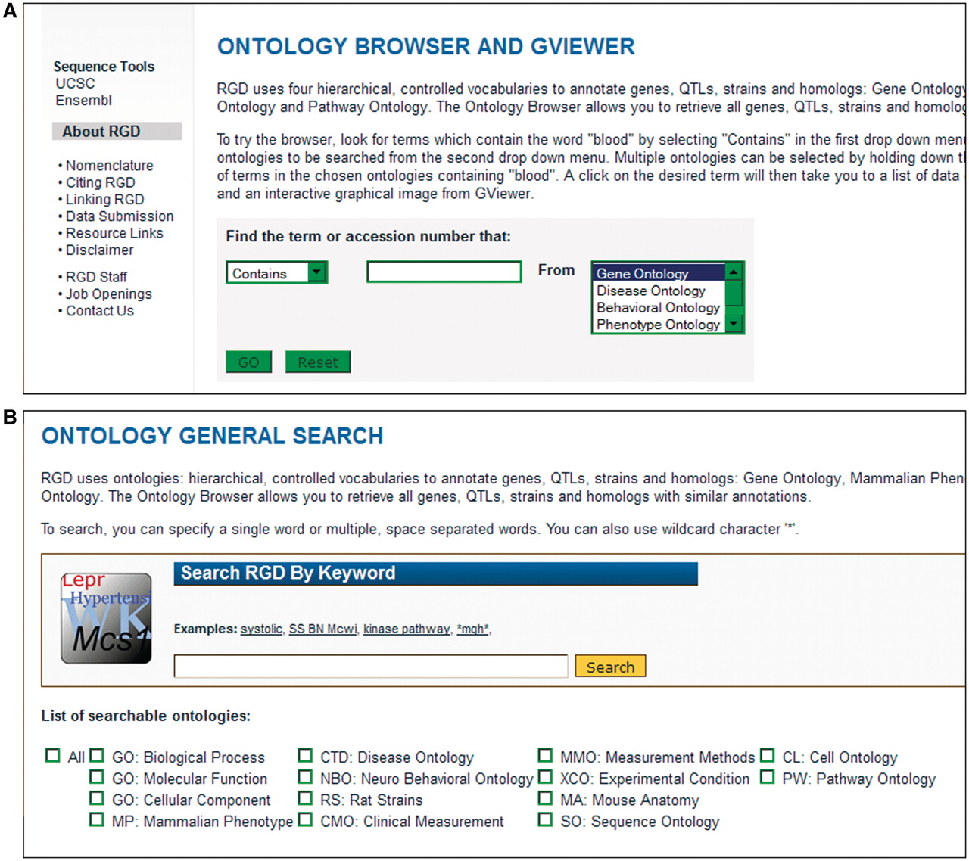
Figure 1. Old and new ontology search. (A) Old ontology search with choice of ‘Contains, Equals, Begins With, or Ends ...
Notes:
Figure 1. Old and new ontology search. (A) Old ontology search with choice of ‘Contains, Equals, Begins With, or Ends With’ for searching terms in one ontology at a time. (B) New ontology search interface with options of searching all or a combination of 14 different ontologies/vocabularies for terms, synonyms or accession numbers.
Unless provided in the caption above, the following copyright applies to the content of this slide: © The Author(s) 2012. Published by Oxford University Press.This is an Open Access article distributed under the terms of the Creative Commons Attribution Non-Commercial License (http://creativecommons.org/licenses/by-nc/3.0), which permits unrestricted non-commercial use, distribution, and reproduction in any medium, provided the original work is properly cited.

