Slide 1
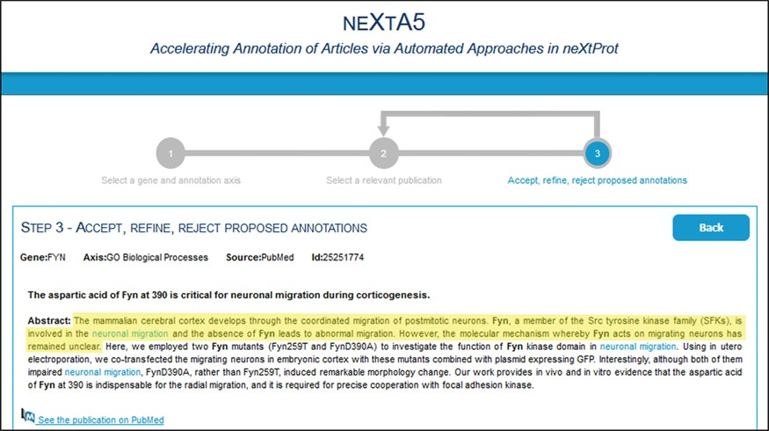
Figure 5 neXtA₅ user interface for curation. One of the guidelines for the curators to select relevant ...
Notes:
Figure 5 neXtA5 user interface for curation. One of the guidelines for the curators to select relevant documents was to not consider statements from titles and from the introductory part of the abstract. Here, the introduction of the abstract of (37) related to FYN function (BP axis) is highlighted in yellow.
Unless provided in the caption above, the following copyright applies to the content of this slide: © The Author(s) 2018. Published by Oxford University Press.This is an Open Access article distributed under the terms of the Creative Commons Attribution License (http://creativecommons.org/licenses/by/4.0/), which permits unrestricted reuse, distribution, and reproduction in any medium, provided the original work is properly cited.

