Slide 1
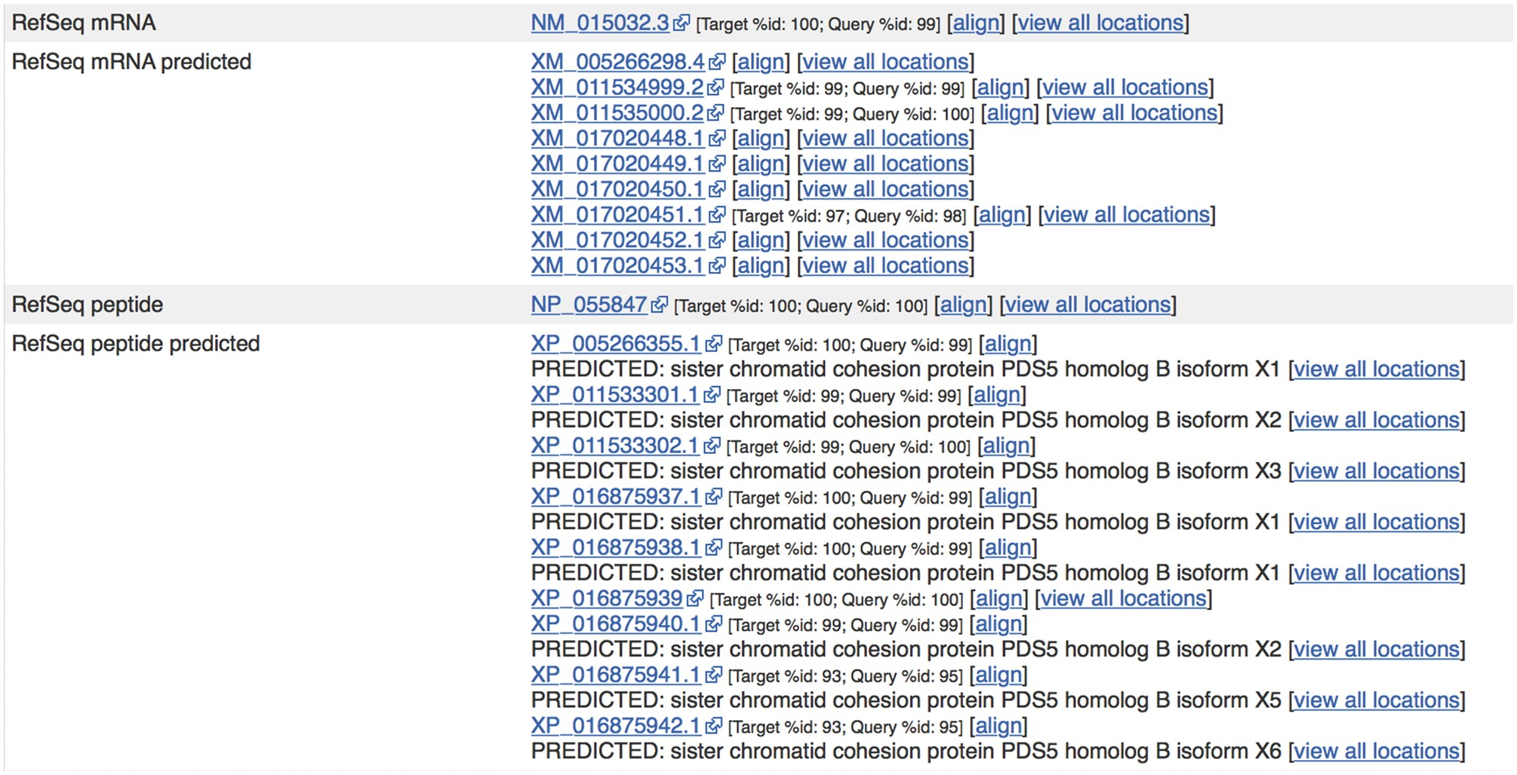
Figure 5. Sequences from external sources are aligned against Ensembl features. For ENST00000315596.14 ...
Notes:
Figure 5. Sequences from external sources are aligned against Ensembl features. For ENST00000315596.14 (http://e87.ensembl.org/Homo_sapiens/Transcript/Similarity?db=core;g=ENSG00000083642;r=13:1-50000000;t=ENST00000315596), a number of predicted RefSeq peptide sequences have been aligned with small mismatches. The curated RefSeq peptide NP_055847 aligns perfectly but the corresponding mRNA sequence, NM_015032.3, does not, indicating that there is a difference in the UTR sequence of this transcript.
Unless provided in the caption above, the following copyright applies to the content of this slide: © The Author(s) 2017. Published by Oxford University Press.This is an Open Access article distributed under the terms of the Creative Commons Attribution License (http://creativecommons.org/licenses/by/4.0/), which permits unrestricted reuse, distribution, and reproduction in any medium, provided the original work is properly cited.

