Slide 1
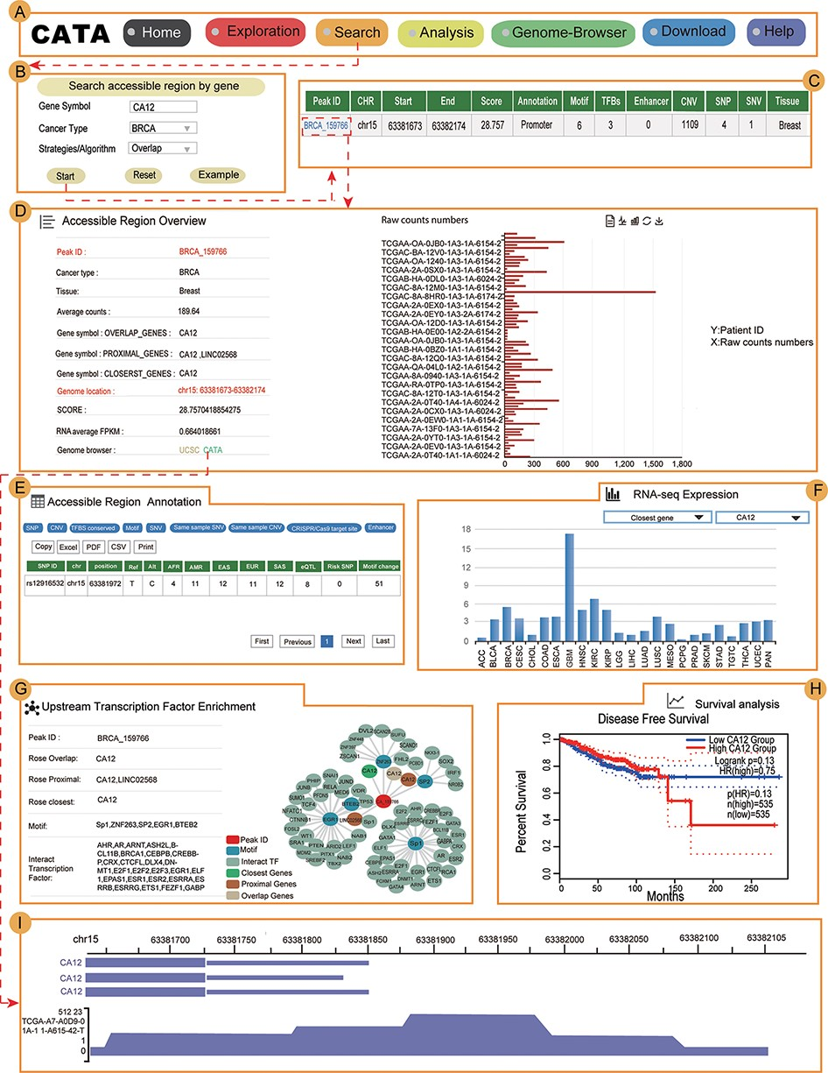
Figure 4. Validation results associated with CA12 in breast cancer. (A) The navigation bar of CATA. (B) Input and ...
Notes:
Figure 4. Validation results associated with CA12 in breast cancer. (A) The navigation bar of CATA. (B) Input and parameters of ‘Search accessible regions by gene’. (C) The brief annotation information about the detailed genetic information in chromatin-accessible regions of CA12, including SNP, motif, CNV, SNV, TFBS, etc. The score is a score of chromatin accessibility provided by TCGA. The higher the score, the more open the chromatin. (D) In accessible region overview, annotation CAR information of CA12 CAR regions including raw count numbers, presented by bar plots and some summary information (overlap genes, proximal genes, closest genes, genome location, score of chromatin-accessible regions, RNA average FPKM) about the accessible region of interest gene. The y-axis is the patient ID provided by TCGA. The x-axis is the count number that is the raw read count of ATAC-seq in the Peak ID. (E) In accessible region annotation, annotation CAR information of CAR regions are provided in tabular form, including SNP, motif, CNV, SNV, TFBS, etc. (F) The visualization of RNA expression of CA12. (G) Upstream TF enrichment of the CA12 graph. (H) The disease-free survival analysis of CA12. (I) Visualization of the CA12 chromatin-accessible region.
Unless provided in the caption above, the following copyright applies to the content of this slide: © The Author(s) 2022. Published by Oxford University Press.This is an Open Access article distributed under the terms of the Creative Commons Attribution License (https://creativecommons.org/licenses/by/4.0/), which permits unrestricted reuse, distribution, and reproduction in any medium, provided the original work is properly cited.

