Slide 1
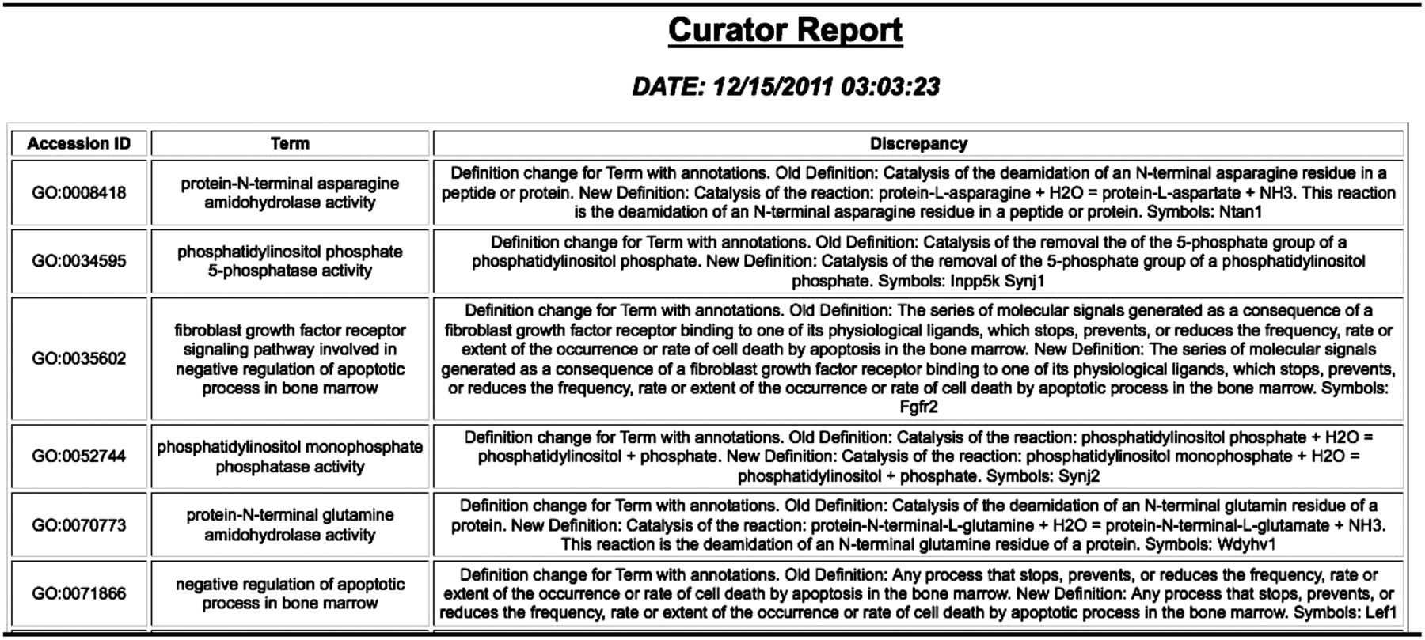
Figure 9. GO change log report showing changes to the GO and genes with annotations using the term that may need to be ...
Notes:
Figure 9. GO change log report showing changes to the GO and genes with annotations using the term that may need to be looked at.
Unless provided in the caption above, the following copyright applies to the content of this slide: © The Author(s) 2012. Published by Oxford University Press.This is an Open Access article distributed under the terms of the Creative Commons Attribution License (http://creativecommons.org/licenses/by-nc/3.0/), which permits non-commercial reuse, distribution, and reproduction in any medium, provided the original work is properly cited. For commercial re-use, please contact journals.permissions@oup.com.

