Slide 1
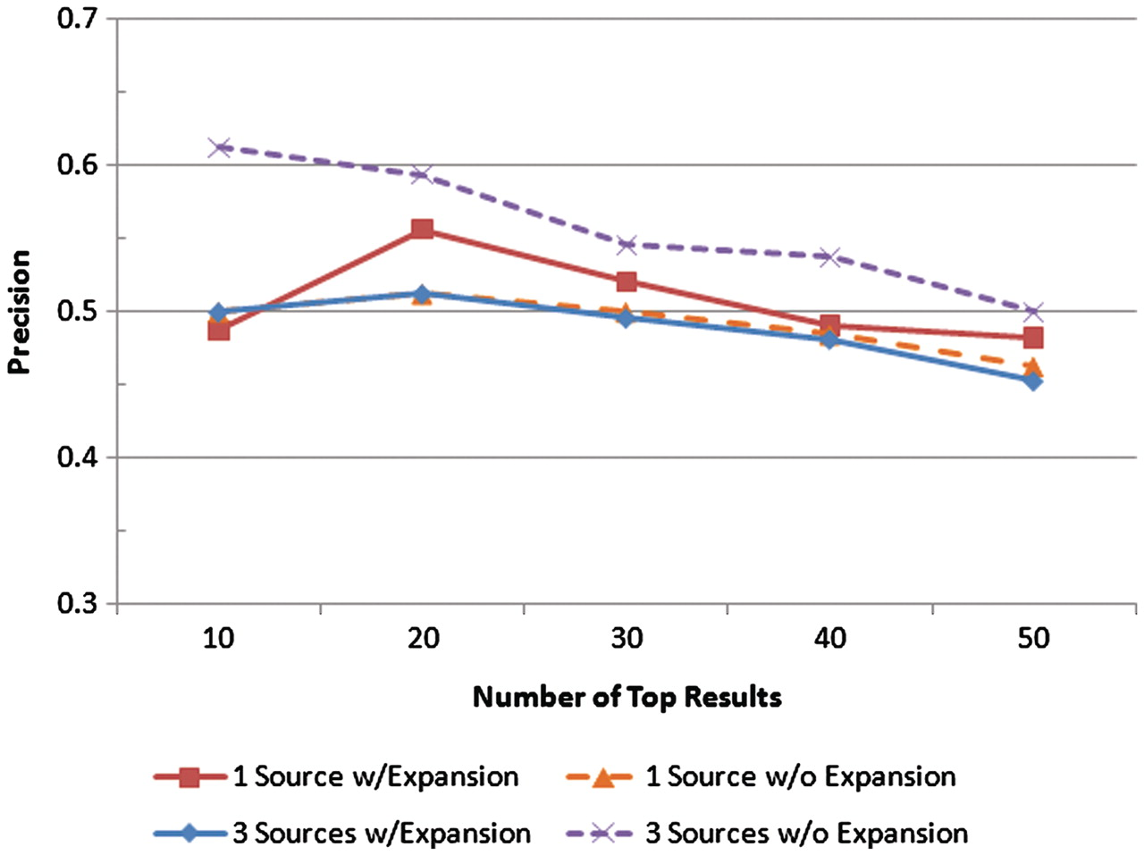
Figure 6. Precision was measured at the top 10, 20, 30, 40 and 50 results for four scenarios: one text source with ...
Notes:
Figure 6. Precision was measured at the top 10, 20, 30, 40 and 50 results for four scenarios: one text source with query expansion, one text source without query expansion, all three text sources with query expansion, and all three text sources without query expansion. The precision values at each of those levels for each scenario are shown.
Unless provided in the caption above, the following copyright applies to the content of this slide: © The Author(s) 2011. Published by Oxford University Press.This is Open Access article distributed under the terms of the Creative Commons Attribution Non-Commercial License (http://creativecommons.org/licenses/by-nc/2.5), which permits unrestricted non-commercial use, distribution, and reproduction in any medium, provided the original work is properly cited.

