Slide 1
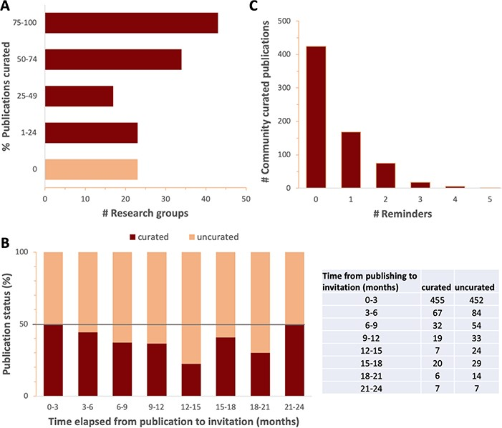
Figure 4 Response to curation invitations. A. Percent of publications curated per research group for all groups that ...
Notes:
Figure 4 Response to curation invitations. A. Percent of publications curated per research group for all groups that have received four or more curation invitations. Research groups with fewer than 4 relevant publications were omitted to focus on research groups dedicated to fission yeast. B. Percent (graph) and number (table) of curated and uncurated publications as a function of the time elapsed between PubMed indexing and the date that the first invitation to curate was sent, in 3-month intervals. The increase in response rate seen in later time intervals could either reflect the increased number of reminders received, or simply be an artefact of the smaller sample sizes. C. The number of community curated publications versus the number of reminders.
Unless provided in the caption above, the following copyright applies to the content of this slide: © The Author(s) 2020. Published by Oxford University Press.This is an Open Access article distributed under the terms of the Creative Commons Attribution License (http://creativecommons.org/licenses/by/4.0/), which permits unrestricted reuse, distribution, and reproduction in any medium, provided the original work is properly cited.

