Slide 1
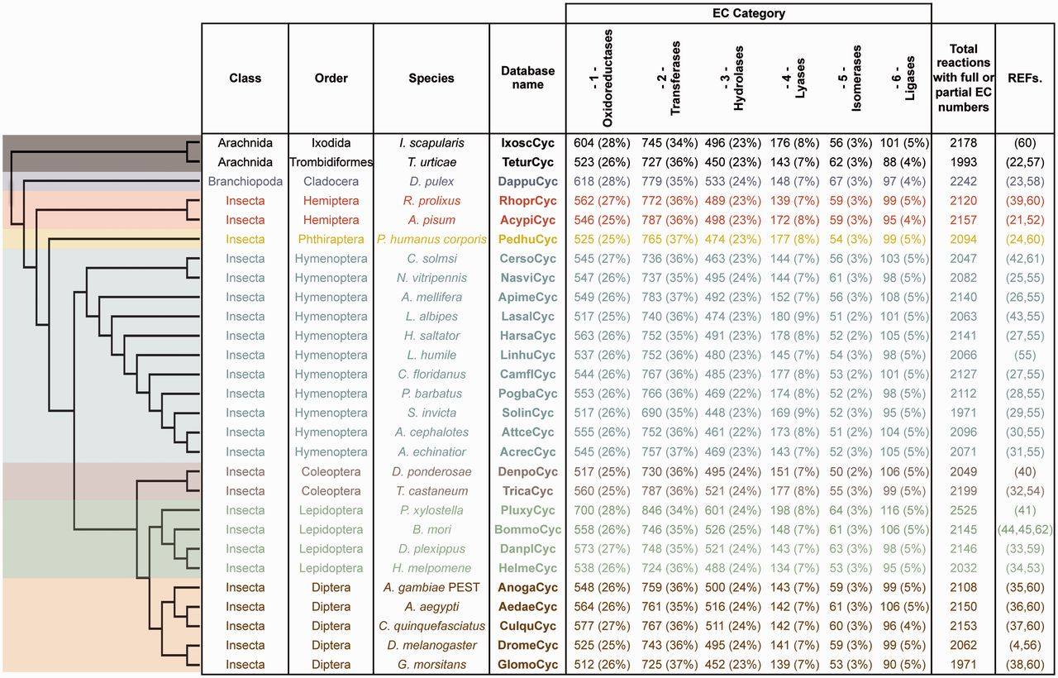
Figure 1. ArthropodaCyc databases list and summary. This table shows the distribution of reactions in the Cyc databases ...
Notes:
Figure 1. ArthropodaCyc databases list and summary. This table shows the distribution of reactions in the Cyc databases across the six top-level categories identified by the Enzyme Commission (E.C.). Included in this table are all reactions in each database which have been assigned either full or partial E.C. numbers, and for which an enzyme has been identified (these statistics do not include pathway holes). Phylogenetic relationships between species are displayed using a cladogram based on available data (46–50).
Unless provided in the caption above, the following copyright applies to the content of this slide: © The Author(s) 2016. Published by Oxford University Press.This is an Open Access article distributed under the terms of the Creative Commons Attribution License (http://creativecommons.org/licenses/by/4.0/), which permits unrestricted reuse, distribution, and reproduction in any medium, provided the original work is properly cited.

Slide 2
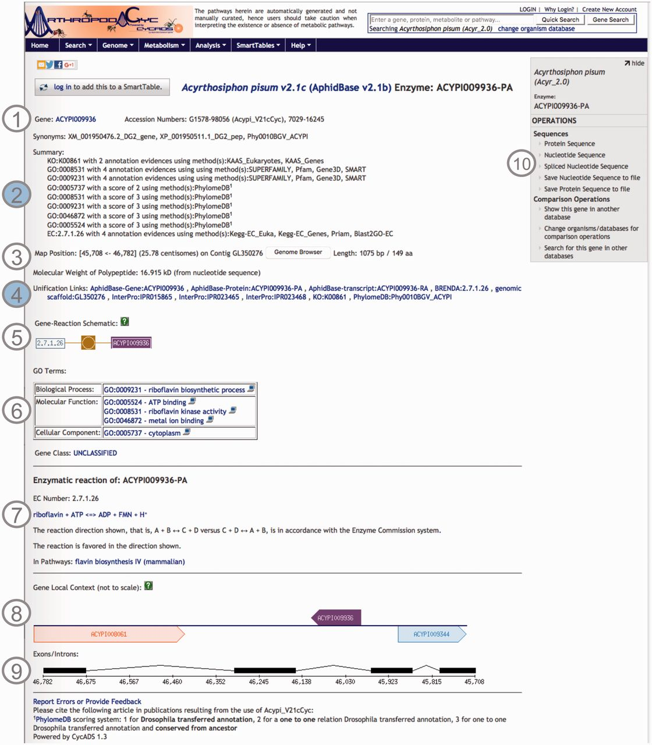
Figure 2. Screenshot of an ArthropodaCyc enzyme page. The page provides several information such as: (1) gene name, ...
Notes:
Figure 2. Screenshot of an ArthropodaCyc enzyme page. The page provides several information such as: (1) gene name, accession numbers and synonym names; (2) a summary of metabolism annotation evidences from KAAS-KEGG, PRIAM, InterProScan, PhylomeDB and BLAST2GO; (3) genome position with an additional link to the corresponding genome browser, and information on gene and protein length and polypeptide molecular weight; (4) external cross-links to specific genomic databases, enzyme annotation and InterProScan domains information and to phylogeny in PhylomeDB; (5) schematics representing the reaction(s) carried out by the enzyme; (6) Gene ontology terms associated with the enzyme functions; (7) additional information on the reaction(s) carried out by the enzyme, including the pathway(s) (if any) where this reaction may occur; (8) gene local context, including neighbouring genes; (9) gene structure in terms of (added) exons/introns organization and (10) an “Operations box” offering several options for comparative analyses. Filled circles, (2) and (4), represent ArthropodaCyc specific features.
Unless provided in the caption above, the following copyright applies to the content of this slide: © The Author(s) 2016. Published by Oxford University Press.This is an Open Access article distributed under the terms of the Creative Commons Attribution License (http://creativecommons.org/licenses/by/4.0/), which permits unrestricted reuse, distribution, and reproduction in any medium, provided the original work is properly cited.

Slide 3
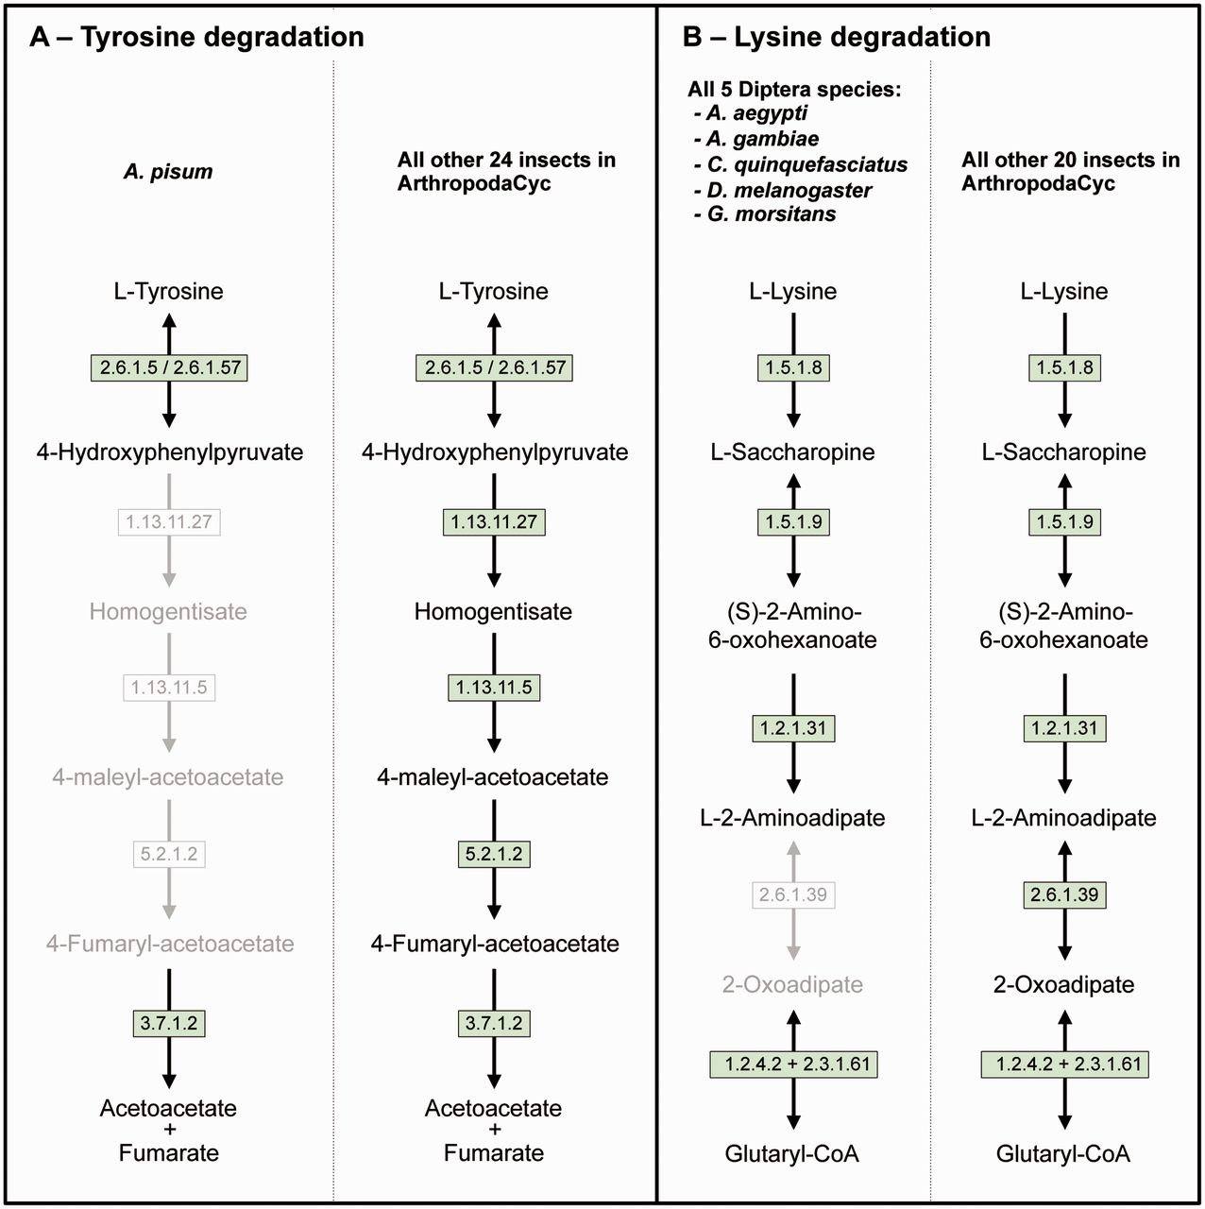
Figure 3. Two examples of insect pathway differences identified using ArthropodaCyc. (A) Pathway of tyrosine ...
Notes:
Figure 3. Two examples of insect pathway differences identified using ArthropodaCyc. (A) Pathway of tyrosine degradation, comparison between A. pisum and the other insects of ArthropodaCyc; (B) Pathway of lysine degradation, comparison between the five species of Diptera and the other insects of ArthropodaCyc. In each pathway, green coloured enzymes are present, while grey enzymes and reactions are absent. Enzymes: 1.13.11.5 = homogentisate 1,2-dioxygenase; 1.13.11.27 = 4-hydroxyphenylpyruvate dioxygenase; 1.2.1.31 = L-aminoadipate-semialdehyde dehydrogenase; 1.2.4.2 = oxoglutarate dehydrogenase (succinyl-transferring); 1.5.1.8 = saccharopine dehydrogenase (NADP+, L-lysine-forming); 1.5.1.9 = saccharopine dehydrogenase (NAD+, L-glutamate-forming); 2.3.1.61 = dihydrolipoyllysine-residue succinyltransferase; 2.6.1.5 = tyrosine transaminase; 2.6.1.39 = 2-aminoadipate transaminase; 2.6.1.57 = aromatic-amino-acid transaminase; 3.7.1.2 = fumarylacetoacetase; 5.2.1.2 = maleylacetoacetate isomerase.
Unless provided in the caption above, the following copyright applies to the content of this slide: © The Author(s) 2016. Published by Oxford University Press.This is an Open Access article distributed under the terms of the Creative Commons Attribution License (http://creativecommons.org/licenses/by/4.0/), which permits unrestricted reuse, distribution, and reproduction in any medium, provided the original work is properly cited.

