Slide 1
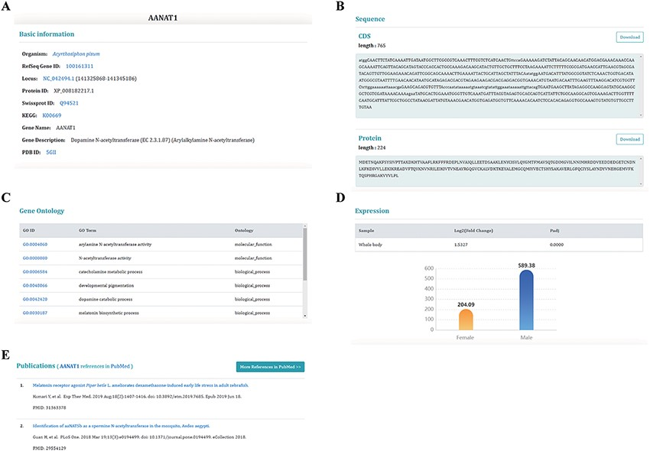
Figure 4. Information on sex-biased genes. (A) Basic genetic information. (B) CDS and protein sequences. (C) The Gene ...
Notes:
Figure 4. Information on sex-biased genes. (A) Basic genetic information. (B) CDS and protein sequences. (C) The Gene Ontology information of this gene. (D) The expression of sex-biased genes. (E) Publications relating to this gene.
Unless provided in the caption above, the following copyright applies to the content of this slide: © The Author(s) 2021. Published by Oxford University Press.This is an Open Access article distributed under the terms of the Creative Commons Attribution License (http://creativecommons.org/licenses/by/4.0/), which permits unrestricted reuse, distribution, and reproduction in any medium, provided the original work is properly cited.

