Slide 1
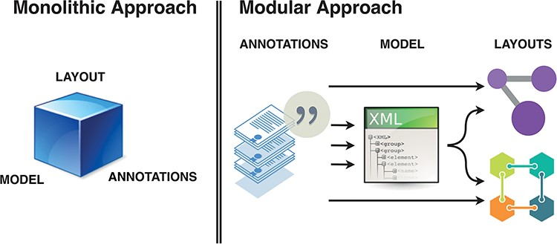
Figure 2. Monolithic vs modular approach to systems biology diagram building. Separation of roles and functions ...
Notes:
Figure 2. Monolithic vs modular approach to systems biology diagram building. Separation of roles and functions requires interoperability, but offers efficiency of dedicated tools. BioKC supports the first step and modelling interoperability—curation of annotated content compatible with SBML.
Unless provided in the caption above, the following copyright applies to the content of this slide: © The Author(s) 2024. Published by Oxford University Press.This is an Open Access article distributed under the terms of the Creative Commons Attribution License (https://creativecommons.org/licenses/by/4.0/), which permits unrestricted reuse, distribution, and reproduction in any medium, provided the original work is properly cited.

