Slide 1
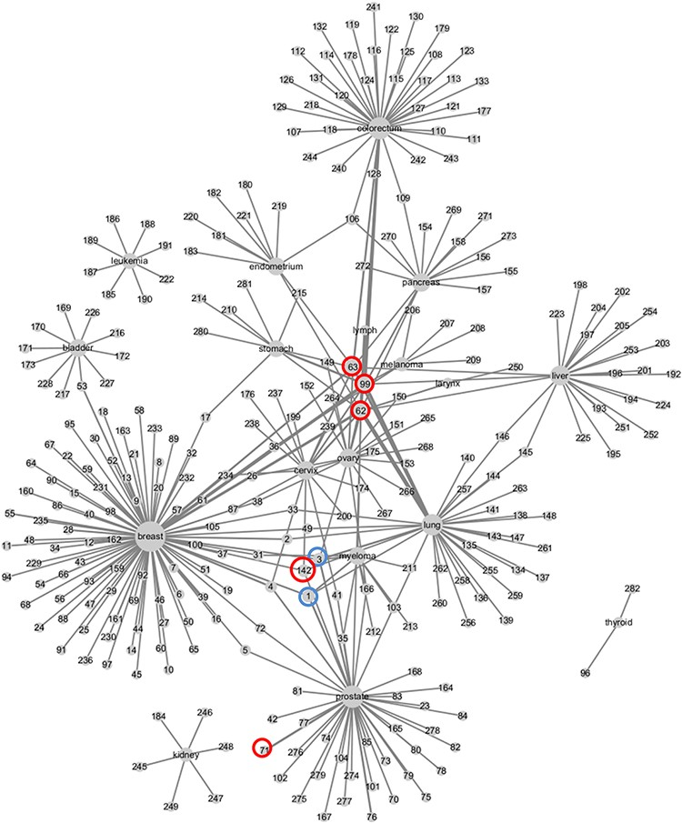
Figure 5. Weighed network of cancers and metabolic biomarkers. Nodes represent cancers and biomarkers, labeled by ...
Notes:
Figure 5. Weighed network of cancers and metabolic biomarkers. Nodes represent cancers and biomarkers, labeled by cancer site and biomarkers’ ID in CMBD. Cancer node and biomarker node are linked by an edge if they are reported in a literature. The size of cancer node represents the number of biomarker nodes linked to it, and the width of edge represents the frequencies that the cancer and the biomarker are reported in literatures.
Unless provided in the caption above, the following copyright applies to the content of this slide: © The Author(s) 2021. Published by Oxford University Press.This is an Open Access article distributed under the terms of the Creative Commons Attribution License (http://creativecommons.org/licenses/by/4.0/), which permits unrestricted reuse, distribution, and reproduction in any medium, provided the original work is properly cited.

